Slide 1
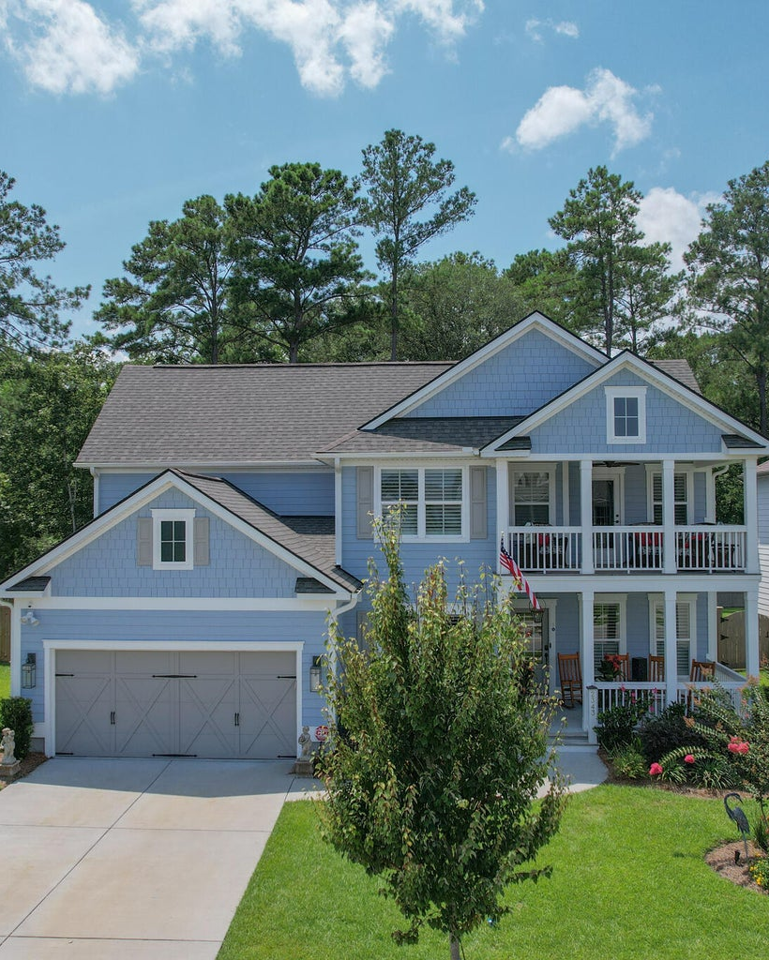

2343 Brinkley Road Oakfield | Johns Island, SC 29455 MLS# 23016353 | $865,000
Wild Dunes Swim & Social
Membership w/ Acceptable Offer
Lovely Lowcountry Style Home in Oakfield A MUST SEE!
4 Bedrooms
3½ Baths
Lovely Custom Features
Kitchen With Fabulous Large Island
Owner’s Suite On First Floor
Loft/Media Room
Porch Balcony
Great Amenities
Short Drive To Downtown & Beaches

