Slide 1
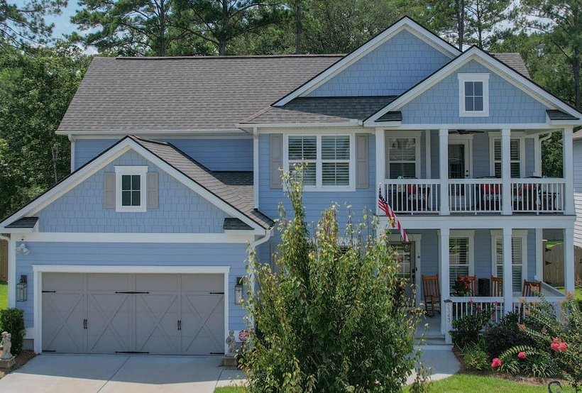

2343 Brinkley Road Oakfield | Johns Island, SC 29455 | MLS# 23016353 | $845,000
Wild Dunes Swim & Social
Membership w/ Acceptable Offer
Beautiful Home on Johns Island
REDUCED $20,000
Lovely Home located on Johns Island, SC in the neighborhood "Oakfield", was built by Pulte Homes using the "Vanderbuilt" open floor Plan which is highly sought after, plus the Owners added approx. $170,000 in upgrades at time of construction. This home has an incredible curb appeal, as well as charming features once you walk inside. Hardwoods throughout, top of the line appliances, including two (2) refrigerated Drawers in Butler's Pantry, an in-home Office, great Study, plus two porches for enjoying the great outdoors. Owner's also had a Generac 22 KWH Whole House Generator installed at time of construction, plus, many, many other extras which you would have to see to appreciate. Oakfield has community amenities such as pool, club house, walking trails and multiple playgrounds.
Sellers of this special property are motivated and just reduced their asking price another $20,000. Easy to Show, please call Showing Time for appt. or Contact Linda Laird, 843-209-7571.

