Slide 1
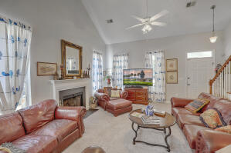
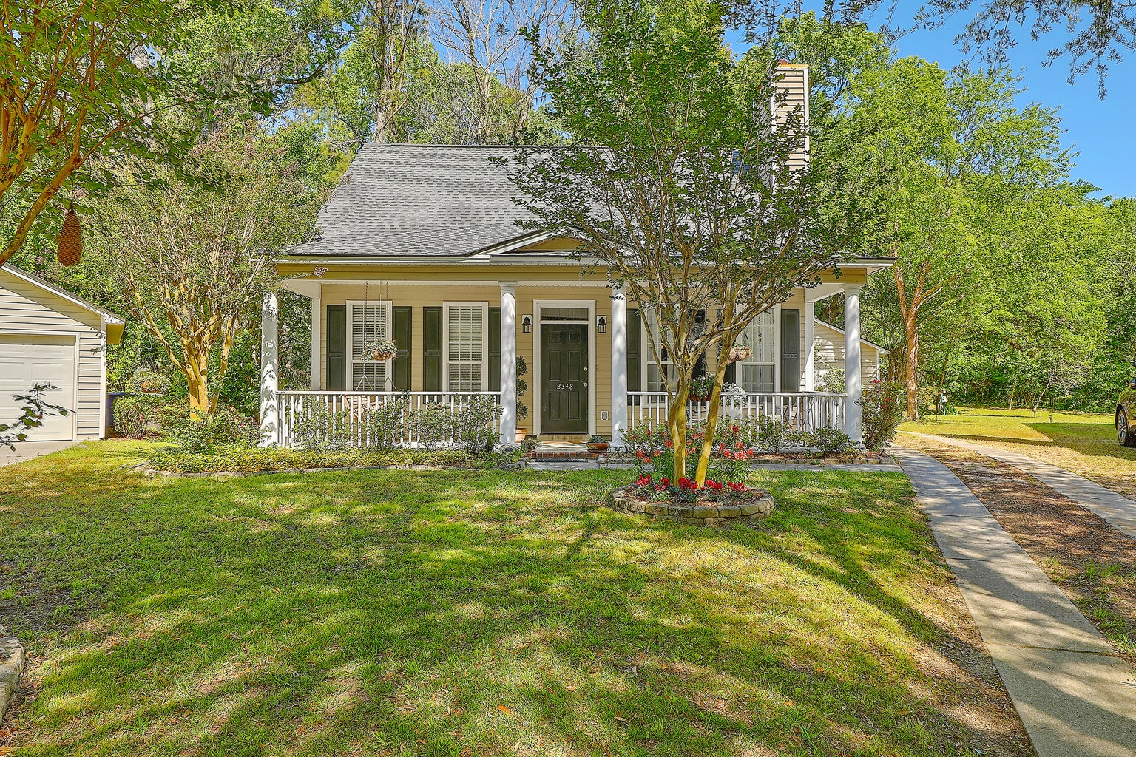
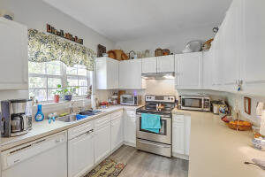
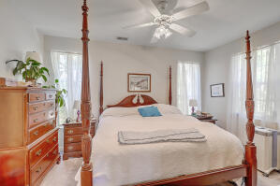
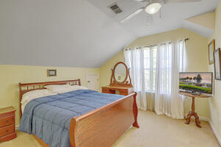
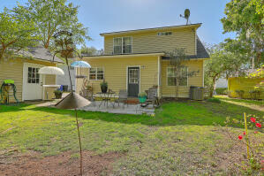
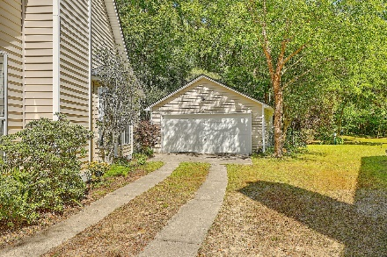


2348 Kennison Lane Chadbury Village | Mount Pleasant, SC 29466 MLS# 23008193 | $565,000
Adorable Home with Scenic Lot in Mt Pleasant
Welcome to this adorable home that has been well maintained and is move in ready. Roof replaced in 2020, HVAC is a Lennox 16 seer and is still fairly young. Termite bond is in place. Downstairs is roomy and consist of the living area, dining room, kitchen, laundry, powder room and the master bedroom which has a full bathroom and walk in closet. There is new plush carpet downstairs and fresh paint on the walls. The ceilings have been scraped and painted. In the living room there is a wood burning fire place for those cold nights. Upstairs you will find two nice sized bedrooms with a Jack and Jill bathroom. Outside in the front you will enjoy the front porch that is big enough for a swing or rocking chairs where you can enjoy the side view of the pond, beautiful trees and landscaping. In the back yard you can enjoy a little piece of serenity on your open patio. If you like wildlife keep your eyes open because you will encounter the animals and birds passing through to take a drink from the nearby stream. There is a lot of shade to keep you cool during the summer. You will also see that this home offers a detached two car garage. This is a prime location, great schools, close to the beach, and in walking distance to stores and dining. Schedule a showing today to really appreciate what this home has to offer in person.
Video Tour: https://vimeo.com/817022918
Kelly Rozier
(843) 209-3129
kellywrozier@gmail.com
Brand Name Real Estate
4 Carriage Lane Suite 106
Charleston, SC 29407

