Slide 1
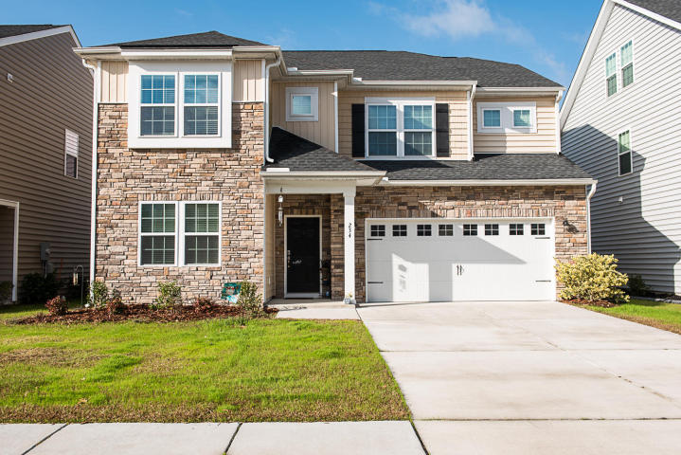
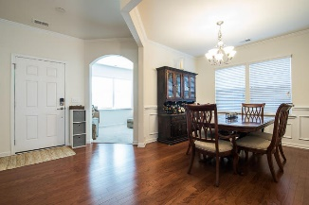
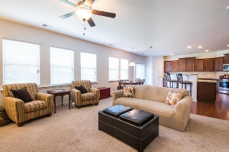
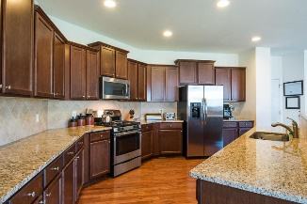
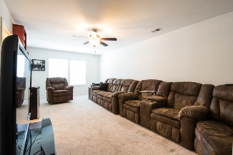
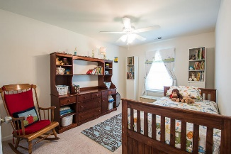
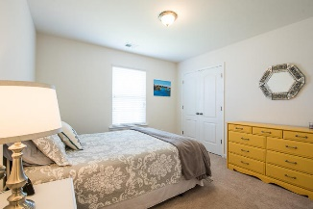
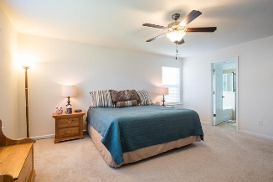
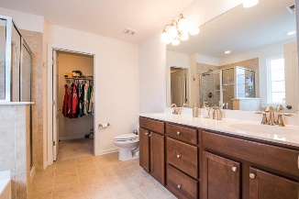
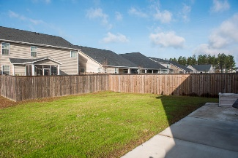
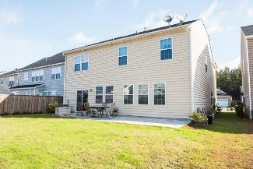


234 Overcup Loop
Cane Bay Plantation ~ Summerville ~ MLS# 16031555 ~ $280,000
Lots Of Room To Roam!
Looking for a beautiful, spacious, practically new home that can accommodate your every need, look no more! Cane Bay features great schools, amenities, shopping, medical, and is located a very short drive from the new Volvo plant to open soon. This 3 year old home features an attractive stone front entry, wood floors, and a humongous kitchen with cabinets and counter top space to die for! There are 5 bedrooms and 3.5 bath, a formal dining area, office, and huge family room which is open to the kitchen area.
Gregg Fesler
GRI, CRS, REALTOR
Office (843) 856-3983 | Mobile (843) 797-0000
gregg@greggfesler.com
Carolina One Real Estate | 628 Long Point Rd. | Mt Pleasant, SC 29464-3032

