Slide 1
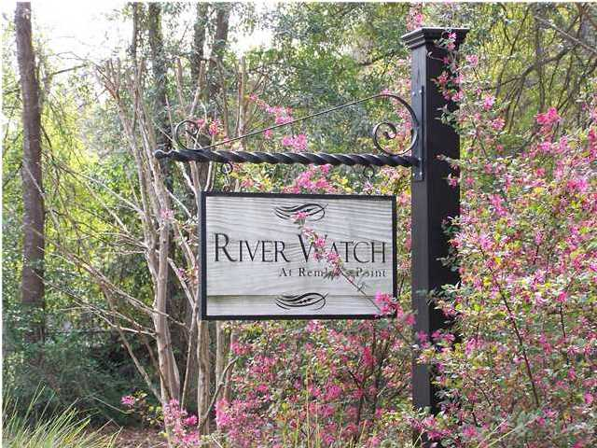
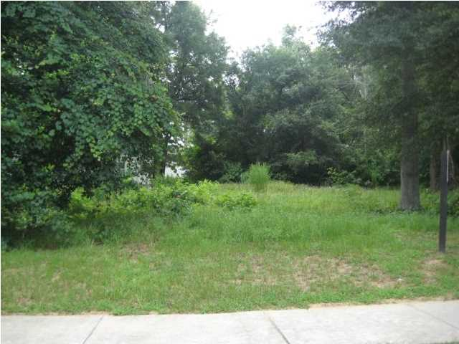
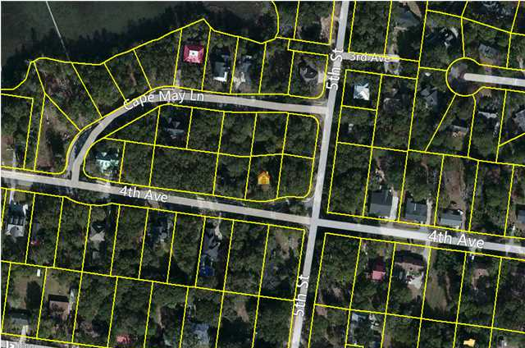
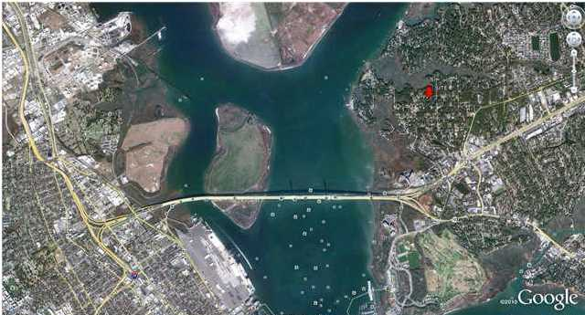

234 4th Ave
River Watch
Mt Pleasant
MLS# 1416853
$255,000
0.26 Acres
Great building lot in very sought after River Watch.
River Watch has just 29 homesites with high quality homes on large wooded lots.
Great location 1.5 miles to the Ravenel bridge,
5 minutes to downtown Charleston and 10 minutes to the beaches.
River Watch also has a community dock on Molasses Creek.
This home is not in a flood zone.
Great Lot in River Watch!!
Kendra Boozer
843.834.5089
kendrafboozer@gmail.com

