Slide 1
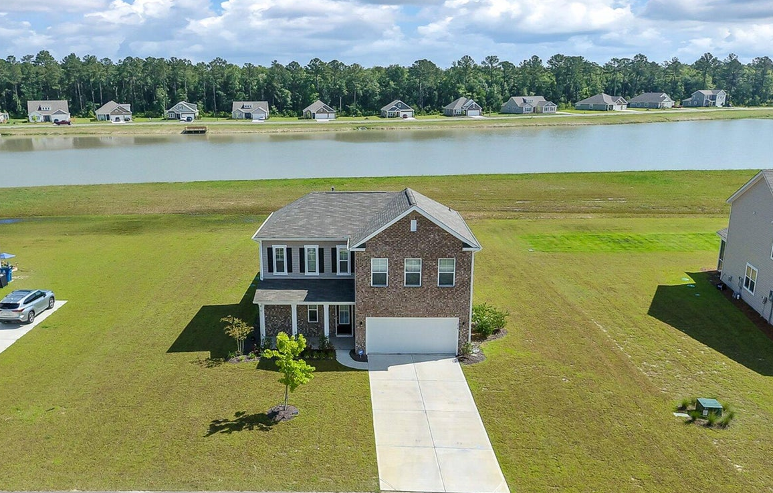
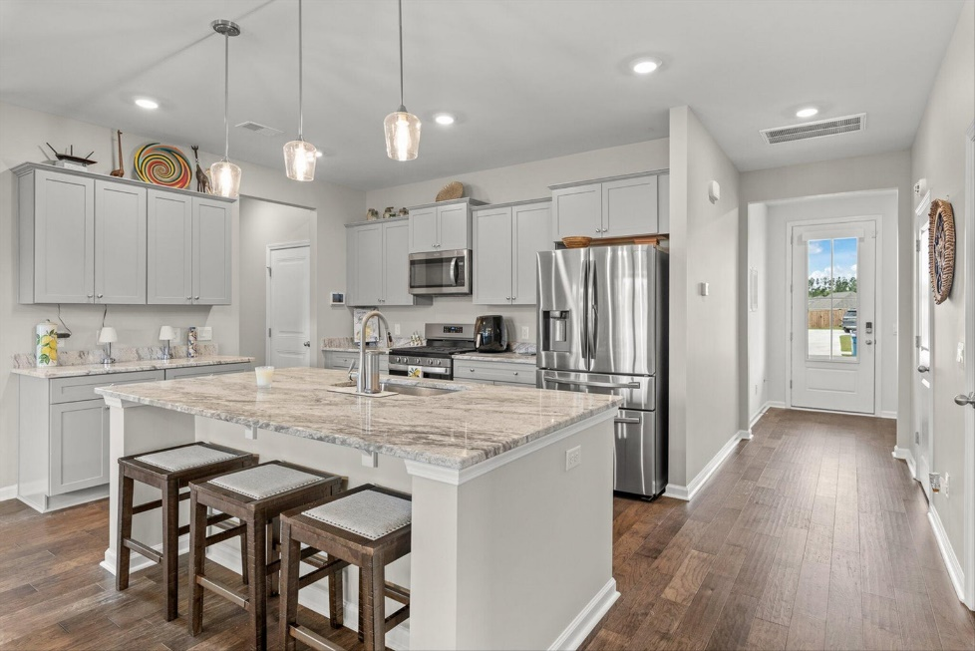








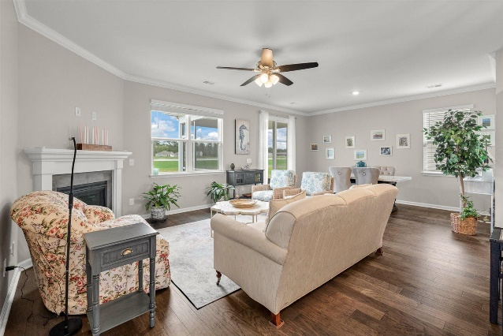
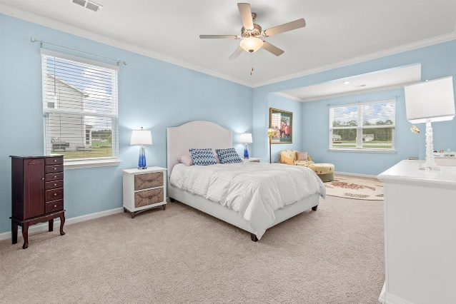
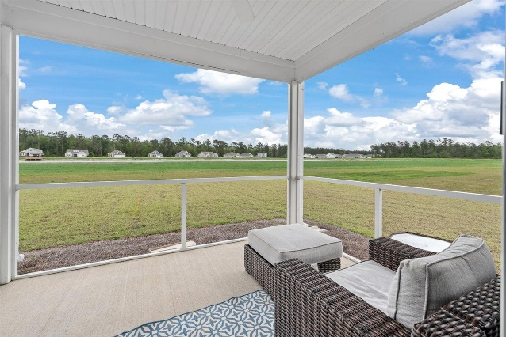
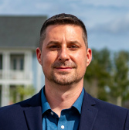
#23021215
234 Silver Creek Drive
French Quarter Creek
Huger, SC 29450
$5,000 Agent Bonus
if we can close this sale be December 31st, 2023
Open House
Sat 10-12 & Sun 10-12
4 BED
3½ BATH
2,516 SF
$600,000
LAKEFRONT HOME 10 minutes from Mt Pleasant. Features 4 bedrooms/3.5 baths. Built with premium upgrades including a welcoming Charleston style gas lantern, hardwood floors, a sitting area in the first floor master bedroom and a spa like master bath with separate soaking tub and shower plus built-in closet organization system. The kitchen has spacious cabinets and stainless steel appliances, granite counters, pendant lighting and a large kitchen island. Downstairs laundry room includes storage cabinets with a drop zone/mudroom area. Upstairs offers 3 large bedrooms, 2 full bathrooms plus an additional family room/flex space/game room. Tons of storage throughout the house and garage. Huger is the best kept secret in Charleston!
Huger is a well kept secret with beautiful new home communities only minutes from all things that make up Charleston. 10 Minutes to Publix CF Rd, 10 Min to Lowes Foods, 13 min to Highway 17, 20 min to IOP, 18 min to Daniel Island, 25 min to Airport & 30 min to Charleston. Walking distance to the French Quarter Creek pool and amenity center. If square footage is important, please measure. Buyer must verify schools if important.
Paula Watts
843-819-1582
paula@paulawatts.com
www.paulawatts.com
Brand Name Real Estate
4 Carriage Ln
Charleston 29407
Matt Kimes
843-860-1669 | mattkimeshomes@gmail.com
www.mattkimeshomes.com

