Slide 1
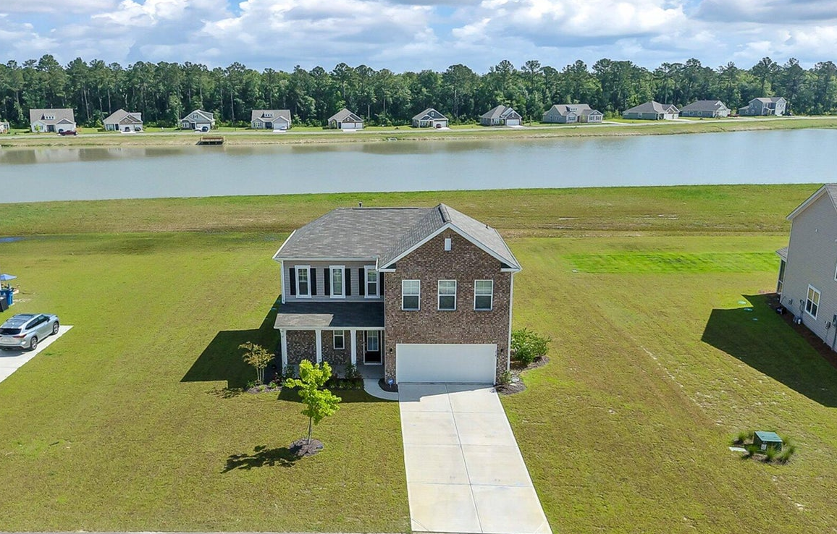
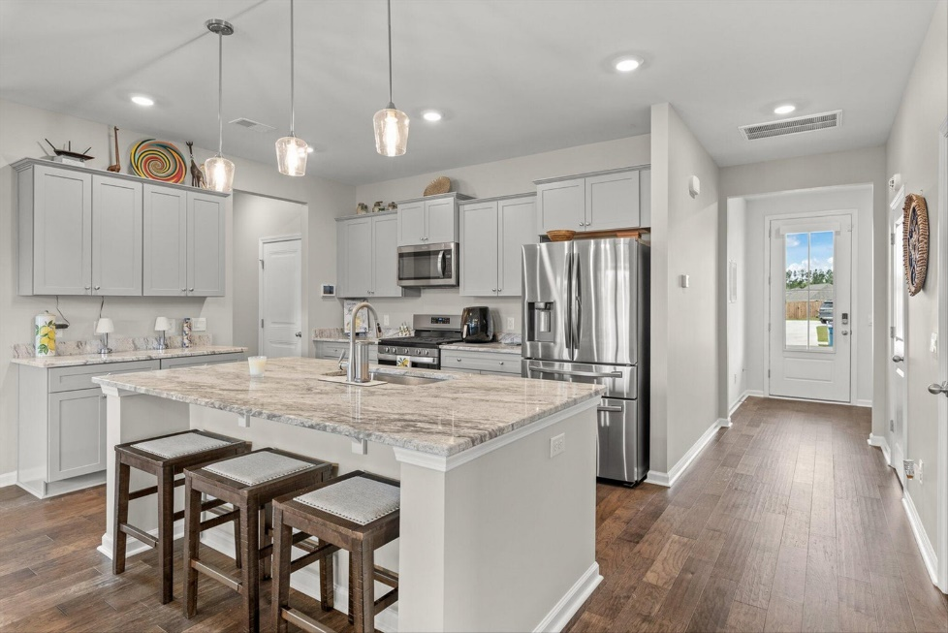








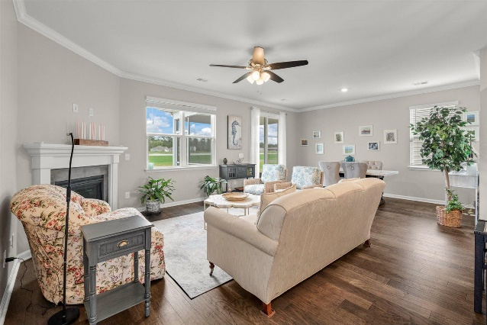
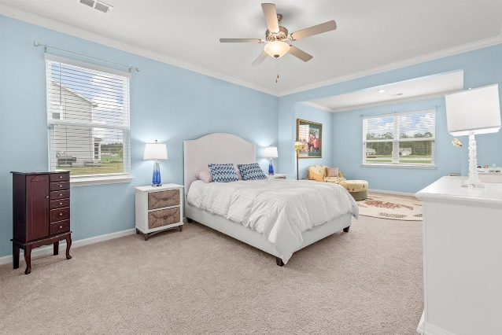
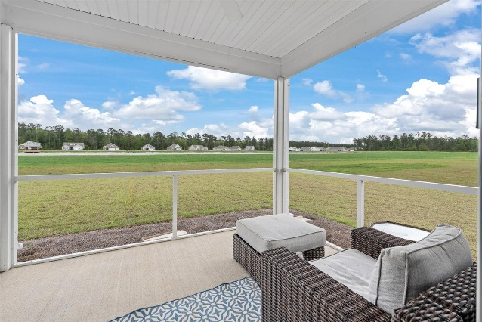
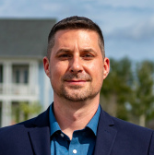
#23008247
234 Silver Creek Drive
French Quarter Creek
Huger, SC 29450
Agent Open House Aug 9th 11-1
Starbucks gift card giveaway for first 10 agents!
Open House
Sat 10-12 & Sun 10-12
4 BED
3½ BATH
2,516 SF
$510,000
LAKEFRONT HOME close to Mt Pleasant, Charleston, Clements Ferry Rd, Daniel Island and local beaches. Features 4 bedrooms/3.5 baths. Built with premium upgrades including a welcoming Charleston style gas lantern, hardwood floors, a sitting area in the first floor master bedroom and a spa like master bath with separate soaking tub and shower plus built-in closet organization system. The kitchen has spacious cabinets and stainless steel appliances, granite counters, pendant lighting and a large kitchen island. Downstairs laundry room includes storage cabinets with a drop zone/mudroom area. Upstairs offers 3 large bedrooms, 2 full bathrooms plus an additional family room/flex space/game room. Tons of storage throughout the house and garage. Huger is the best kept secret in Charleston!
Huger is a well kept secret with beautiful new home communities only minutes from all things that make up Charleston. Walking distance to the French Quarter Creek pool and amenity center which is currently under construction. If square footage is important, please measure. Buyer must verify schools if important.
Paula Watts
843-819-1582
paula@paulawatts.com
www.paulawatts.com
Brand Name Real Estate
4 Carriage Ln
Charleston 29407
Matt Kimes
843-860-1669 | mattkimeshomes@gmail.com
www.mattkimeshomes.com

