Slide 1
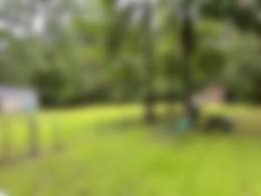
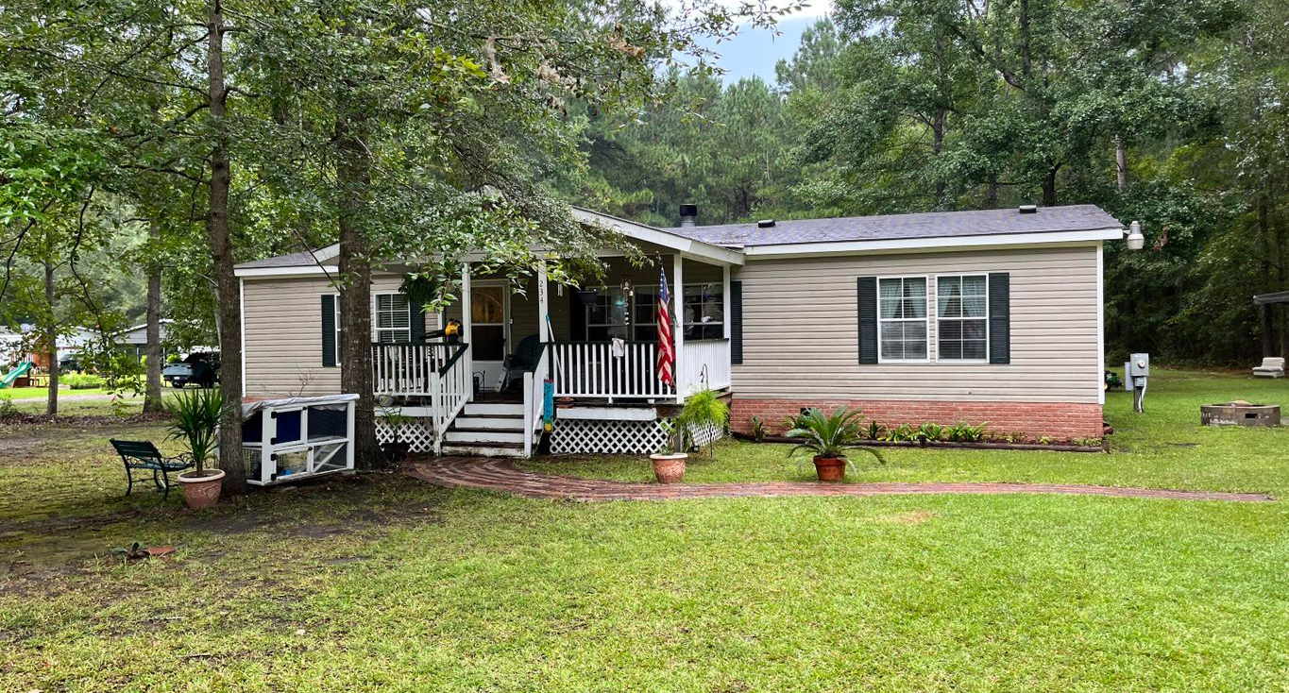
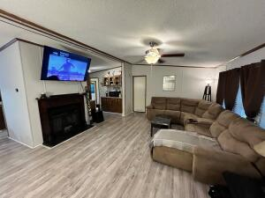
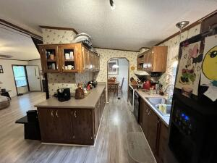
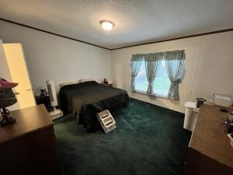
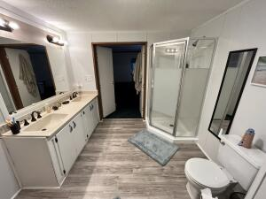
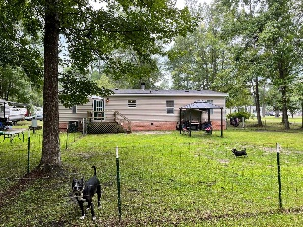


Priced to SELL!
234 Whippoorwill Drive
Whippoorwill | Summerville, SC 29483 | MLS# 22022920 | $225,000
Well maintained, move-in ready mobile home on a beautiful .82 acre lot. Dorchester 2 schools! As you walk in from the front porch you'll notice the brand new laminate plank flooring in the living room, kitchen, and dining room. The living room features a wood burning fireplace as well as vaulted ceilings. The flow from the living room to the kitchen to the dining room is great, perfect for family meals and entertaining. Off of the kitchen is the laundry room and door to the back yard. To the right of the living room is the primary bedroom with walk-in closet, and bath. Separate from the other two bedrooms for privacy. The primary bath is huge, with double sinks, a soaking tub and separate shower. To the left of the living room is a short hallway that leads to the other two bedrooms, both with walk-in closets, and the second bath. Off the back door is a fenced in area. There is no HOA in this neighborhood so there's plenty of room for all your toys.
Gary Raymond (843) 729-3688 | gary.raymond@agentownedrealty.com
AgentOwned Preferred Group | 1400-G Palm Blvd. | Isle Of Palms, SC 29451

