Slide 1
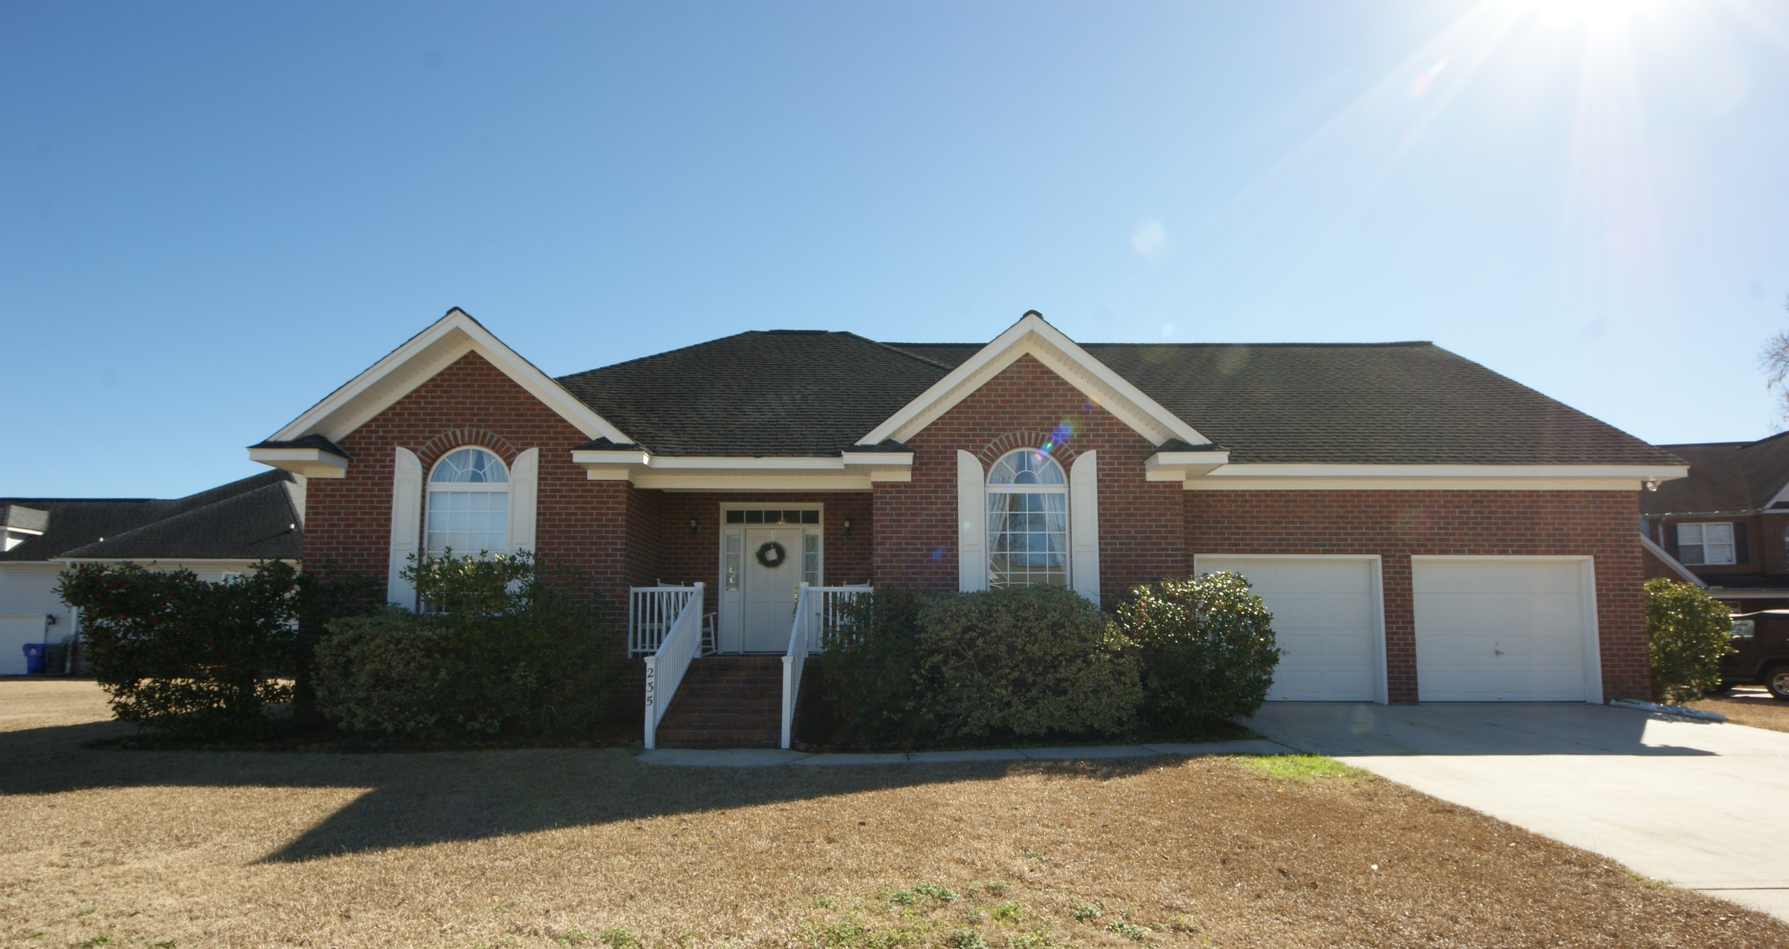
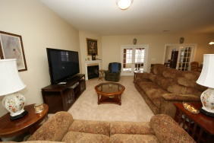
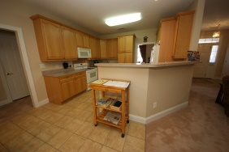
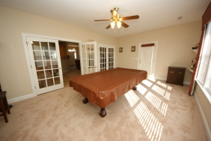
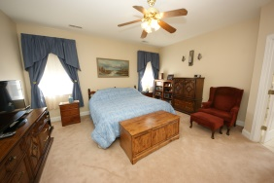
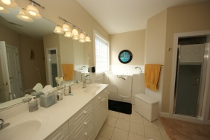
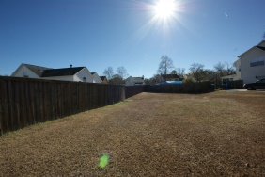


~ Seller's Leaving Area ~
Will Consider All Reasonable Offers
Price Reduced!
235 Harlech Way
Shadowmoss ~ Charleston, SC 29414
MLS# 15001310 ~ $299,900
You are going to absolutely love this custom built Brick home with freshly painted interior & exterior. The pride of ownership shows with every attention-to-detail throughout. This one owner home features an open floor plan for relaxing & entertaining your friends. The beautiful Great room/fireplace is adjacent to the double French doors leading to the spacious bright sun room. You will enjoy the eat-in kitchen with built-ins, ample cabinets & counter space right at your fingertips. It also boasts of a full size freezer next to the refrigerator for easy cooking. Entertaining will be a joy with the oversized formal dining room, large palladium window with gorgeous custom drapes. The amazing master bedroom suite is separate from the other 3 bedrooms. You will be delighted with the large master bath featuring double raised vanity, walk-in bath, walk-in shower with bench, raised toilet & huge walk-in-closet. Two additional bedrooms are located on the opposite side of the home for privacy. One of the bedrooms has access to the hall bath without having to enter the hall. It also features a large palladium window with stunning custom drapes. The third room is a nice size and could be a bedroom or home office. The finished room over the two car garage is awesome with plenty of room for an upstairs family room, playroom, or 4th bedroom with half bath. The two car garage is spotless. The owners had wider doorways installed at construction and later installed a walk-in bath that is also wheelchair accessible. Brand New beige carpet, 17 windows, Kenmore quiet top of the line dishwasher, Delta kitchen faucet & disposal all installed in 2014. 80gal water heater and booster & attic fan in 2013, Kenmore quiet garage door openers in 2015, HVAC replaced in 2009. Smoke free & nicely landscaped lot in cul-de-sac just waiting for you.
Sandra Siegling CRS GRI
843-343-1119
sandy.siegling@gmail.com
ERA Wilder Realty, 125-F Wappoo Creek Dr, Charleston, SC 29412

