Slide 1
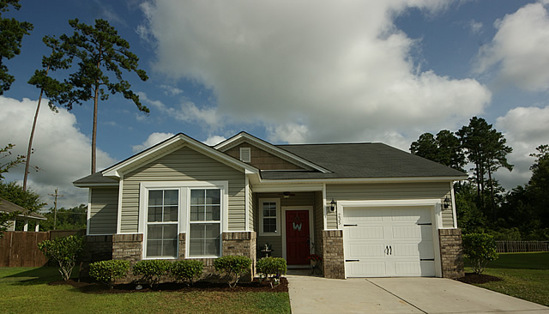
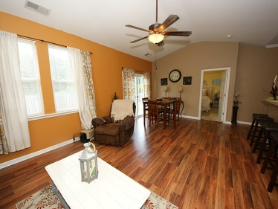
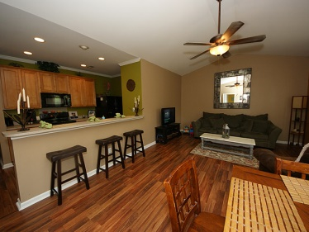
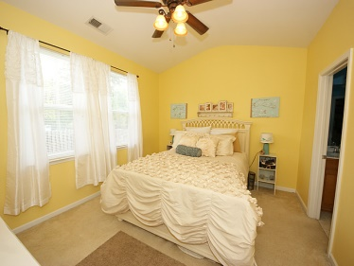
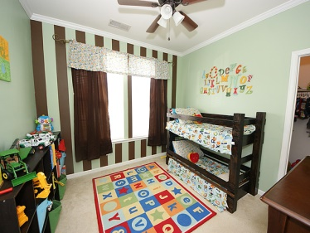
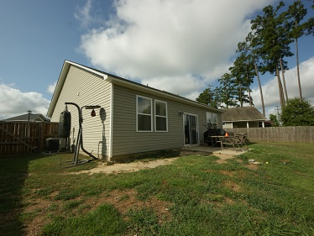


235 Meadow Wood Rd Felder Creek· Summerville· MLS# 1417673
Open House · Saturday, August 2nd · 12-2pm
$1,000 Agent Bonus*!!
BEST & LOWEST PRICED Home in all of Felder Creek!! Located in the Summerville area of Berkeley county, so you get to take advantage of the lower property taxes compared to Summerville in Dorchester County yet go to the all new schools of Cane Bay!! This one-owner RANCH style home is in IMMACULATE shape. The sellers are the ORIGINAL OWNERS who have taken great pride in this home & you will not find another 1 story home at this price in this great of shape in this area. They've even added a privacy fence on the sides & rear of the home. Great for dogs or kids to keep safe!! Most homes of this size & price point are bare with no upgrades and usually low popcorn ceilings. Not this home…It has it all and then some!! From the moment you step up to the front doorstep, you're welcomed by a covered stoop with a side area great for a bistro table & chairs. Upon opening the front door, you are greeted with a beautiful double arched foyer over new laminate wood floors which welcome you to the home! In addition to the foyer, the laminate floors are in the, halls, kitchen, laundry, pantry, dining & family room!!).Other design features & upgrades include: Gorgeous 42" maple kitchen cabinets with adjustable shelves, upgraded black appliances (built-in microwave, smooth top range & dishwasher), cathedral style vaulted ceilings in both the family & owners' suite (all other ceilings are 9' in height) & so much more to see!! This split floor plan offers the master bedroom on the back of the home for maximum privacy & quiet time. The master bathroom has a raised large vanity & garden tub/shower combo for relaxing. For low morning disturbance, the closet is conveniently accessed from the bathroom which maximizes wall space. The two guest bedrooms share a full bath that also has a raised vanity & is generous in size. One of the guest bedrooms even offers a walk-in closet. This home is on a great lot that's wider on the back side which gives a nice big back yard, a rarity in a newer development like this one! The large back yard has a nice grilling patio & is fully sodded. Very tastefully decorated with neutral paint colors that appease even the most picky buyers. Have a lease that's not expiring for a few months? No worries, the sellers may be interested in renting back...it's a win-win situation so you won't miss out!! You really have to see this home in person! But don't wait too long to schedule your showing because, AT THIS PRICE, IN THIS LOCATION, AND THIS BEAUTIFUL & CLEAN, IT WON'T BE ON THE MARKET LONG!!
*$1,000 selling agent bonus paid at closing for a satisfactory contract signed this weekend (Aug 2nd-3rd)
Pheobe Lail-Chambers
843-906-5463
pheobelail@gmail.com
www.infinity-realty.com
infinity realty
PO Box 676
Mt Pleasant, SC 29465

