Slide 1
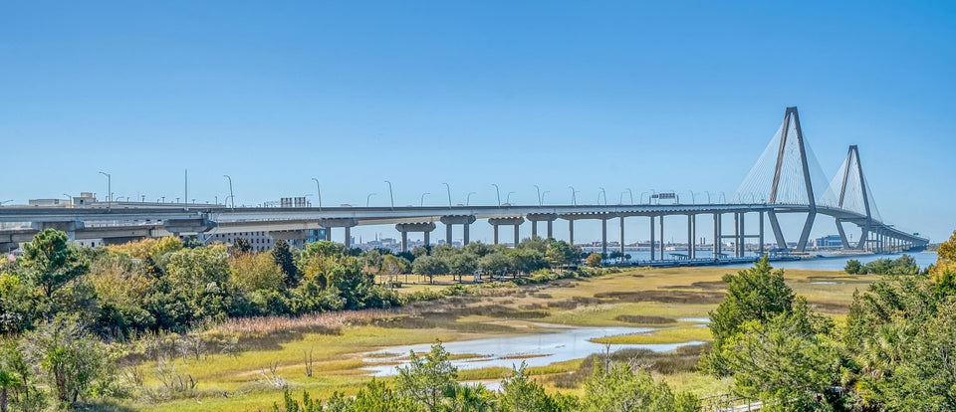
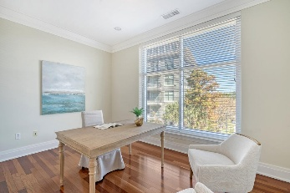
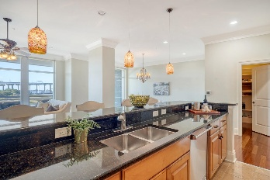
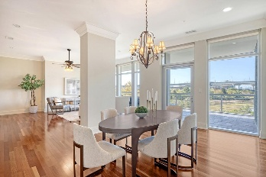
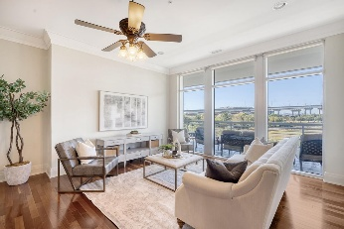
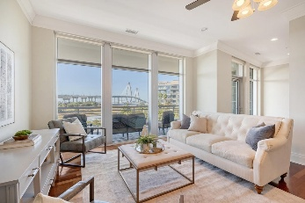
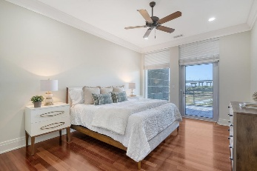
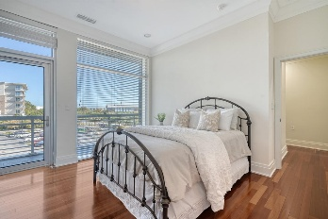
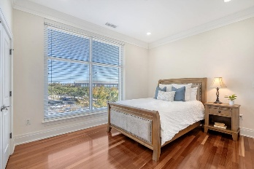
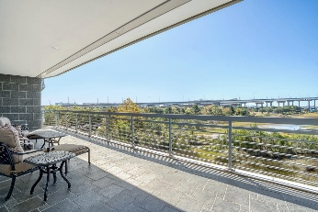
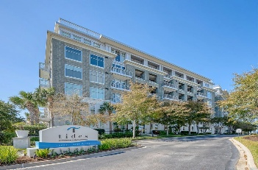



EXPANSIVE HARBOR VIEWS!
235 Cooper River Drive
Tides Condominiums
Mount Pleasant, SC 29464
MLS# 24027727 | $2,600,000
Panoramic views of the Charleston Harbor! Discover the epitome of coastal elegance in this stunning condominium, ideally located at the foot of the iconic Ravenel Bridge. With breathtaking, expansive views of the harbor and just minutes from the vibrant heart of downtown Charleston, this property offers a perfect blend of luxury and convenience. Boasting four spacious bedrooms, each with its own dedicated full bath, this home features an open floorplan that invites natural light through an abundance of windows. Gleaming hardwood floors lead you through the stylish living spaces, seamlessly connecting the living room, dining area, and gourmet kitchen. The chef's dream kitchen is equipped with exquisite granite countertops, top-of-the-line stainless steel appliances, a vented range hood and an oversized island, making it perfect for entertaining. A generous walk-in pantry provides ample storage for all your culinary needs.
Retreat to the master suite, where panoramic harbor views set a serene atmosphere. The expansive walk-in closet and luxurious ensuite bathroom complete with a soaking tub and a spacious walk-in shower, offer a private sanctuary for relaxation.
The community offers a resort lifestyle with amenities including a sparkling pool, a state-of-the-art exercise area, and a stylish clubhouse, perfect for social gatherings or quiet evenings.
VIDEO TOUR
Leesa Northrup
Office: 843.884.1622
Mobile: 843.442.0987
Fax: 843.746.4994
lnorthrup@carolinaone.com
Carolina One Real Estate 628 Long Point Road Mount Pleasant SC 29464

