Slide 1
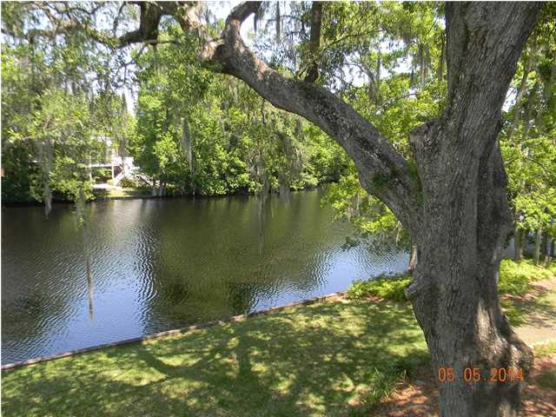
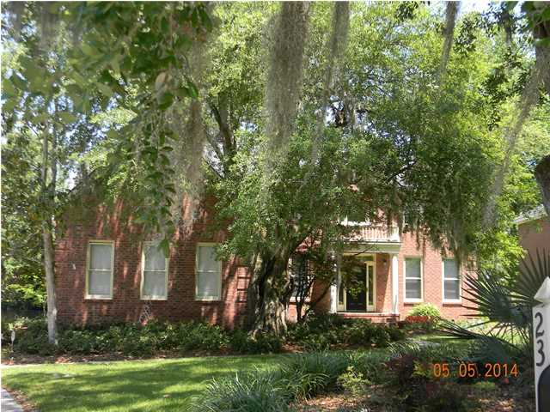
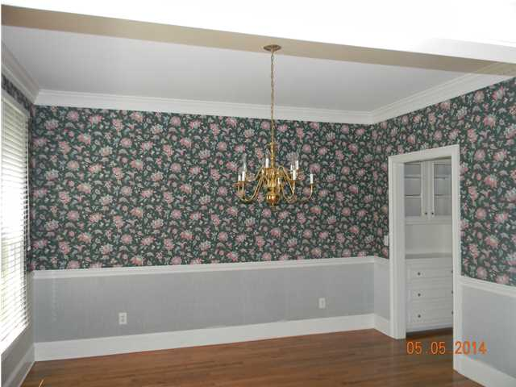
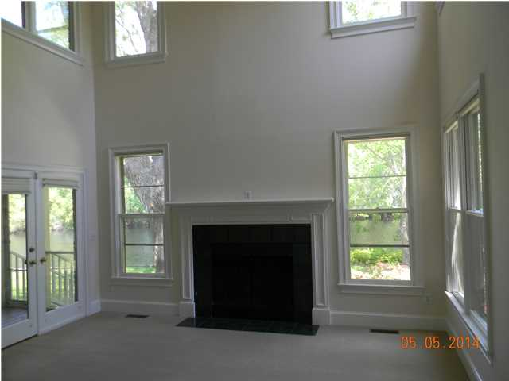
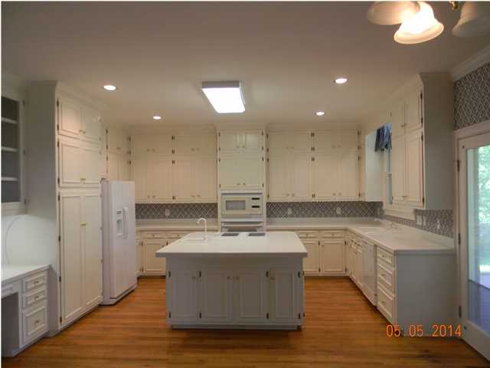
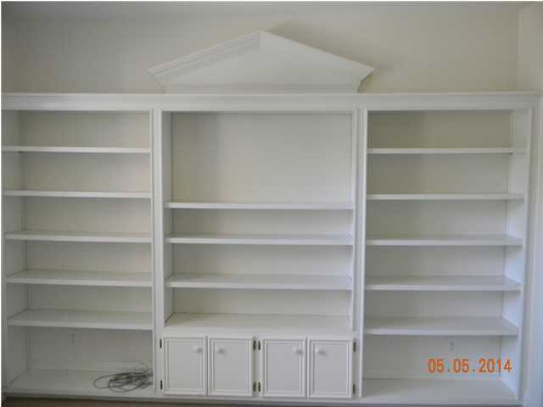
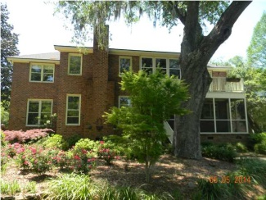

Stunning Location
2362 Stevenson Dr
McLaura Hall, Charleston, SC
MLS# 1412183
$449,860
5 Bedrooms | 4 Baths | 3,385 sf
Lovely traditional home on stunningly beautiful lot with grand oaks overlooking lake with a marsh view. This one owner home has so much to offer. Formal living room and dining room with a butler's pantry. Spacious kitchen with huge island that has breakfast bar. Lots and lots of cabinets, pantry cabinets have built in spice racks that fold in for added space. Built in desk in kitchen. Beautiful hardwood floors on first floor. Big family room with fireplace with gas logs (requires propane tank)also family room has high open ceiling. Screen porch off of kitchen overlooking beautiful lake. There is a bedroom downstairs that could be a master bedroom - built in shelves and a full bathroom off of this bedroom. There are stairs from the foyer and from the kitchen. The master bedroom upstairs is huge with a private sunroom. The master bathroom is also huge with a separate shower and a whirlpool tub, dual sinks each with their own vanity. Built in cabinets galore and another room that has closets and could be a nursery, an office, or an incredible dressing room. Another bedroom upstairs has its own bathroom and the other two bedrooms have a Jack and Jill bathroom. All of the upstairs bedrooms have walk in closets. Irrigation system, termite bond, flood insurance
Kitty LaTorre, ABR
cblatorre@hotmail.com 843-830-1900 {M}
ERA Wilder Realty, 125 Wappoo Creek, Suite F, Charleston, SC 29412

