Slide 1
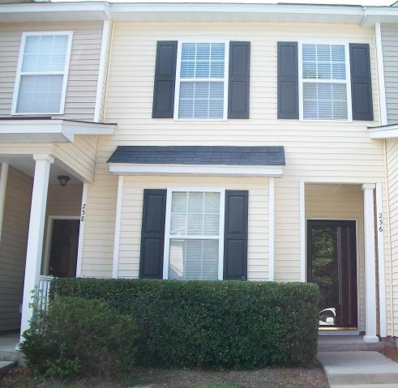
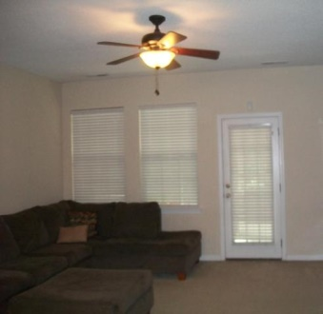
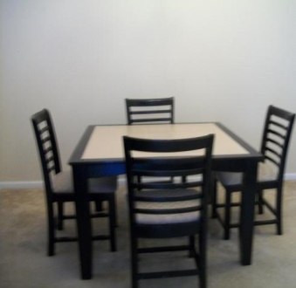
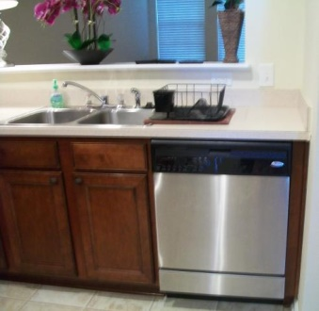
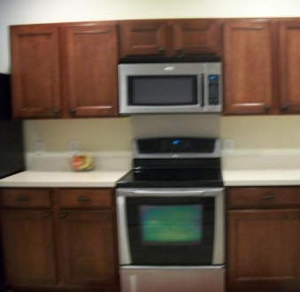
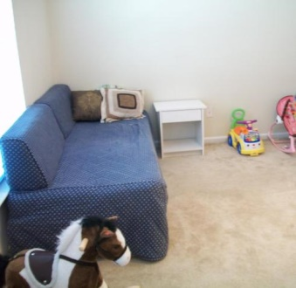
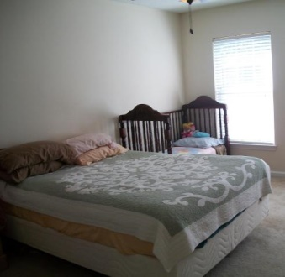
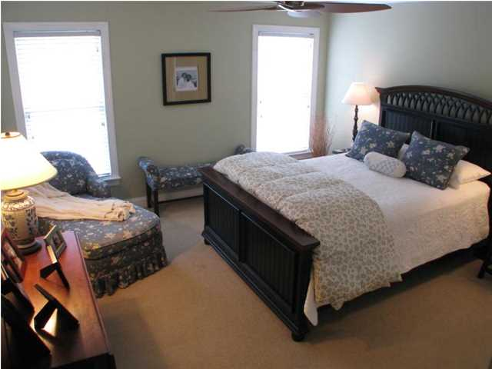
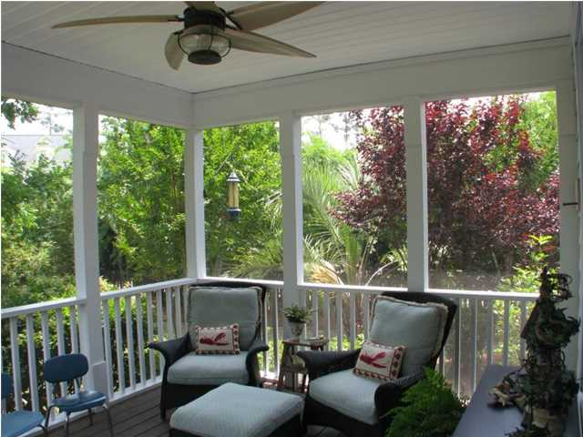
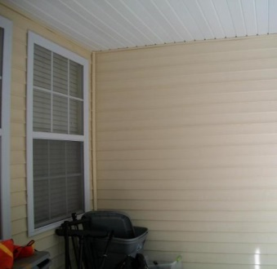
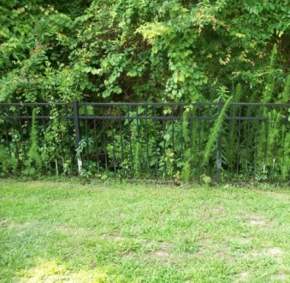


236 Brookshire Road
Liberty Hall Plantation
Goose Creek, SC 29445
MLS# 15015663
$120,000
2 Bedrooms | 2½ Baths | 1,368 sf
Great location!!! Move in ready townhome located at Wedgewood in Liberty Hall Plantation. Your townhome features 2 bedrooms, 2.5 bathrooms, living room, kitchen, dining room, laundry room, screened in back porch and backs up to protected wooded wetlands. Living room has a ceiling fan and has an open pass-through into the kitchen. Spacious kitchen has cherry wood cabinets, tons of counter space, Stainless Steel appliances (including refrigerator), pantry and recessing lighting. Dining room is open to the kitchen. The master bedroom has a ceiling fan and 2 walk-in closets. Master bathroom has a sink with extended counter top and garden tub/shower. The secondary bedroom has a ceiling fan and a full bathroom. Laundry room is upstairs. The screened in back porch overlooking the protected wooded wetlands behind your home. Close to schools, Naval Weapon Station, Boeing, shopping, Wal-Mart, Lowe's, and dining. Liberty Hall is a family community with great features for your enjoyment, such as a swimming pool with open air pavilion, play park, volleyball court and sidewalks.
Move in ready townhome
Debbie Toombs
843-345-7895
debbie.toombs@cbunited.com
www.cbunited.com

