Slide 1
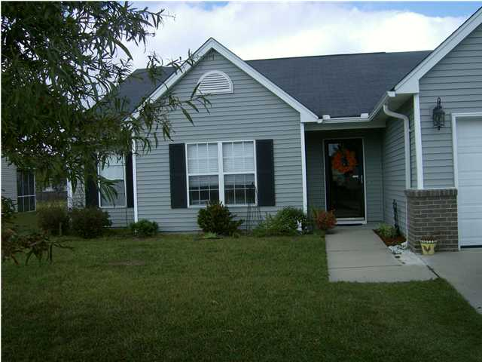
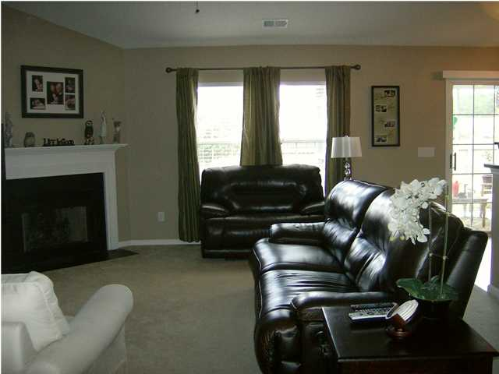
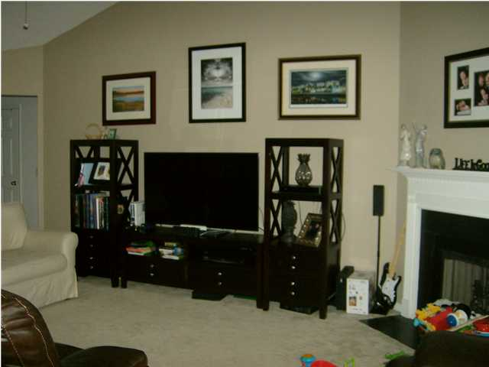
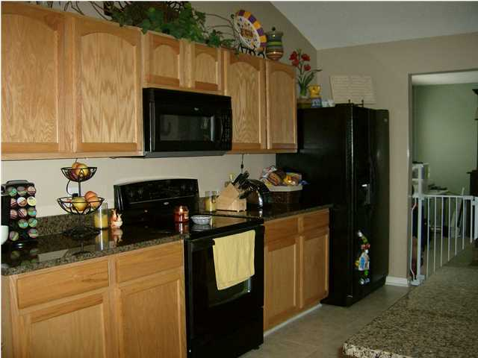
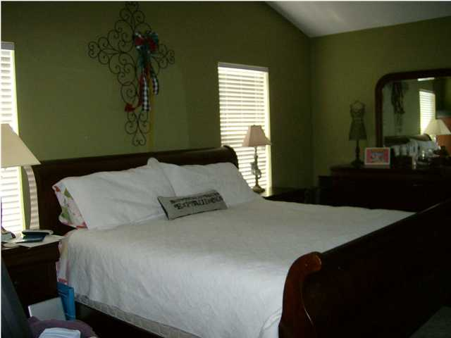
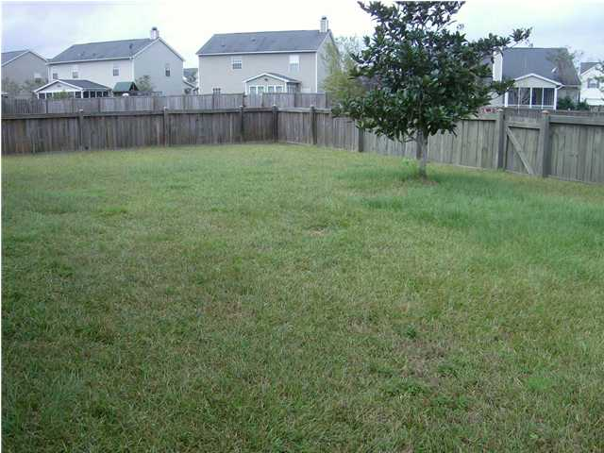
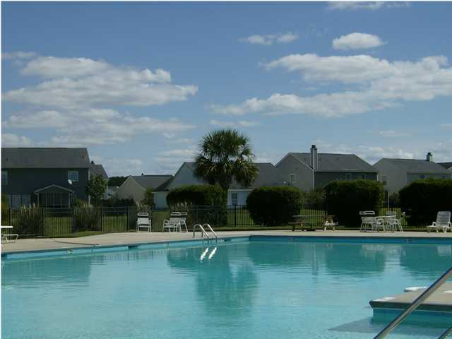


236 Dovetail Cir
Weatherstone Summerville
MLS# 1223033
Available November 1, 2012
Renting at $1,250/Mo
Close to Everything
Pretty 3 bedroom 2 bath home is on a pond lot.
Open Floorplan w/ Formal Dining Room
Cathedral Ceilings in Great Room & Master
Fireplace
Kitchen has Granite Countertops
Master Suite + 2 Additional Large Bedrooms
Screened Porch & Fenced Yard
View of Pond with Fountain
Short walk to Community Playground & Pool
Close to I-26 & Downtown Summerville
Convenient Place to Live
Small dogs allowed, No cats
Liz & Bob Simonds
843-437-9696
lizandbob@agentowned.com
AGENTOWNED REALTY CO. PREMIER GROUP, INC.
141-A N. MAIN STREET
SUMMERVILLE, SC 29483

