Slide 1
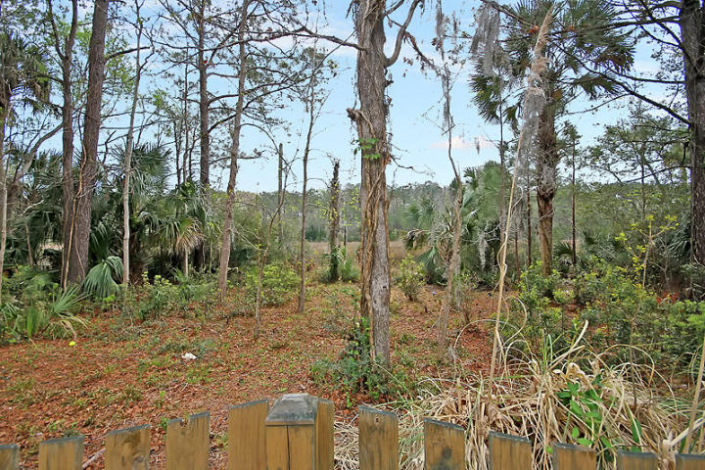
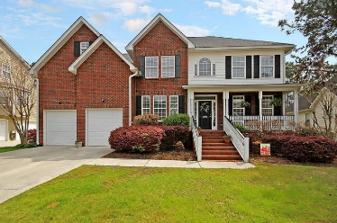
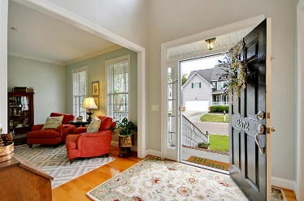
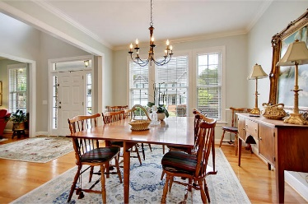
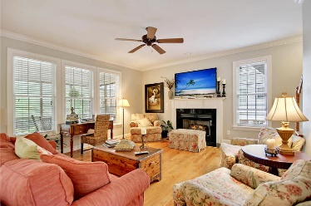
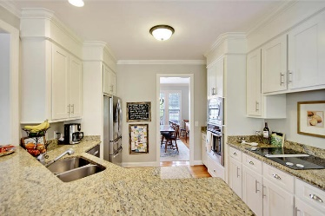
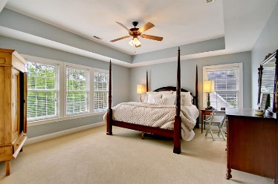
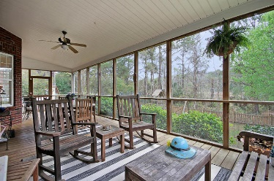
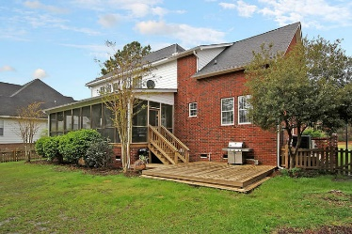

2372 Bergeron Way
Planters Pointe · Mt Pleasant · MLS# 18006907 · $525,000
Gorgeous Listing
Marsh Front Home Reduced $25,000
STUNNING MARSH FRONT home, sturdy brick exterior with updated gourmet kitchen, new cabinet doors and granite counter tops. Come see this spacious 5 bedroom 3 bath home with first floor mother in law/guest bedroom with adjoining full bath. This home has a study/office on the first floor as well as large dining room. The kitchen opens to family room with fireplace, both with gorgeous marsh views. The kitchen also features breakfast area with built in seating, and stainless steel appliances. The owners have made many refreshing updates including light fixtures and door hardware to a home that already was well appointed with lots of hardwoods, tile, crown moldings and trim. All 5 Bedrooms are generous sized with great closet space. The master bedroom over looks the marsh and features trey ceiling and leads to a spa-like master bathroom that serves as a calming, roomy retreat with dual sinks, soaking tub and separate shower. There is a slab with access under the screened porch for storage. Neighborhood amenities include pool (with chillers to ensure its refreshing all summer), tennis courts, basket ball court, new fire-pit & grill stations ,beautiful clubhouse miles of trails with work-out stations along them. Walk to the grocery store Starbucks, bars/restaurants, pizzeria or the Wando River.
Stan Huff
843-670-2835
stan.huff@agentowned.com
Jill Marcacci
843-297-5590
jill@agentowned.com
www.agentownedrealty.com
AgentOwned Realty Co. Preferred Group, Inc. | 824 Johnnie Dodds Blvd | Mt Pleasant, SC 29464

