Slide 1
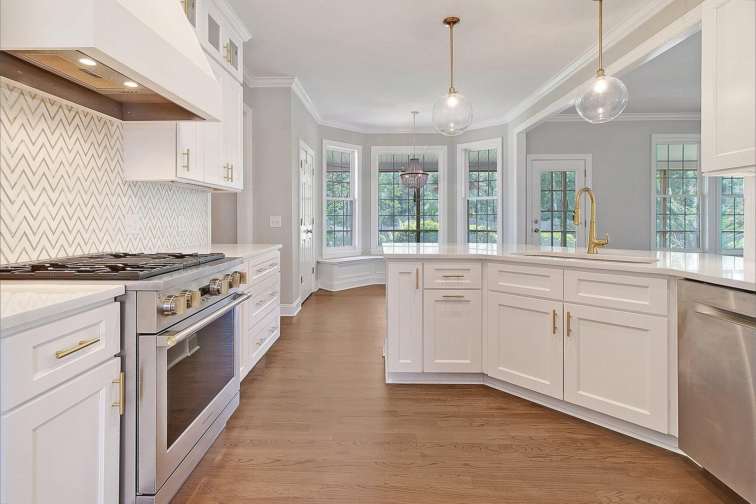
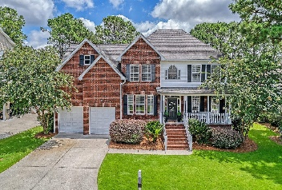
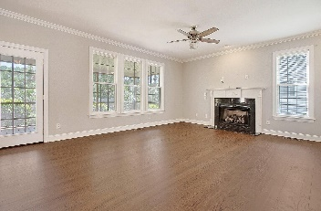
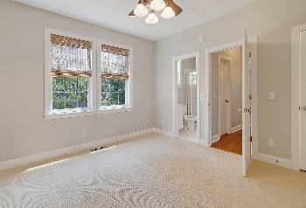
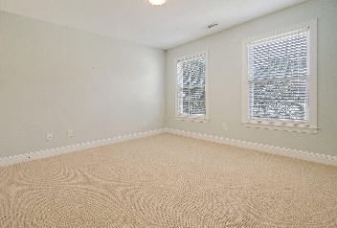
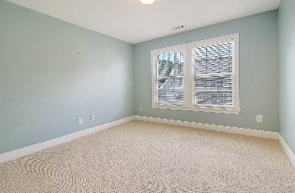
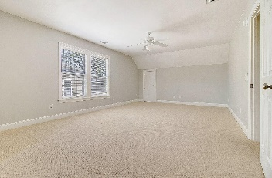
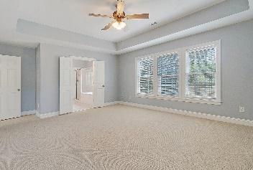
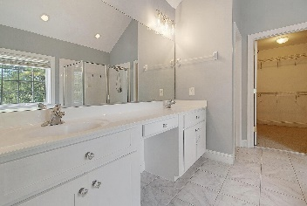

2372 Bergeron Way Planters Pointe · Mount Pleasant, SC 29466 MLS# 23018627 · $875,000
New Low Price
STUNNING MARSH FRONT home with huge screened-in porch, sturdy brick exterior, NEW gourmet kitchen, new cabinets, appliance and counter tops. Come see this spacious 5 bedroom 3 bath home with first floor mother in law/guest bedroom with adjoining full bath.
This home has a study/office on the first floor as well as large dining room. The kitchen opens to family room with fireplace, both with gorgeous marsh views. The kitchen also features a gorgeous commercial style gas stove, breakfast area with built in seating, and stainless steel appliances.
The owners have made many refreshing updates including light fixtures and door hardware to a home that already was well appointed with lots of hardwoods, tile, crown moldings, and trim. All 5 bedrooms are generous sized with great closet space.
Stan Huff
843-670-2835 stan.huff@agentowned.com
Jill Marcacci
843-297-5590 jill@agentowned.com
www.agentownedrealty.com
AgentOwned Realty Co. Preferred Group, Inc. | 824 Johnnie Dodds Blvd | Mt Pleasant, SC 29464

