Slide 1
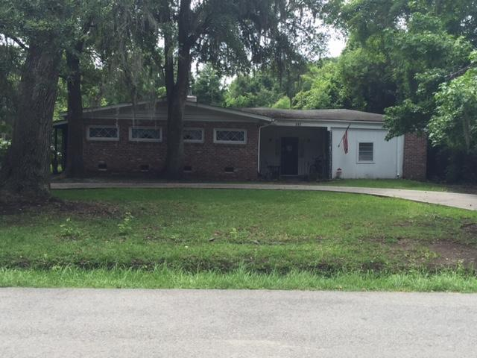
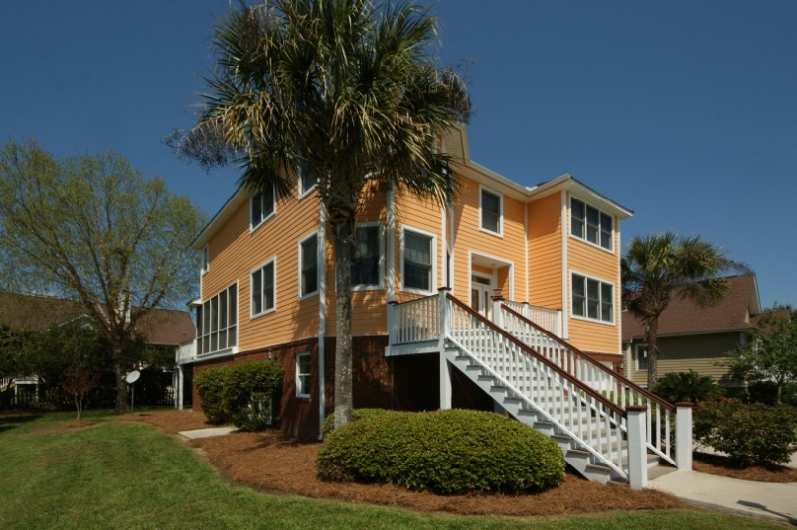
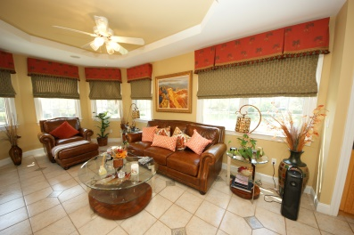
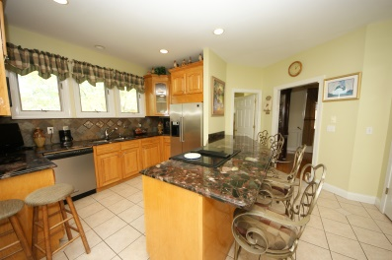
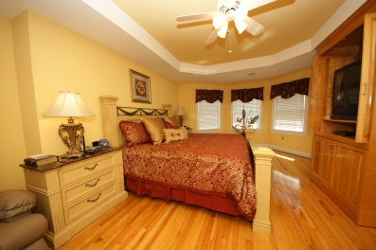
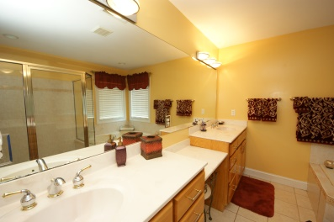
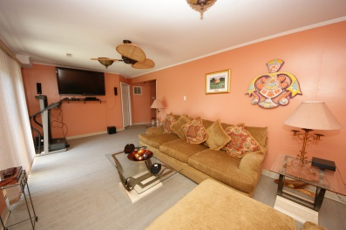
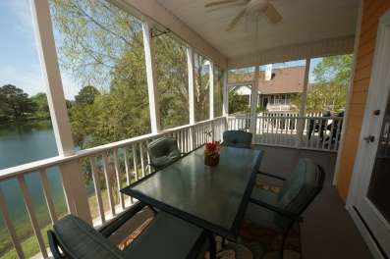

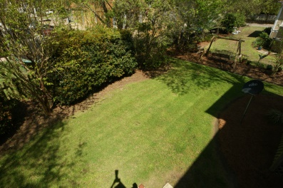
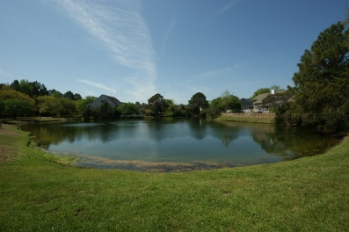
Just Reduced!
This property is zoned OG-General Office district. It is currently used as a residential care facility. This 1996 square foot property has five bedrooms and one and half bathrooms. It sits on a third of an acre and has a large yard. The possibilities for this property are endless.
This is a great place to open a business in this very convenient location. It can be easily converted to a residence.
237 Fleming Road
Pecan Grove
Charleston, SC 29412
MLS# 15017004
$289,999
Terry Seabrook
Mobile 843 607-2490
Office 843 577-2676
seabrookspace@aol.com

