Slide 1
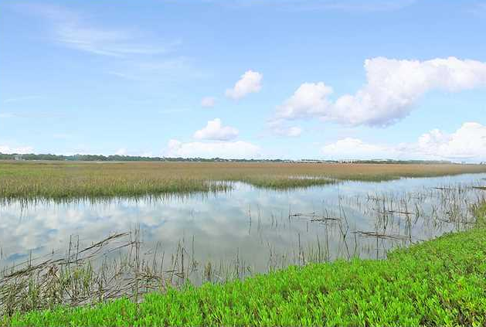
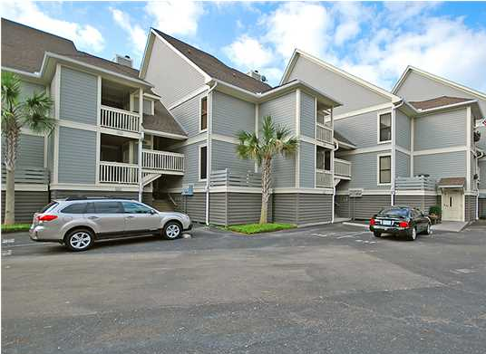
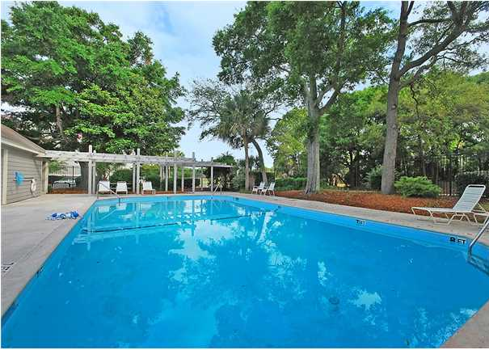
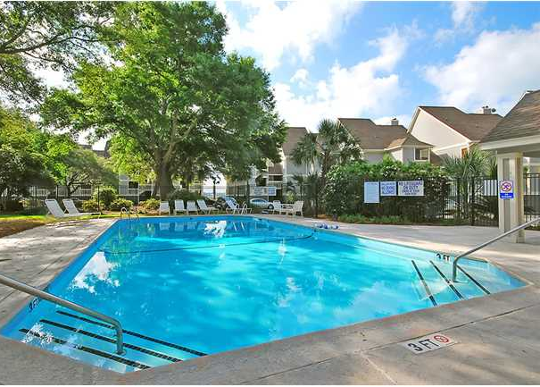
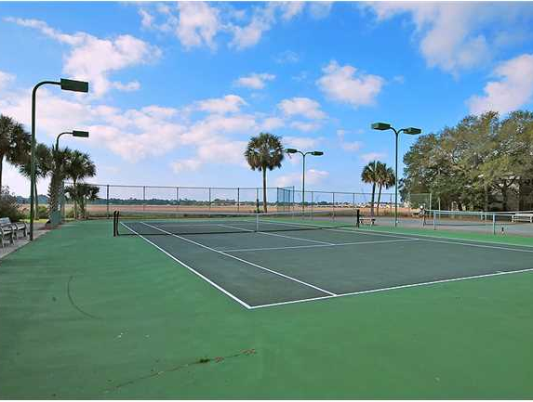
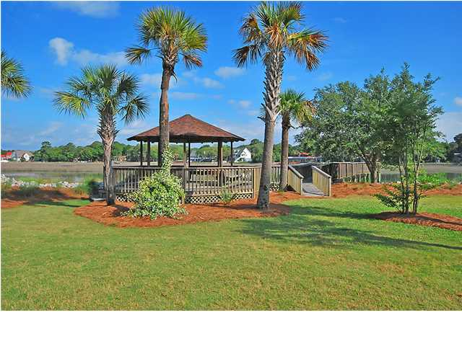
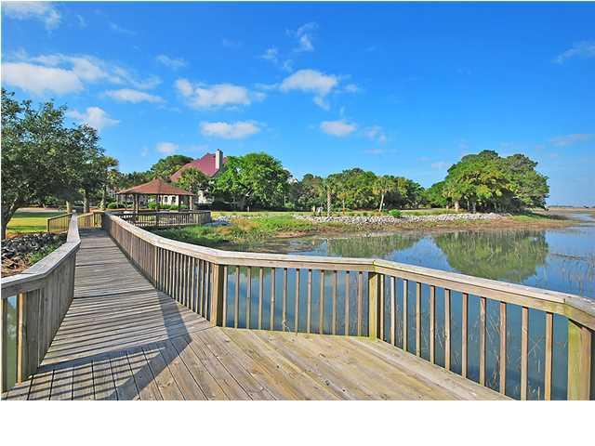
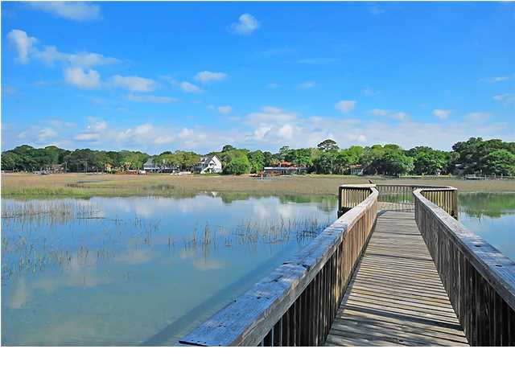

Spectacular View!
237 Little Oak Dr ~ Folly Beach ~ MLS# 1413456 ~ $229,000
Looking for maintenance-free living with a view? Then look no further with this two bedroom, two bath villa in Little Oak Island where you can enjoy peaceful views of the tidal creek and Folly River from your very own private balcony. As you enter the home, your eyes are immediately drawn forward to the wall of windows and amazing views. Inside this lovely unit, you'll find an open floor plan makes entertaining a breeze. The spacious kitchen opens up to the dining area and living room. The living room is the perfect place to relax and enjoy the view, and you'll stay cozy on cool winter nights in front of the fire place. This villa is all about the views, and the master bedroom is no exception. The master bedroom comes equipped with a screened-in porch that is perfect for relaxing any time of the day. The screened-in porch opens up to another deck which can also be accessed through the living room. A spiral staircase from the deck to the ground gets you next to the water in seconds. In addition to the resort-like feel you'll experience from looking out the windows of this home, you'll also have access to the community amenities which include clay tennis courts, a sparking swimming pool, and a gazebo with a dock that will make you feel like you're walking on water. If you hear the ocean calling your name, you are just minutes away from the beautiful sands of Folly beach. Or if you're in the mood for the historic charm that downtown Charleston provides with its shopping, dining, and parks, you're just a short drive away. In life some will tell you that you can't have it all, but with this fantastic villa, you truly can! Be sure not to miss out on this piece of paradise. Agents: Please note that the regime fee covers flood insurance and all amenities
*Seller offering a $2,000 credit for paint and flooring updates with an acceptable offer
Call or email for details: (843) 642-3546 or ben@mattoneillteam.com

