Slide 1
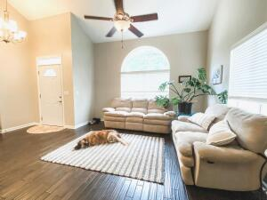
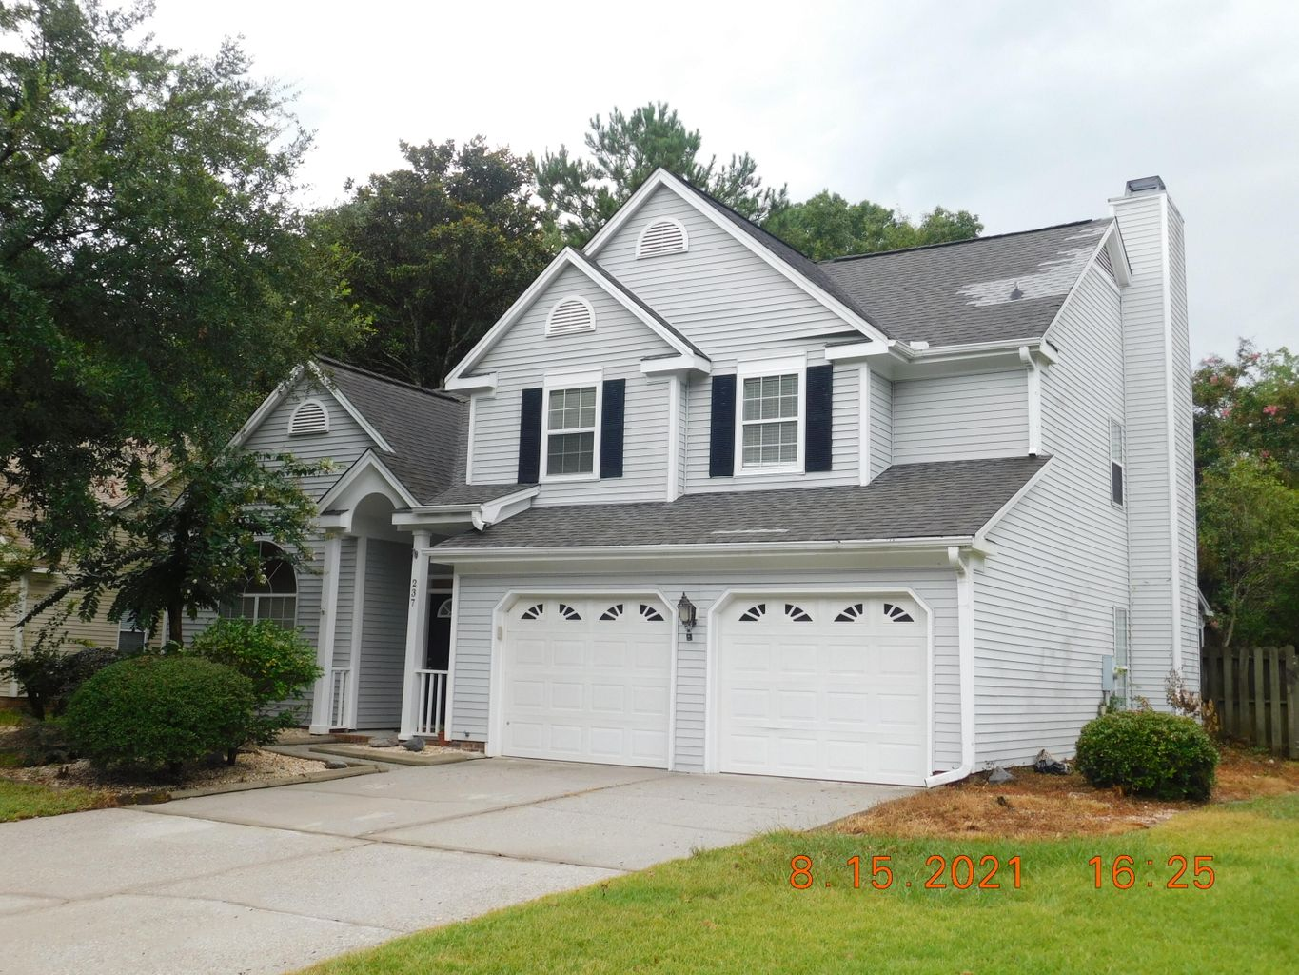
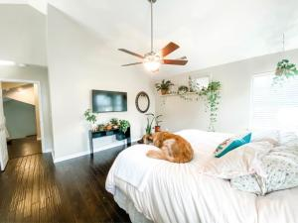
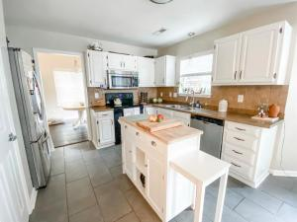
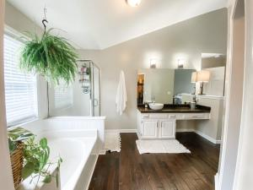
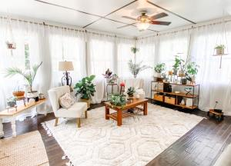
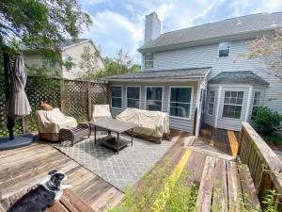


Open House Saturday From 11-4 INCREDIBLE OPPORTUNITY IN BRANDYMILL Minutes From Summerville, And Located In The Dorchester II School Area
237 Smithfield Avenue
Brandymill | Summerville | MLS# 21022367 | $309,000
As you enter this home, you are immediately greeted by the large open floor plan and high ceilings The living/dining room is oversized and offers tons of space just off the kitchen. The kitchen is spacious with beautiful cabinets, counter tops with tile back splash. The kitchen has stainless steel dishwasher, microwave and range and breakfast nook, perfect for the chef at heart. The family room is large with a wood burning fireplace and additional room which can be used as a sun room, or office area, Just off the sun room is a spacious deck and fenced in back yard, perfect for the family pet and entertaining and cookouts. There is also a spacious 2 car garage with lots of space set up for the craftsman in the family. The second floor features a LARGE MASTER BEDROOM, master bath with garden tub and separate stand up shower and large walk in closet. There are 2 additional bedrooms and hall bath, offering privacy for visiting guests This location, and home offers a great deal and ready to move in. A must see, asap, and WILL NOT LAST LONG.
Al Hammons
M 843-893-8684 | O 854-444-3232 | a.hammons@bhhsscre.com
BHHS Southern Coast Real Estate | 1525 Ashley River Road | Charleston, SC 29407

