Slide 1
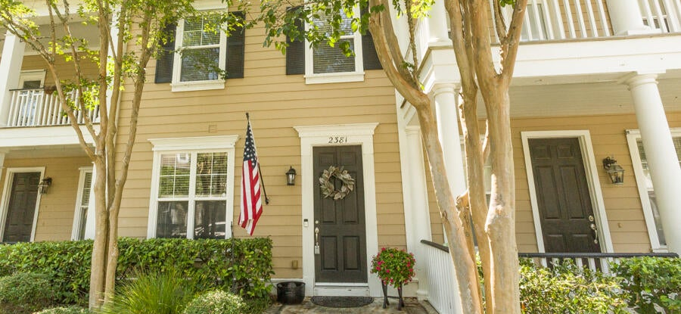
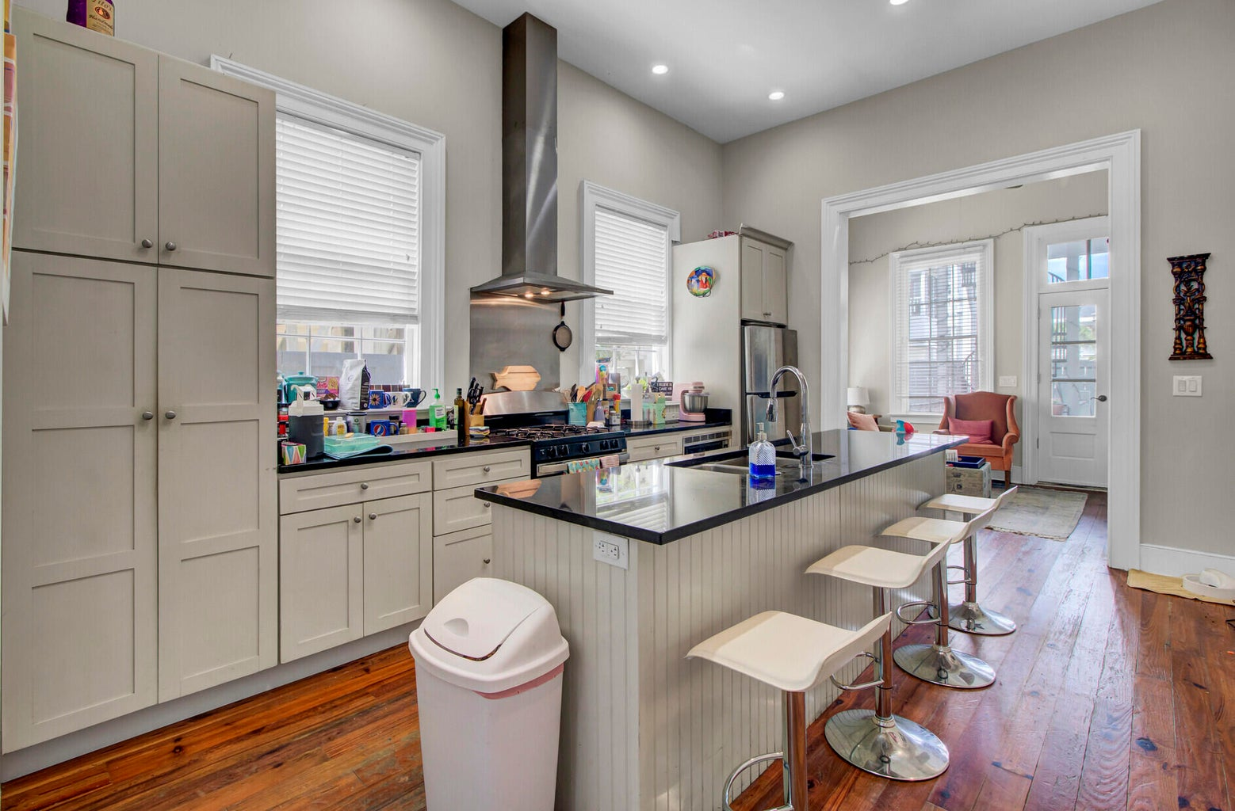
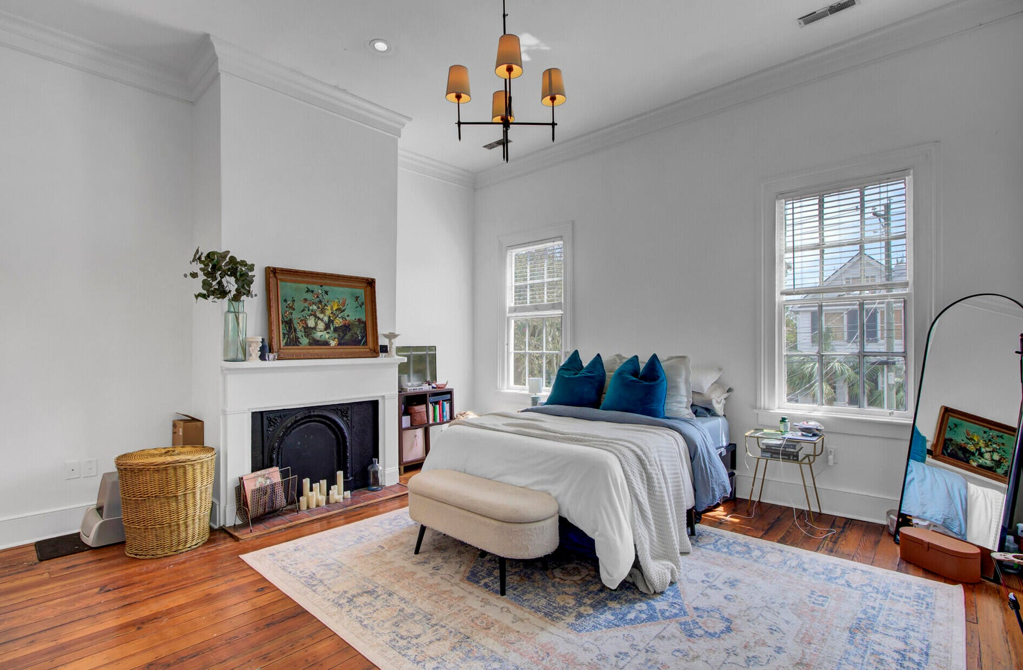
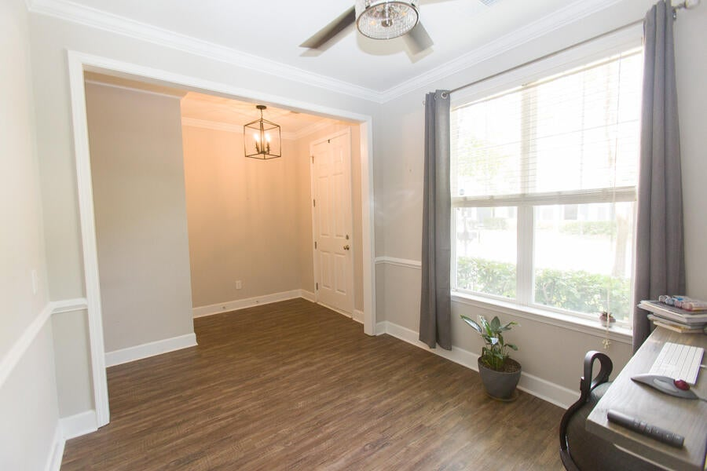
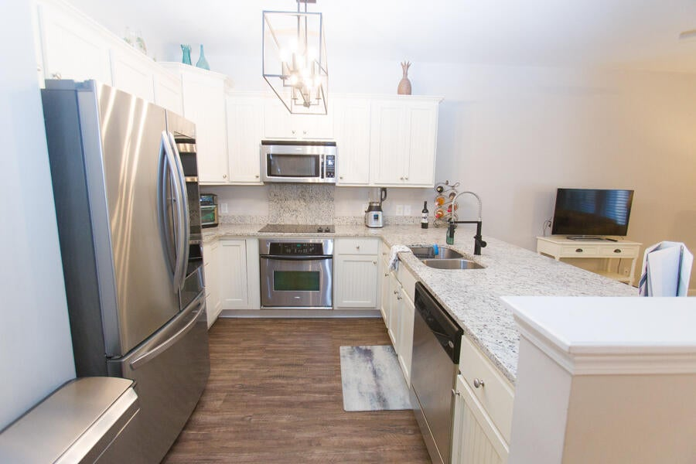
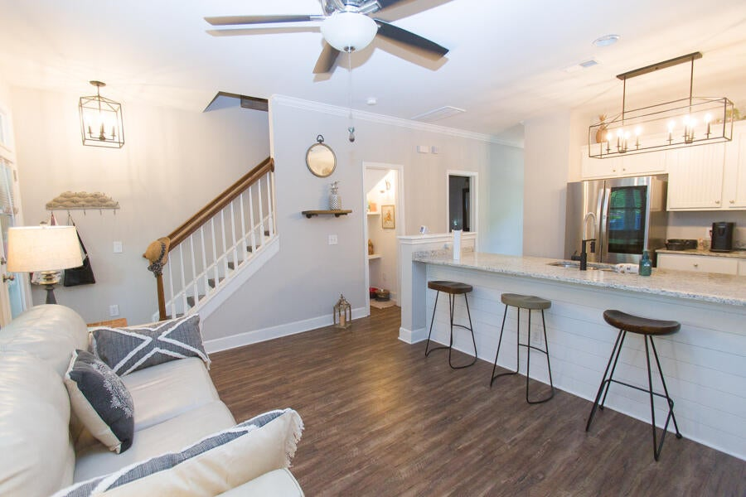
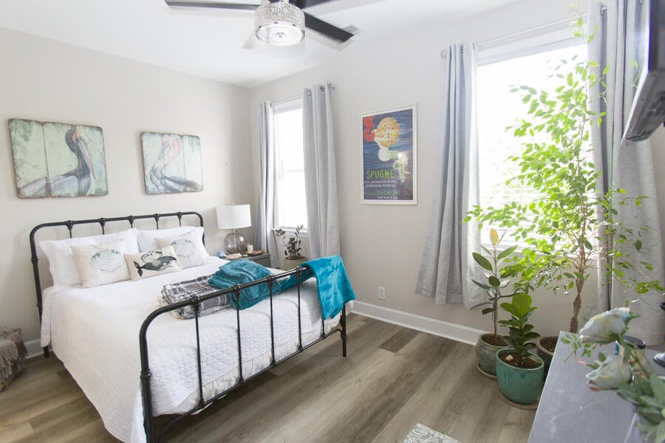


NEW PRICE !! NEW PHOTOS !!
MT PLEASANT ... UNDER 400K !!!
3% Buyer’s Agent Compensation!
2381 Kings Gate Lane #3105
Dunes West | Mount Pleasant| $399,900
Discover unparalleled elegance in Mt. Pleasant's most esteemed condominium community within The Heritage of Dunes West. This meticulously updated two-story townhouse features two bedrooms and 2.5 baths, complemented by soaring 9-foot smooth ceilings. The chef's kitchen boasts expansive granite countertops, stylish shiplap accents, and a convenient breakfast bar. Throughout, you'll find durable LVP flooring, with ceramic tile enhancing the baths. A massive screened porch with two large storage closets provides ample space, while the private fenced backyard ensures serenity and seclusion. Enjoy top-rated Mount Pleasant schools and a wealth of local amenities. Within a 5-mile radius, you'll find a range of dining and shopping options, including The Wando River Marina and Grill, perfect for docking your boat and savoring a meal. Nearby, you'll have access to three grocery stores, two Starbucks, and various local shops. For recreation, the Isle of Palms beach is just 10 miles away, along with Shipyard Baseball Park, three acclaimed golf courses, and two picturesque parks:
Laurel Hill County Park: Spanning 745 acres, this park offers miles of scenic trails for running, walking, or biking.
Fulton Park: Currently under construction, this 250-acre park will feature sports facilities, a performance stage, picnic pavilions, a playground, a dog park, walking trails, and a community building with a two-court basketball gymnasium, a walking track, and studios for music, art, dance, and camp activities.
Residents of Dunes West also enjoy access to numerous amenities, including parks, walking trails, and optional neighborhood pool and golf memberships. Additionally, the new Roper St. Francis Hospital and Mt. Pleasant Fire Department Station #5 are conveniently nearby.
2381 Kings Gate Lane is ideal as a primary residence, a weekend retreat, or a promising investment opportunity. Don't miss your chance to own this exceptional property!
Christine DeCocker
843-860-9972
ttlrealtor@gmail.com
ERA Wilder Realty Inc | 125 Wappoo Creek Ste F | Charleston, SC 29412

