Slide 1

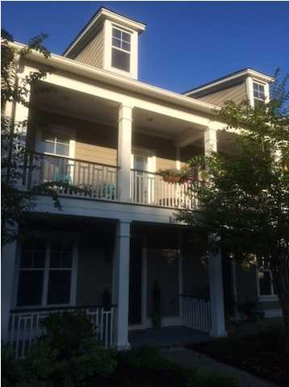
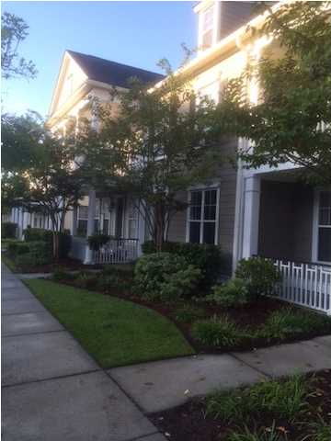
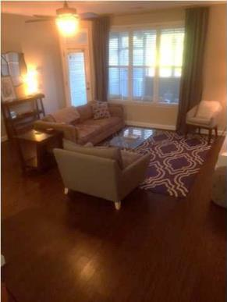
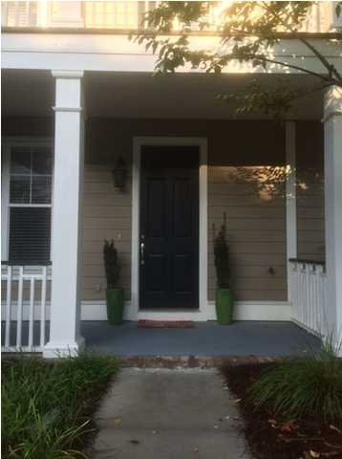
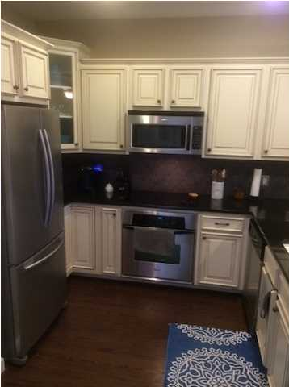


Clean and Contemporary Dunes West
Town Home For Sale
Clean and contemporary town home in the highly sought after Dunes West "The Heritage Community". A meticulous owner has updated all the things that make this town home comfortable and move in ready. Updated appliances, countertops, new flooring and lighting makes this a quick opportunity to get settled. Park right behind your place and walk in at ground level. A very nice front porch and back screened porch await pleasant evenings of convenience yet privacy. Care free living with all the exterior taken care of by the property regime. 2BR/2.5BA, Dining Room, Open Kitchen, Den and upstairs rooms with walk in closets. The photos speak for themselves. Call to schedule your appointment today.
Address: 2389 Kings Gate Ln
Bed/Bath: 2 / 2½
Square Ft: 1,442
City: Mount Pleasant
Subdivision: The Heritage at Dunes West
County: Charleston
Listing ID: 1425051
Listing Price: $235,000
Area: CHS-Mt.Pleasant North of IOP Connector

