Slide 1
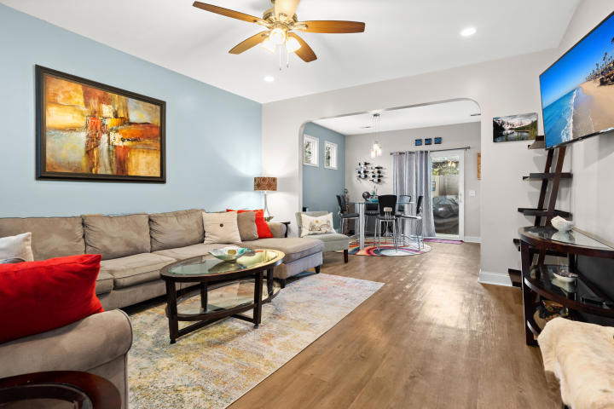
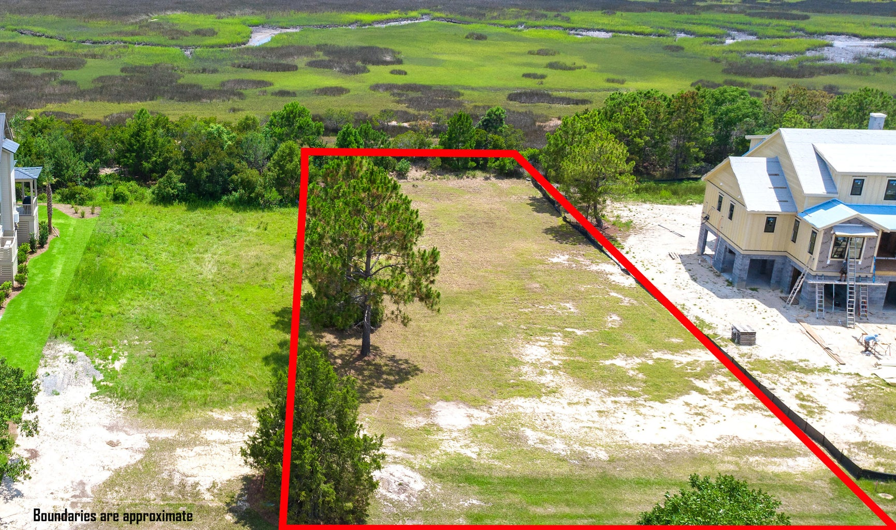
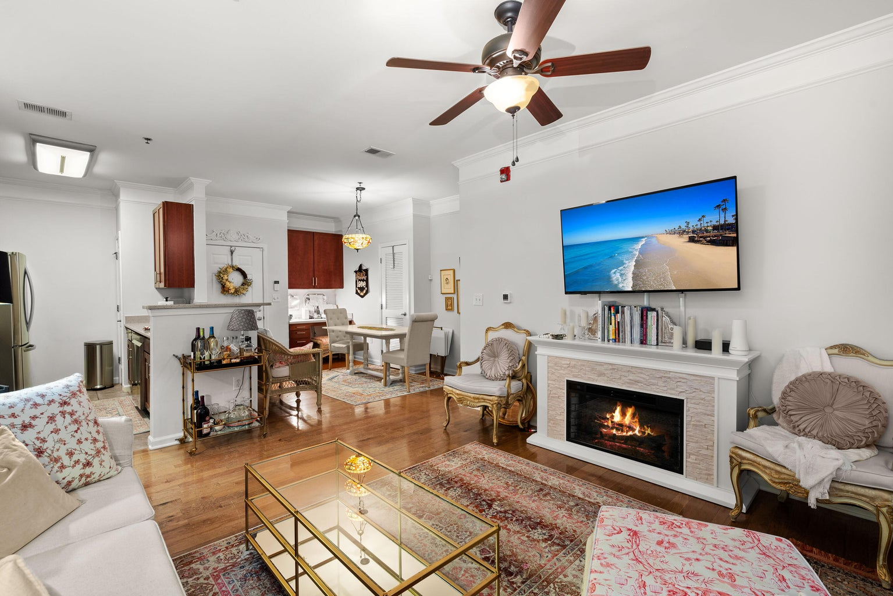
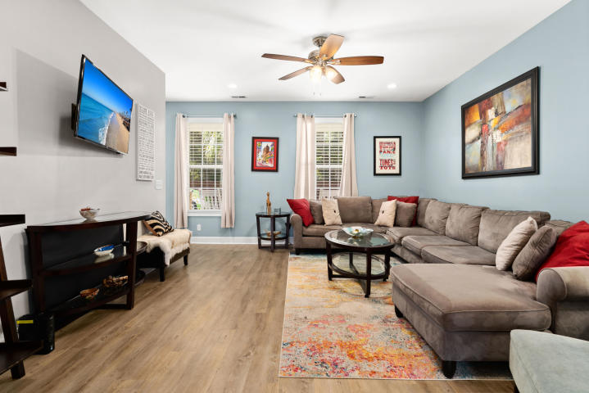
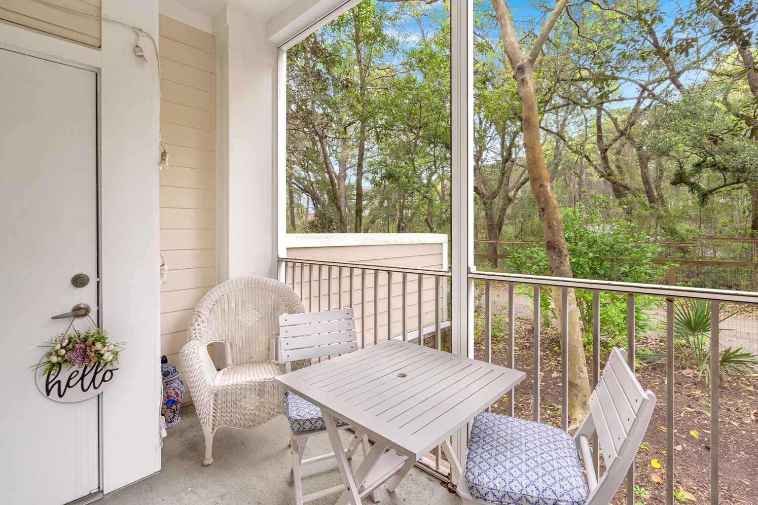
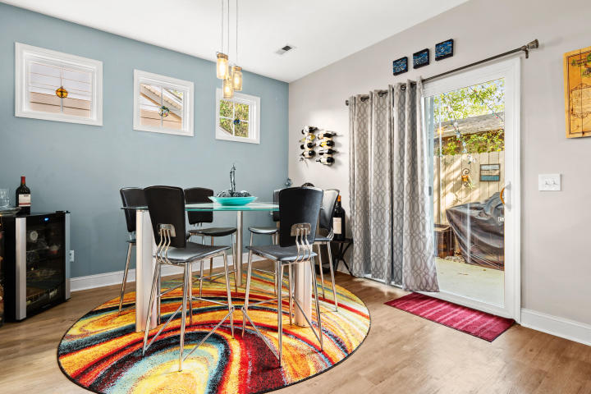
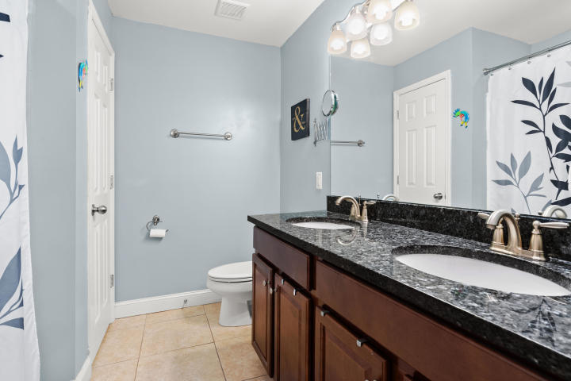
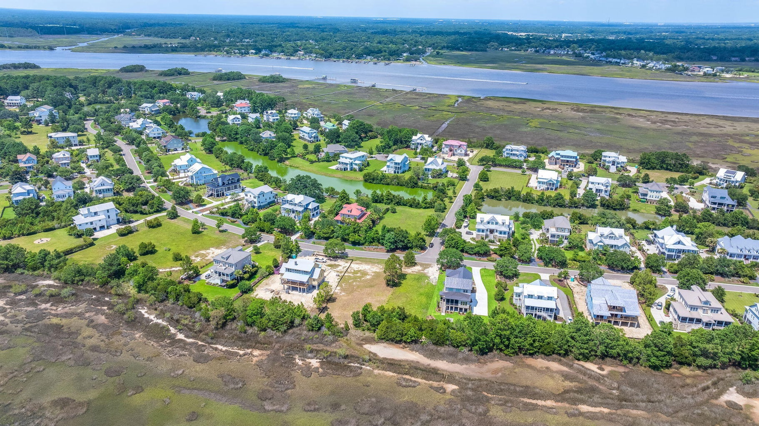
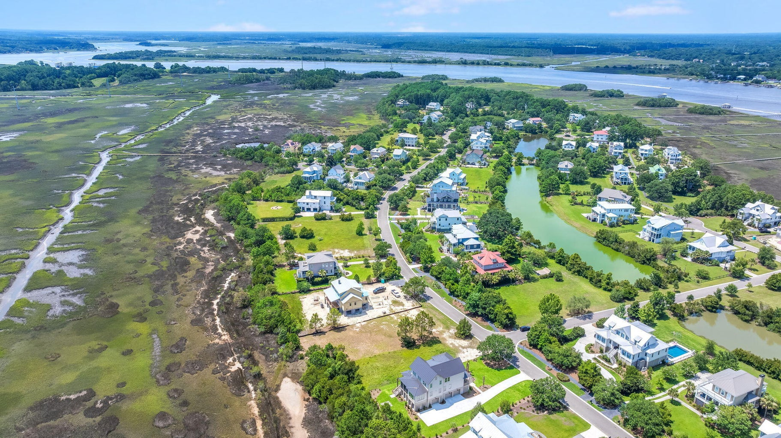
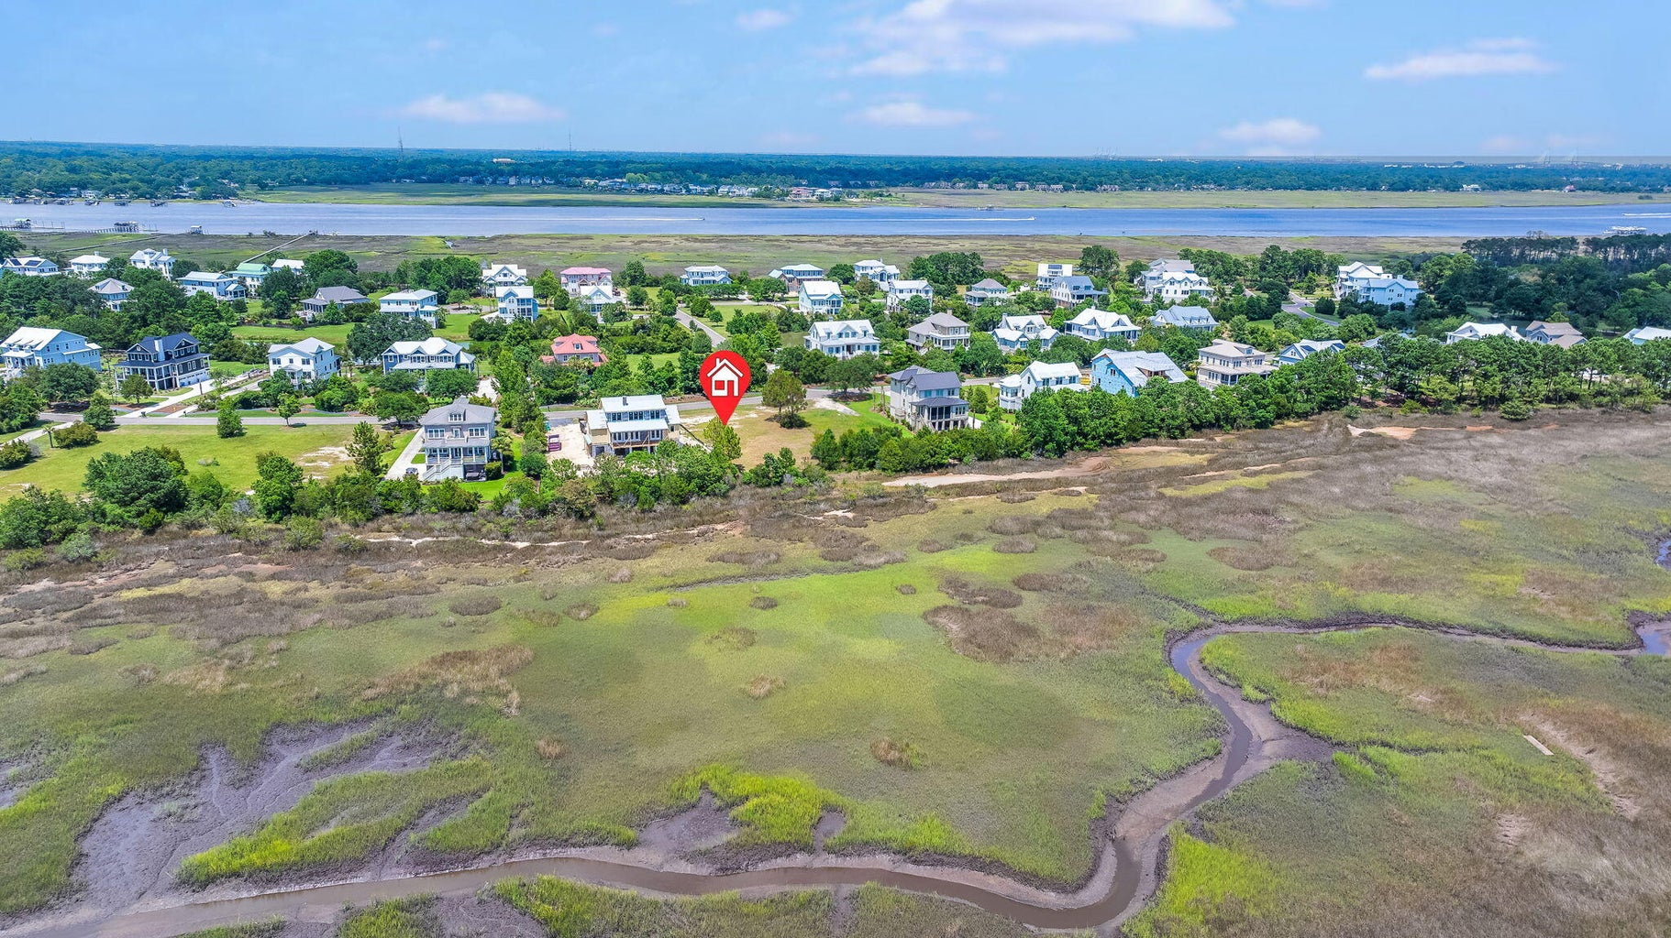
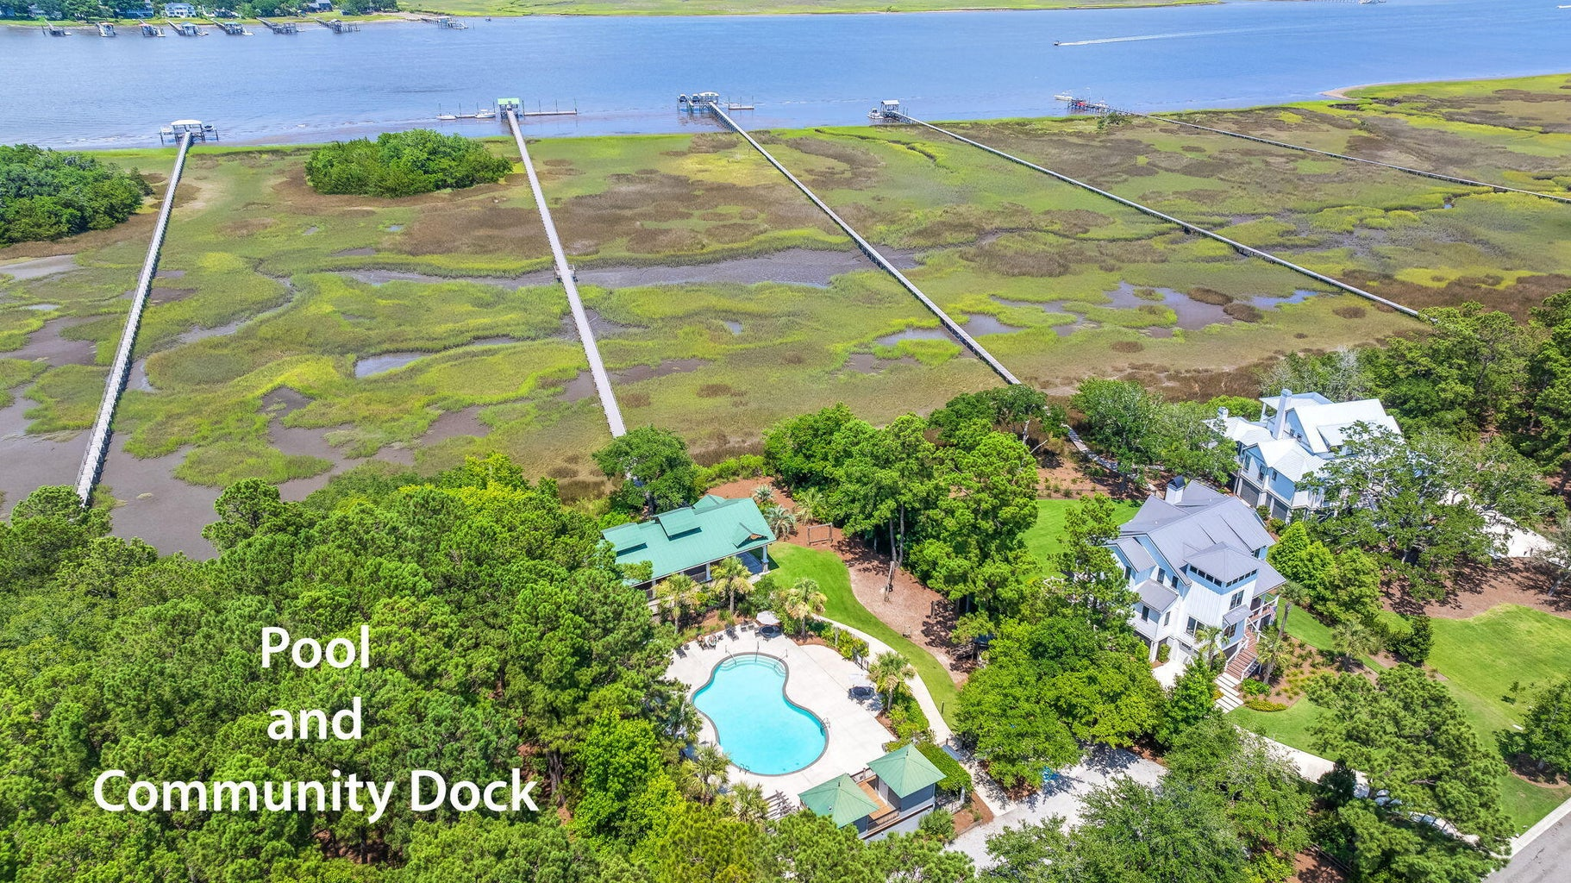


Gorgeous Marshfront Lot with Sunset Views!
2389 Rushland Landing Road
Rushland Plantation · Johns Island, SC 29455 · MLS# 24017307 · $459,000
Striking sunset views from one of the larger marshfront lots in the neighborhood! Rushland is a serene coastal enclave surrounded by the Intracoastal waterway and tidal marshes. There is an easement on the left side, to give you an even larger lot feel. The owner has stunning house plans that are almost complete (still time for a new owner to make changes) and have already been approved by the ARB. Plans can convey with an acceptable offer. Amenities galore in the neighborhood featuring a community pool, playpark, cabana, and dock on the Intracoastal waterway.
Keller Williams Realty Charleston West Ashley
1180 Sam Rittenberg Ste 300
Charleston, SC 29407
Amy Z. Powers
(843) 534-3523
amy@amyzonarich.com
liveandlovecharleston.kw.com

