Slide 1
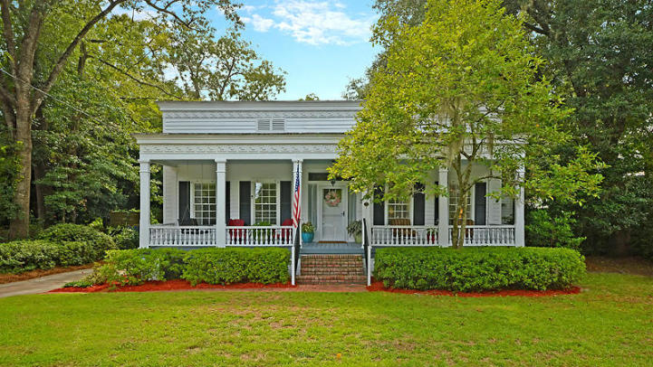
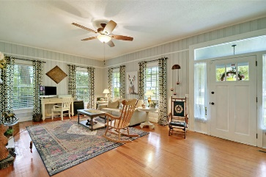
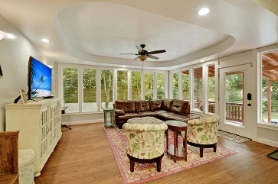
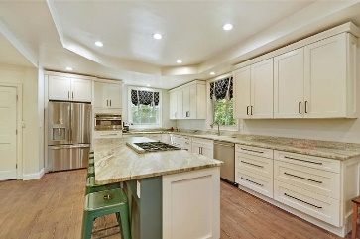
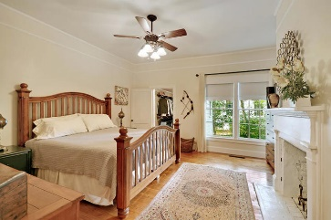
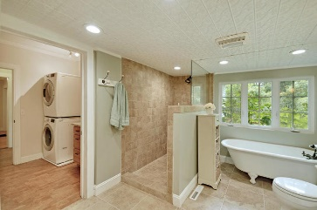
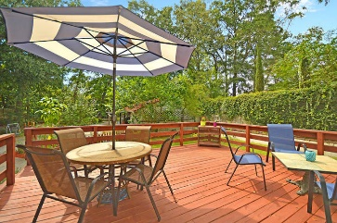
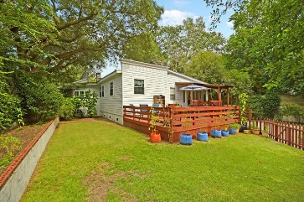
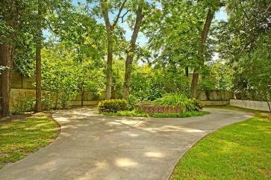

238 S Memorial Avenue Walterboro, SC 29488 · MLS# 19022084 · $350,000
Just Listed Historic Walterboro Showstopper!
Just Listed Historic Walterboro Showstopper!
Seller will pay buyer's agent $5,000 at closing
with accepted offer by noon June 7, 2019!
Enjoy timeless Greek Revival craftsmanship with all the modern conveniences of a 2019 custom home. STUNNING 4 bed, 2 bath single story home, 10ft ceilings in the historic downtown district. Custom kitchen boasts Leather granite countertops, HUGE 130 inch granite slab island, 36 inch commercial dual fuel range and oven, built-in convection microwave, all SS appliances, LED lighting, tray ceilings. Kitchen designed for a chef!! Formal and informal living rooms. 200K BTU tank-less water heater, water distribution manifold, pex water lines, and schedule-40 piping throughout. This house retains 90% the original hardwood flooring of the house- GORGEOUS! Master suite fireplace, walk in closet, custom bathroom with door-less shower and claw foot tub! Guest bathroom completely remodel in 2019. 10ft privacy wall around back property with electric gate entrance. Enjoy the majestic oak trees and koi pond while relaxing on your 400+sqft back deck in privacy. The home is a short walk to beautiful, historic downtown Walterboro with wonderful restaurants and antique stores. Come take a look because you will not find another home that offers as much as this one! List of upgrades are in attachments.
Stan Huff
843-670-2835 stan.huff@agentowned.com
Jill Marcacci
843-297-5590 jill@agentowned.com
www.agentownedrealty.com
AgentOwned Realty Co. Preferred Group, Inc. | 824 Johnnie Dodds Blvd | Mt Pleasant, SC 29464

