Slide 1
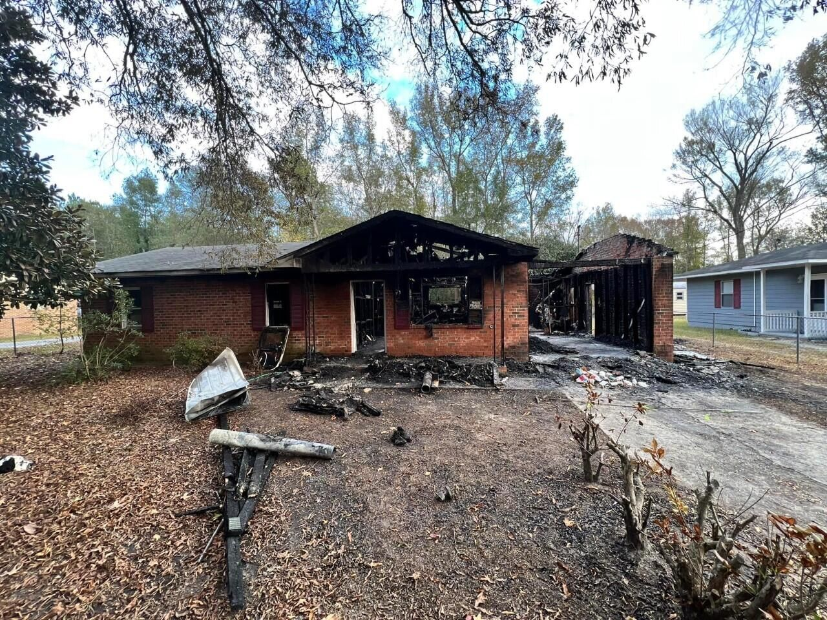
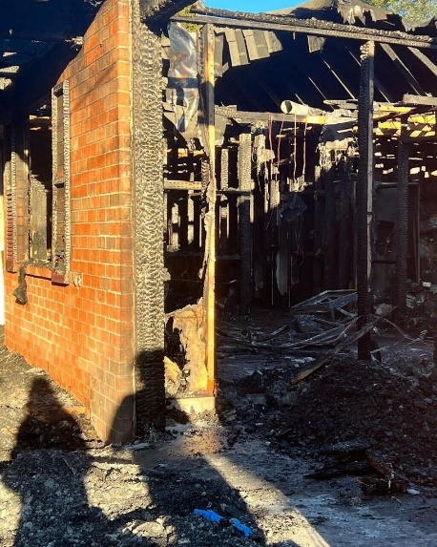
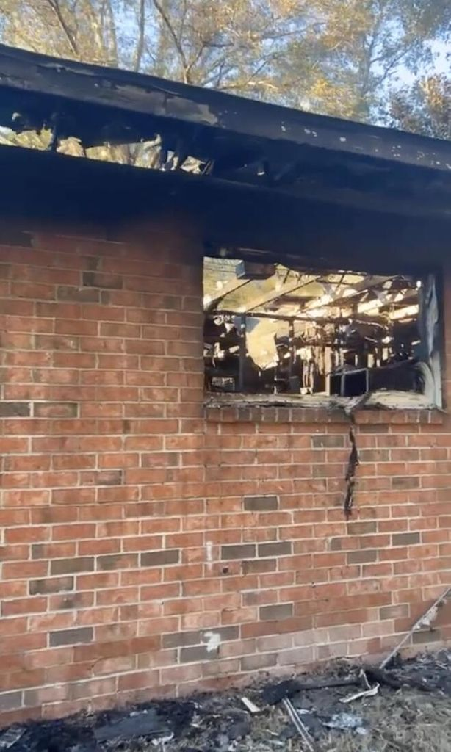



INVESTOR SPECIAL!
238 Perry Street
Allendale, SC 29810
MLS# 23007182
$9,000
House has fire damage and needs to be rebuilt. It appears some parts of the home are salvageable but will need to mostly be rebuilt.
Home was sold in September 2022 for $76,000 and still needed cosmetic repairs. Handy man special. Please enter property at your own risk.
Sold as-is, where-is.
Original home was 3 bedrooms, 1.5 bathrooms, 1,114sqft. Public sewer and water.
Nick Mazzilli
(843) 640-5575
nick@nickmcharleston.com
www.mavenrealtysc.com
Maven Realty
2180 McMillan Ave
#71672
Charleston, SC 29405

