Slide 1
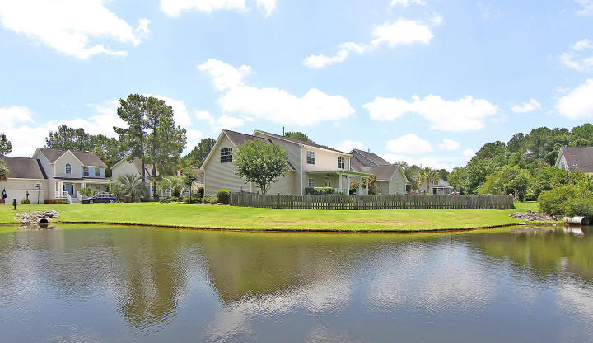

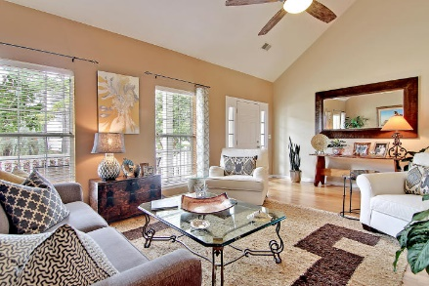
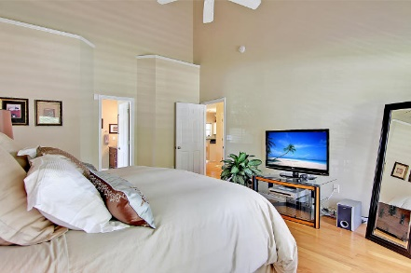
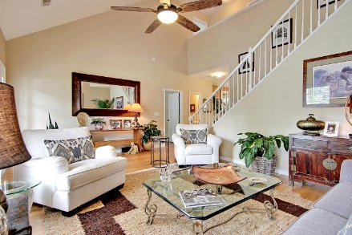
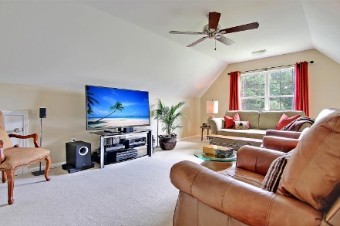
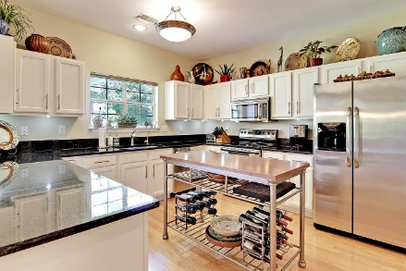
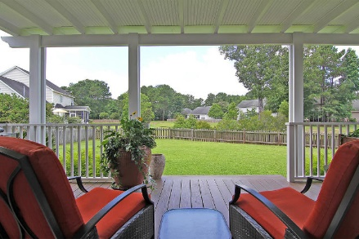
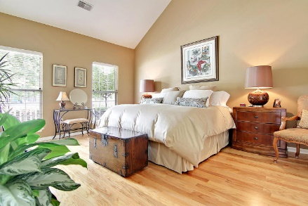
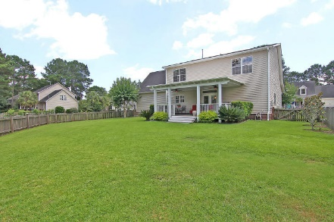
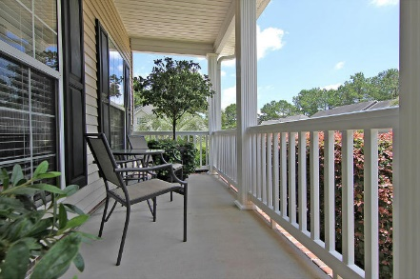
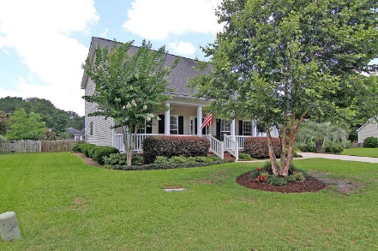

Parkshore Marshfront
Price Reduced in Rivertowne
2395 Bergeron Way ~ Mt Pleasant ~ MLS# 16016600 ~ $429,900
Mount Pleasant’s Rivertowne lives up to its reputation of being a beautiful community full of beautiful homes with this 4BR, 2.1BA, 2CG residence that backs to a peaceful pond.
The professional landscaping and full front porch welcome you into the home with its high ceilings, open floor plan, hardwood floors and lots of natural light. The soaring vaulted ceiling in the living room leads to the granite kitchen which has a breakfast bar, SS appliances, custom pantry and eat-in area with access to the deck.
The fenced-in backyard is spacious and has views of the water. The 1st floor owner’s retreat also has a vaulted ceiling and an en-suite bath with dual vanity, garden tub, walk-in shower and walk-in closet.
This home has been meticulously maintained and is move-in ready.
Call or email for details: (864) 934-5447 or Missy@MattOneillTeam.com

