Slide 1
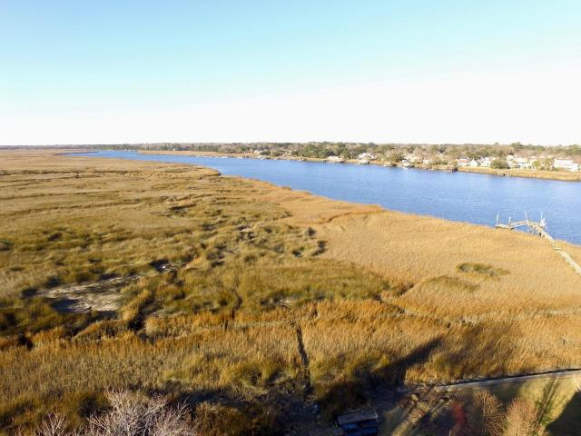
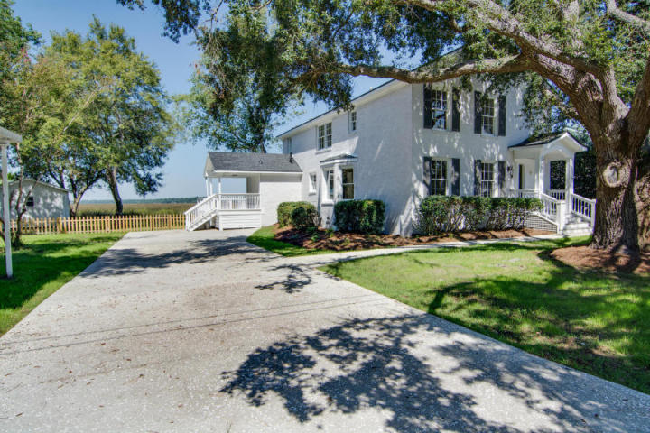
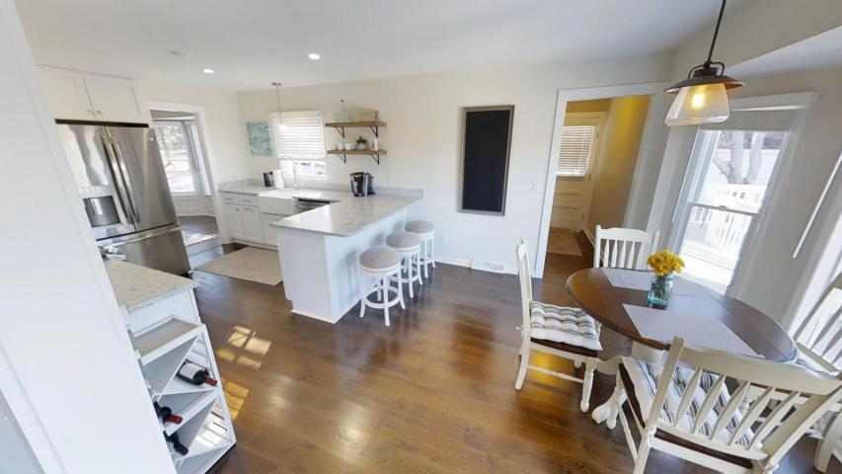
Better Than A New Home…
$500,000
Shows Like A Model Home And Is Move In Ready!!!
$40,000
Price Reduction!
2395 Furman Drive
Drayton On The Ashley | Charleston, SC 29414
MLS# 18001572 | $500,000
This home is totally upgraded and updated in every way. 1,000 feet from the home is a boat ramp, boat dock and community open area with picnic and play park fronting directly on the Ashley River and less than 1 mile from the Shadowmoss Golf Course. Imagine sitting on your rear deck overlooking the Marsh and Ashley River, the privacy and view from the first or second floor rear deck can not be beat. The home has hardwood floors throughout the first floor, open kitchen with marble counters, stainless steel appliances (check out all the photos). The community has no required HOA fees but you can choose to use the pool for an annual fee of $250 and $150/yr dock fee ($375/year for both) which are optional. This lot is very wide and has covered parking for 3 vehicles plus a large concrete driveway with room enough for your boat and additional vehicles.
Rick Willis
843-327-3017 Rick@RickWillis.com The Group, LLC

