Slide 1
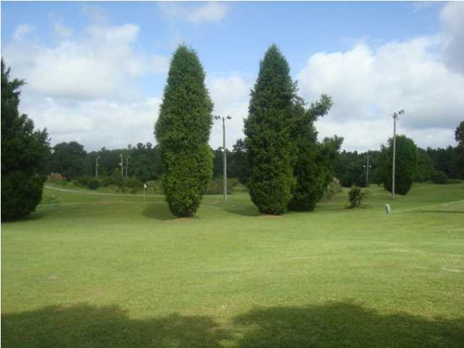
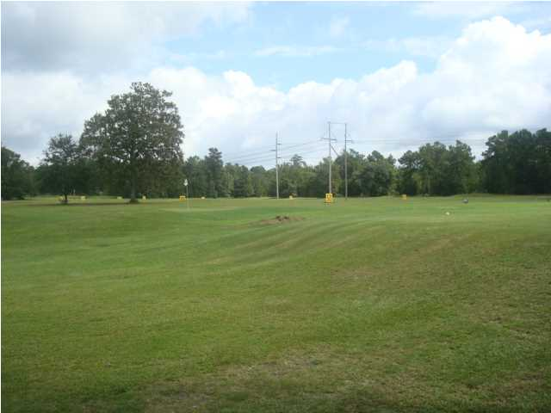
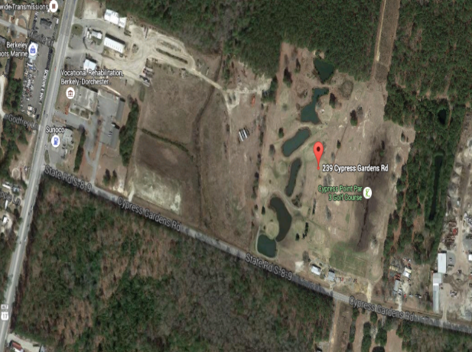
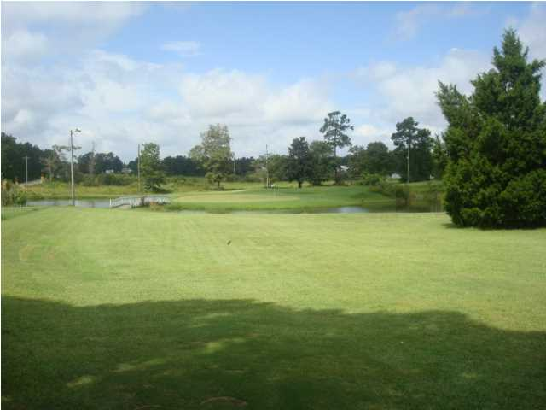
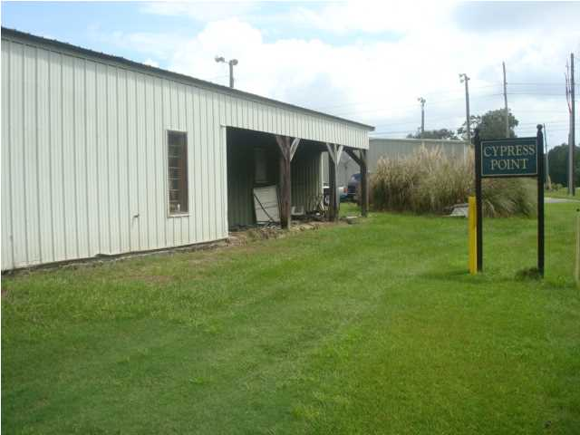
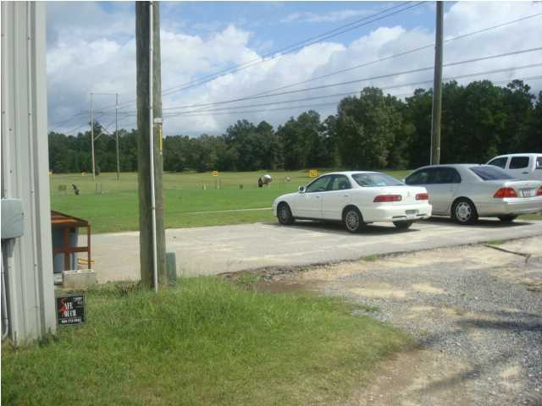
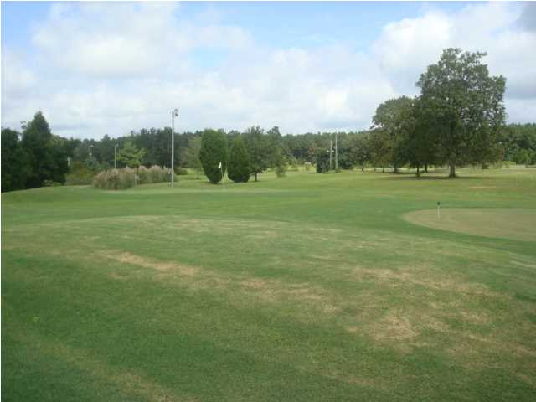
PRIME DEVELOPMENT LAND
COMMMERCIAL/RESIDENTIAL
NOW A GOLF COURSE
$50,000/ACRE
10 Minutes from I-26 ~ Cypress Gardens Rd.
In the path of growth and new housing boom. This property is only about 1/4 mile from the newly widened 4 lane Highway 17-A that has public sewer available. Cypress Gardens Rd. is the major road that connects Highway 52 with Hwy 17-A. New home developments are expanding and being created very close to this property located off Cypress Garden Rd...Hwy 52 and Hwy 17-A and the Cane Bay Area on Hwy 176. The property has an operating Par 3 Golf Course and Driving Range with storage building and small clubhouse. The property has 1,000 feet of road frontage on Cypress Gardens Rd. The property consists of 2 separate parcels TMS# 210-00-00-066 has 20.06 Acres and TMS# 210-00-00-126 has 10.35 Acres. Seller will also subdivide land and sell a smaller portion. Zoning will permit both Commercial and Residential dwellings.
MLS #15010203 - 30.41 acres - $1,500,000
MLS #15010204 - 20.06 acres - $1,100,000 | MLS #15010206 - 10 acres - $580,000
MLS #15010208 - 5 acres - $299,000 | MLS #15010210 - 3 acres - $199,000
In the path of growth and new housing boom. This property is only about 1/4 mile from the newly widened 4 lane Highway 17-A that has public sewer available. Cypress Gardens Rd. is the major road that connects Highway 52 with Hwy 17-A. New home developments are expanding and being created very close to this property located off Cypress Garden Rd...Hwy 52 and Hwy 17-A and the Cane Bay Area on Hwy 176. The property has an operating Par 3 Golf Course and Driving Range with storage building and small clubhouse. The property has 1,000 feet of road frontage on Cypress Gardens Rd. The property consists of 2 separate parcels TMS# 210-00-00-066 has 20.06 Acres and TMS# 210-00-00-126 has 10.35 Acres. Seller will also subdivide land and sell a smaller portion. Zoning will permit both Commercial and Residential dwellings.
MLS #15010203 - 30.41 acres - $1,500,000
MLS #15010204 - 20.06 acres - $1,100,000 | MLS #15010206 - 10 acres - $580,000
MLS #15010208 - 5 acres - $299,000 | MLS #15010210 - 3 acres - $199,000
Rick Willis
843-327-3017
Rick@RickWillis.com
The Group, LLC

