Slide 1
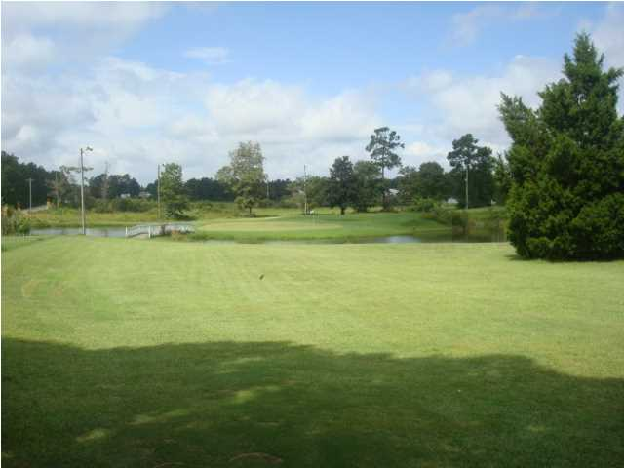
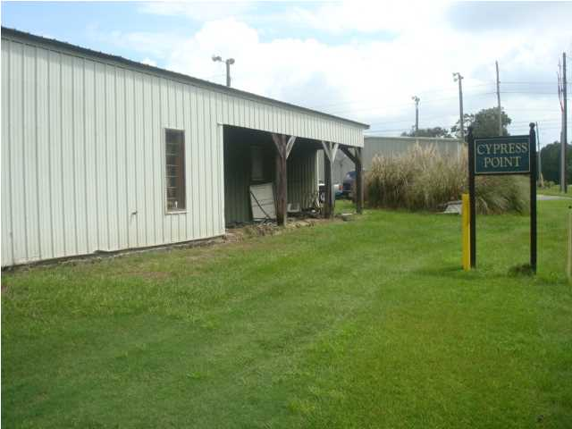
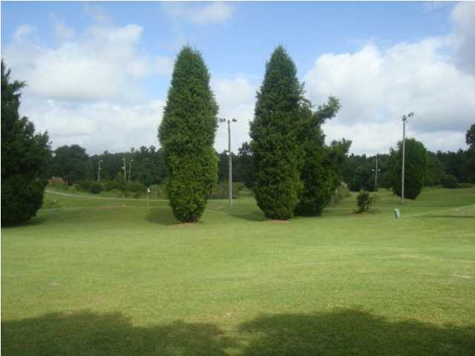
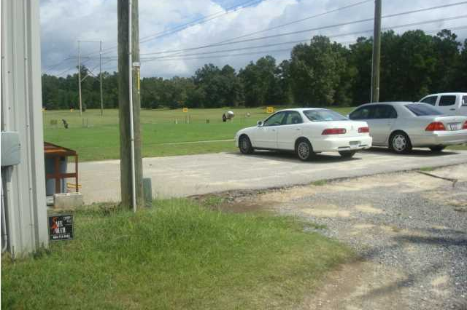
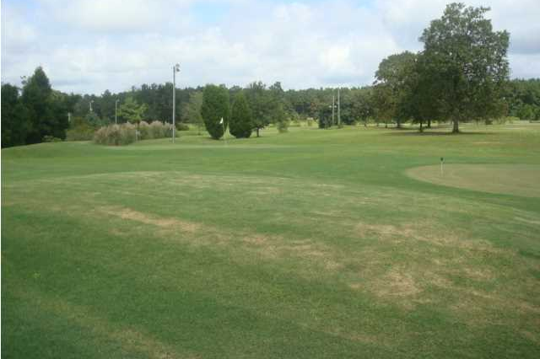
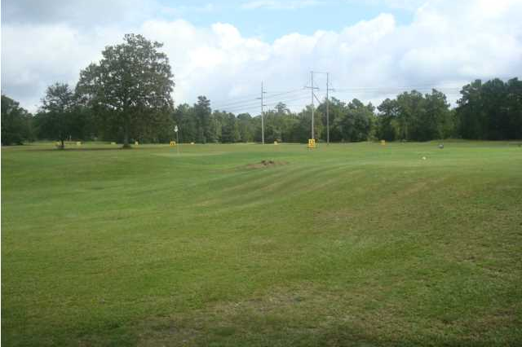
ZONED COMMERCIAL FOR LESS THAN $50,000/ACRE
IDEAL FOR RESIDENTIAL DEVELOPMENT
OWNER FINANCING/WILL SUBDIVIDE
239 Cypress Gardens Rd – Now a Par 3 Golf Course
In the path of growth and new housing boom. This property is only about 1/4 mile from the newly widened 4 lane Highway 17-A that has public sewer available. Cypress Gardens Rd. is the major road that connects Highway 52 with Hwy 17-A. New home developments are expanding and being created very close to this property located off Cypress Garden Rd...Hwy 52 and Hwy 17-A and the Cane Bay Area on Hwy 176. The property has an operating Par 3 Golf Course and Driving Range with storage building and small clubhouse. The property has 1,000 feet of road frontage on Cypress Gardens Rd. The property consists of 2 separate parcels TMS# 210-00-00-066 has 20.06 Acres and TMS# 210-00-00-126 has 10.35 Acres. Seller will also subdivide land and sell a smaller portion. Zoning will permit both Commercial and Residential dwellings and Owner Financing Available.
3 AC-$199,000 | 5 AC-$299,000 | 10.35AC-$580,000
20.06 AC-$1,100,000 | 30.41 AC-$1,500,000
Rick Willis
843-327-3017
rwillisteam@gmail.com
The Group, LLC

