Slide 1

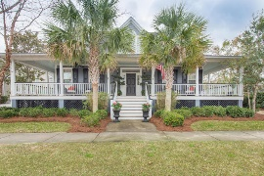
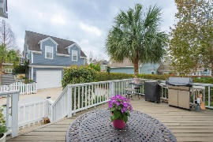
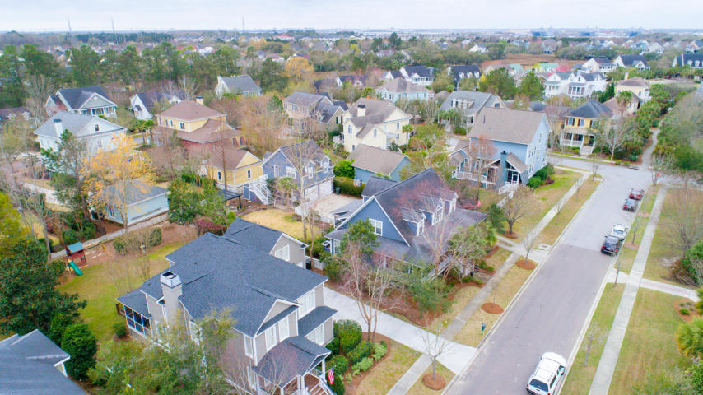
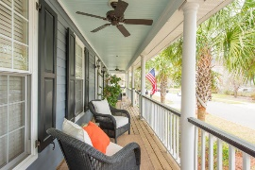
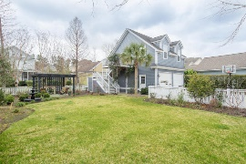
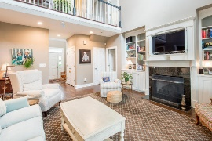
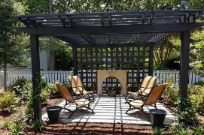
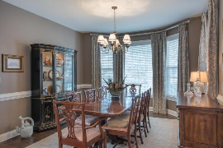
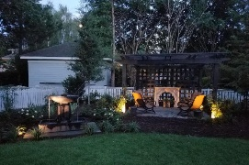
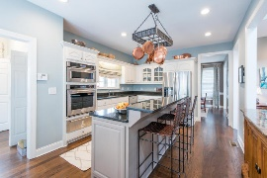
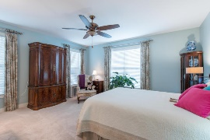
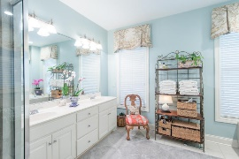
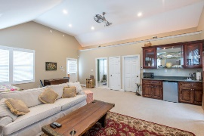
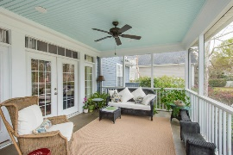
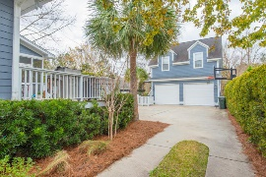

Southern-Style Charmer on Daniel Island ~ Priced to Sell ~
239 Fairchild Street
Charleston, SC 29492 ~ MLS# 17005594 ~ $725,000
Beautiful, Southern-Style home with full wrap around front porches located in the established Codner’s Ferry neighborhood on Daniel Island. This elegant and charming 4 bedrooms, 3.5 bath home is a must see! It has an efficient floor pan w/ the master bedroom on the first floor, a 2-car detached garage with an approx. 700 SQ FT FROG apartment above it. New wall to wall carpet in master bedroom and custom built closet. Recent upgrades include; energy-efficient LED can lights throughout, fresh paint, new ceiling fans, granite counter tops, stainless steel appliances in the kitchen; and new French doors in the master bath and laundry room. Outside, be sure to appreciate the custom-built pergola, calming water fountain, accent lighting as well as the manicured garden. Finally , enjoy the endless amenities the island has to offer weather it be the two community swimming poos, many tennis courts, walking/jogging trails, boat landings and play parks. Schedule your viewing today!
Andrew Tackitt
(843) 437-8726
andrew@radekopf.com
Erin Quinn Hanhauser
(843) 743-8204
erin@radekopf.com
1205 Two Island Court, Suite 201 | Mount Pleasant, SC 29466 | Phone: (843) 579.2217 | Fax: (843) 971-0281

