Slide 1
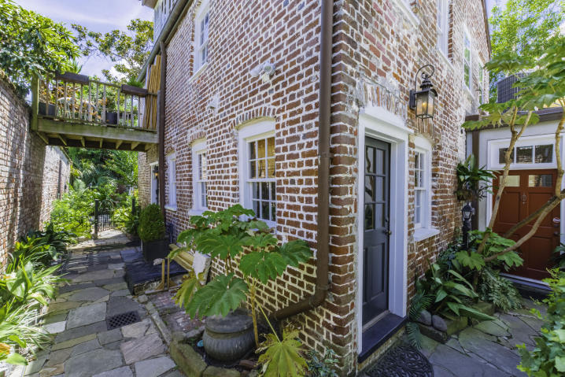
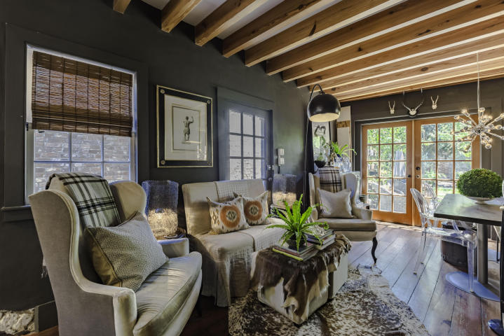
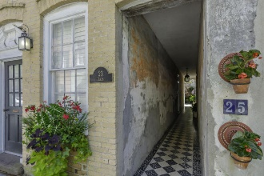
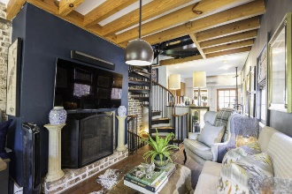
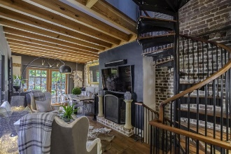
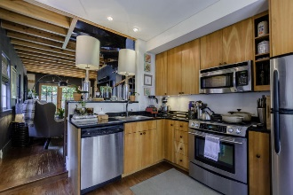
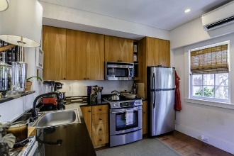

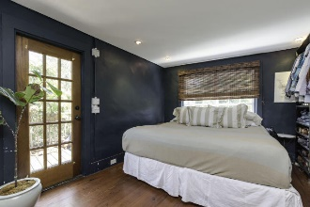
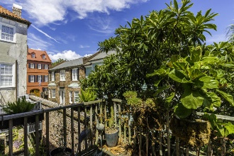
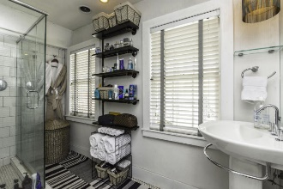
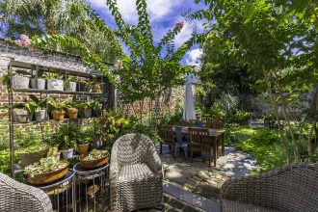
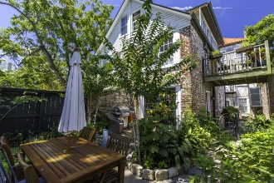

23 Queen Street ~ Unit G
French Quarter ~ Charleston ~ MLS# 16022038 ~ $789,000
Move In Ready Downtown, French Quarter Home
As you step into the beautiful arched tiled walkway one can feel like they've been transported in time to a European city. The splendor of Charleston is exhibited in this private oasis. Upon entering the front door one can see straight into the lush back courtyard, large in size for downtown standards. The first floor is comprised of a beautiful gourmet style kitchen with stainless steel appliances and a gas range for the cook in the family. The kitchen opens into the living room that is adorned with beautiful French doors that opens up into the plush private courtyard. The courtyard garden allows for year round wonderful outdoor living in a most private of settings. The second floor has a dual private master bedroom with it's own en-suite and a balcony that over looks the city of Charleston. The third floor is comprised of a private dual master bedroom with an en-suite as well.
This Queen's Street residence has an impeccable address that is in the heart of the City of Charleston and in walking distance to most of the downtown area.
A jewel of a home and a must see!
Carolyn Dubrofsky
843-324-9645 M
cdubrofsky@comcast.net
The MarshallWalker.com Group
582 Rutledge Ave
Charleston, SC 29403

