Slide 1
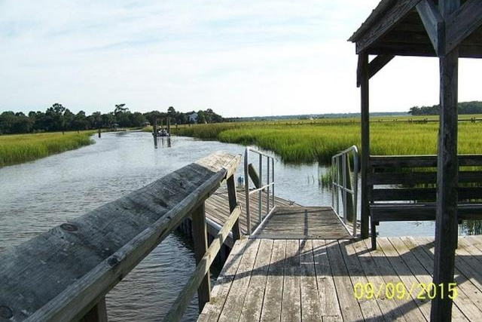
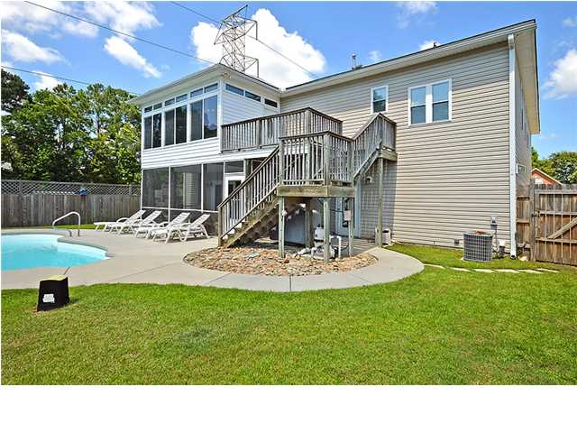
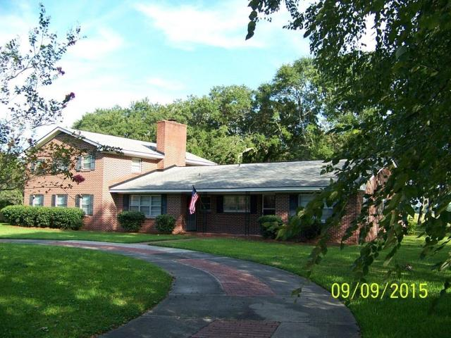
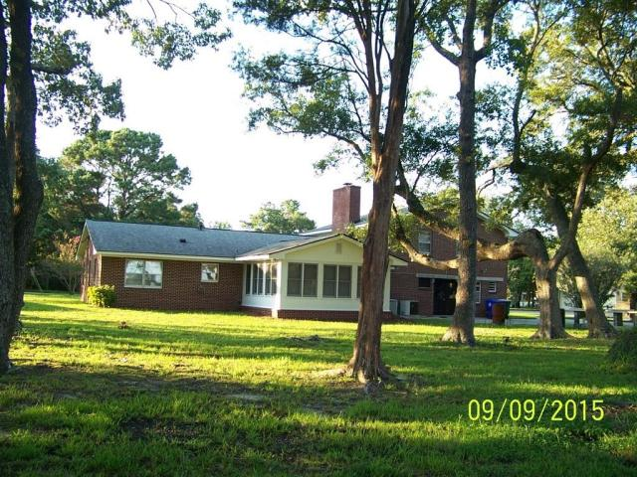
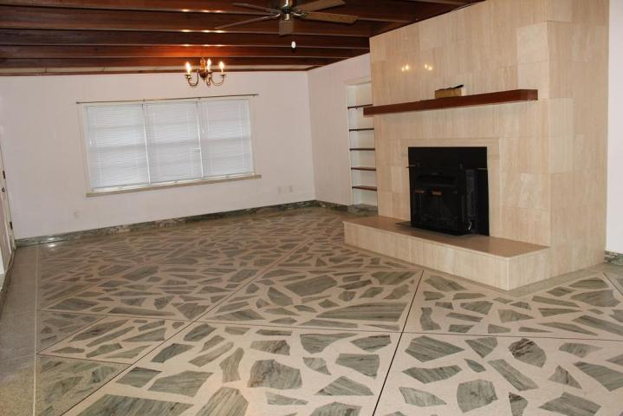
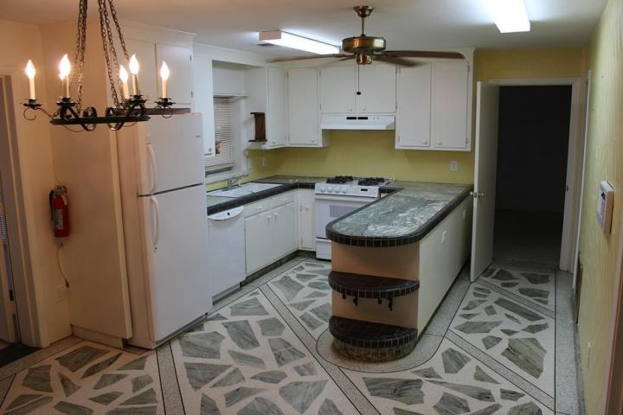
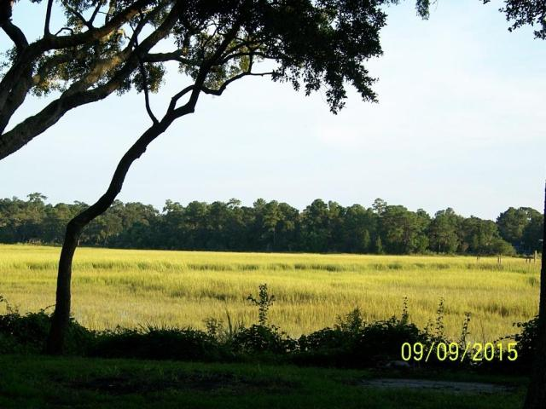
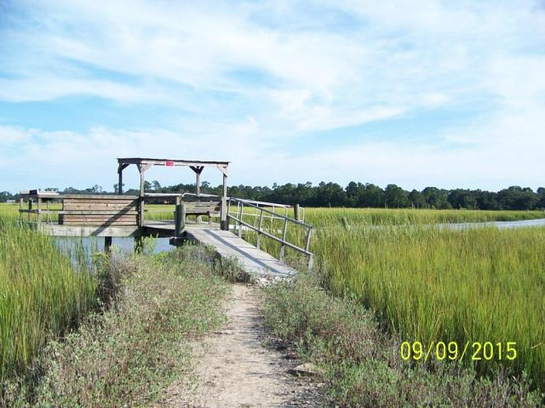
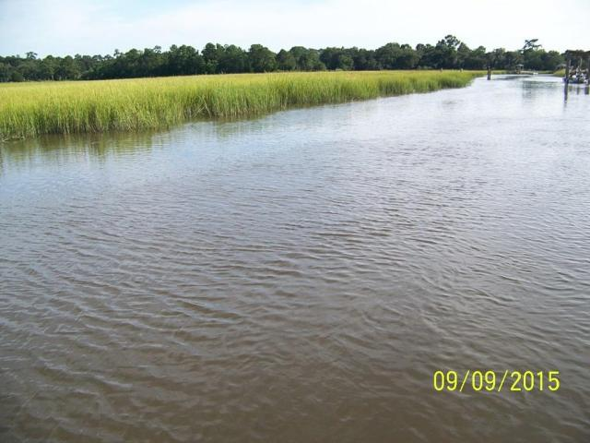
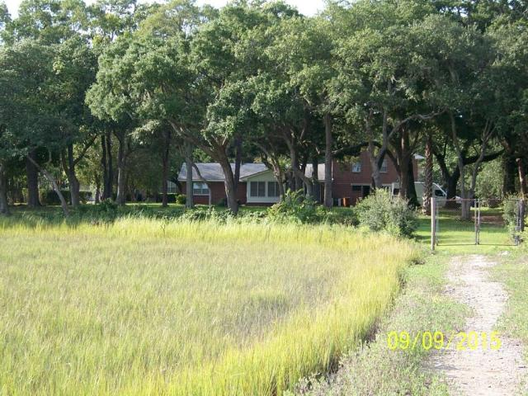

Price Reduced!
Open House Saturday 12-4
23 Lord Calvert Drive
Harrison Acres ~ Charleston ~ MLS# 15026701 ~ $829,900
DEEP WATER!
Beautiful marsh and water view with large yard. Crab and fish from your own deep water dock. Brick home, 4 bedrooms/3 full baths, in Harrison Acres. 2.2 acres with 1 acre high land, 1.2 acres King's Grant marsh.
Stunning lot with walkway to deep water, covered pier head and floating dock on Wappoo (Coburg) Creek.
Formal living and dining room, den with travertine fireplace, terrazzo floors with marble inlay downstairs, sunroom, 3bdrms/2baths upstairs with terrazzo floors, huge walk-in cedar closet, bedroom with bath and walk-in Jacuzzi tub downstairs. Ceramic tile bathrooms, marble countertops in kitchen, ceiling fans.
Garage converted to recreation/workshop rooms with 1/2 bath. Newer 5 year-old roof. Natural gas stove and public water and sewer. Detached storage building. Great neighborhood. Convenient to Interstate 526, Hwy 17 and Hwy 61.
For more information, contact
Joe Dabit | support@mattoneillteam.com | 843-814-0136

