Slide 1
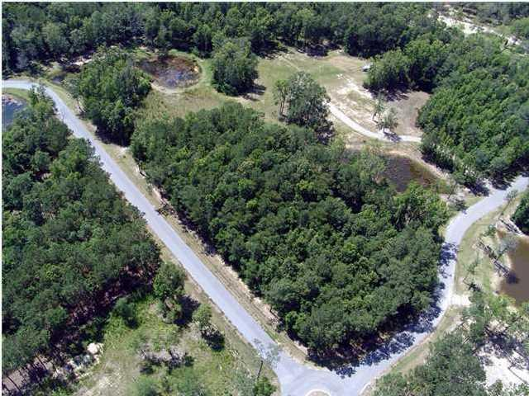

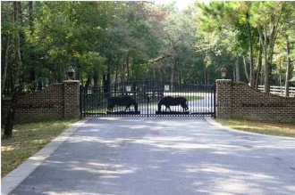
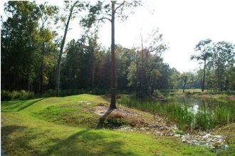
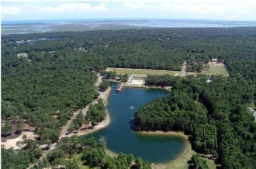
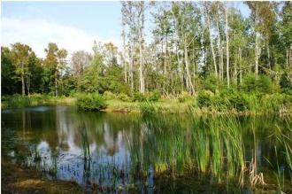
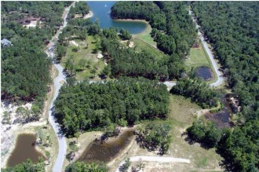
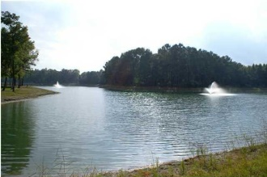


Your Dream Home Here
23 Old Rosebud Trail
Pepper Plantation ~ Mount Pleasant ~ MLS# 1422168 ~ $295,000
GREAT PRICE! Build your dream home on this gorgeous 3.28 acre corner lot in beautiful Pepper Plantation. This lot really stands out with (2) adjacent HOA ponds! One is 1.685 acres and the other is 0.484 acres. Also located in the subdivision is a beautiful (11) acre lake with a dock. You have the feel of country living while being close to shopping and close to Mt. Pleasant Roper Hospital & Wando High school. Amenities include several miles of riding/walking trails, a quarter-mile training track and a fantastic million dollar clubhouse overlooking the lake. Buyer will need to verify all items of importance, including but not limited to: schools, flood zone, HOA, covenants & restrictions and utilities.
Virtual Tour Available at
http://tours.listingsinmotion.com/public/vtour/display/222956?idx=1
Bill Barnhill
843-364-6903
bill@billbarnhill.com
496 Bramson Ct., Suite 200
Mount Pleasant, SC 29464

