Slide 1
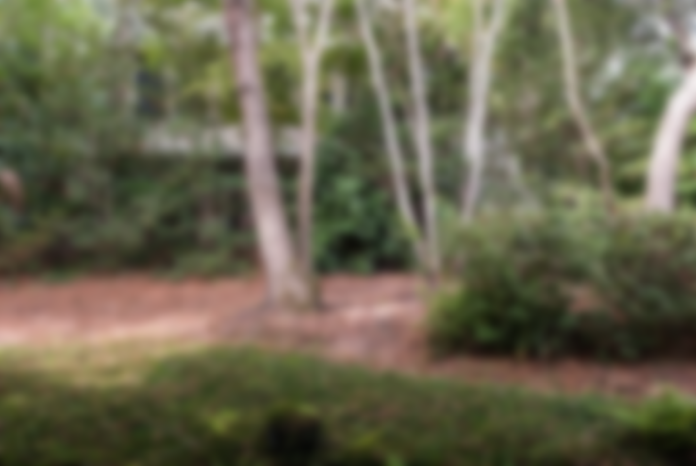
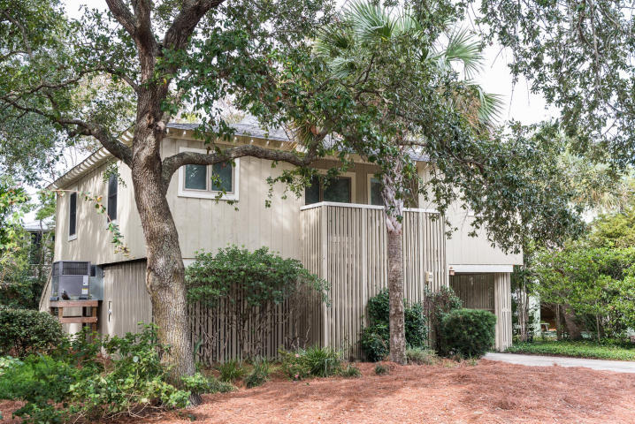
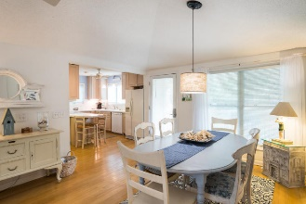
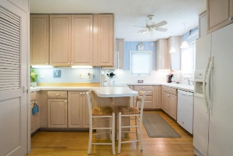
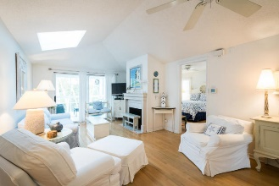
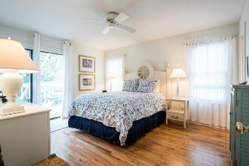
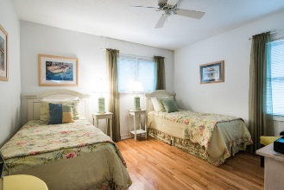
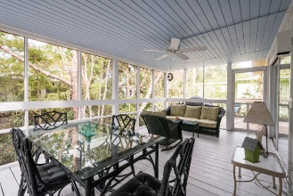
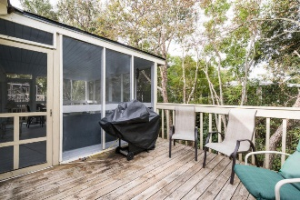
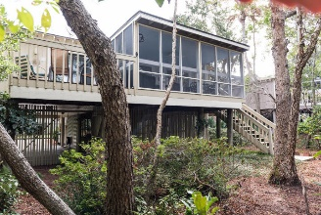


23 Sandcrab Court
Isle of Palms, SC 29451 ~ MLS# 17027807 ~ $599,000
Island Lifestyle
WELCOME to this quaint, comfortable and charming beach cottage in a neighborhood of pastel bungalows. This three bedroom, two bath cottage in Wild Dunes has so much potential you can't afford to pass it up! Upon entering this well maintained home with lovely hardwood floors throughout, you will find a spacious living and dining room flooded with natural light, supplied by a beautiful skylight. This area opens onto a large screened porch and it also has a gas burning fireplace for those cozy winter nights. An efficient galley kitchen boast newly updated appliances, plenty of cabinet space and the laundry area. Master bedroom has a private bath and a walk-in closet, with doors opening onto the back deck and screened porch, a perfect place for entertaining. There are two inviting guest bedrooms and a full bath opposite the master suite, one of which also opens onto the screened porch. This home is being sold partially furnished, see Documents for Furniture & Furnishings Exclusions. Parking under this elevated construction provides tons of storage for bikes, golf carts, beach gear and more. Home is currently used by Owners as well as a rental investment. A perfect ocean side location on the island and just a short stroll to miles and miles of beautiful beaches, within a few minutes walking distant to all the amenties of the resort, pool, golf tennis, fitness center, restaurants, shopping, etc.
This is a great rental, second or primary home with many updates and a solid rental history which is available upon request. Owners recently replaced the HVAC w/Air Purifier System within the last two years, along with hardwood floors throughout, new dishwasher and microwave along with new ceiling fans on rear porch.
$2,300.00 credit available toward buyer's closing costs and pre-paids with acceptable offer and use of preferred lender.
Linda Laird
REALTOR
M (843) 209-7571 | O (843) 886-8110
linda.laird@carolinaoneplus.com | www.lindalaird.com
Leading Real Estate Companies of the World
Carolina One Real Estate
1503 Palm Blvd
Isle of Palms, SC 29451-2280

