Slide 1
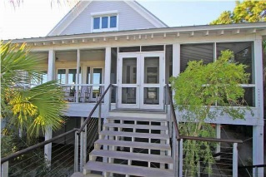
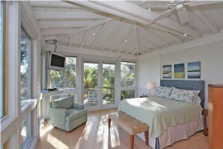
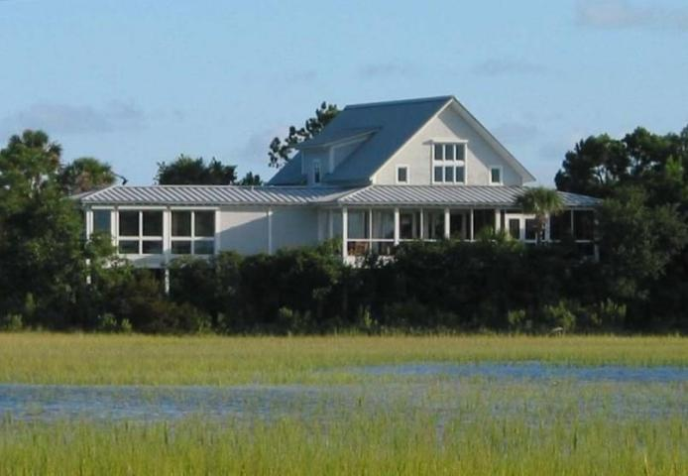
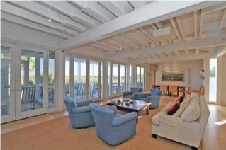
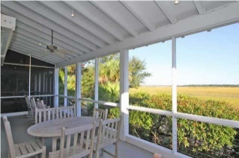
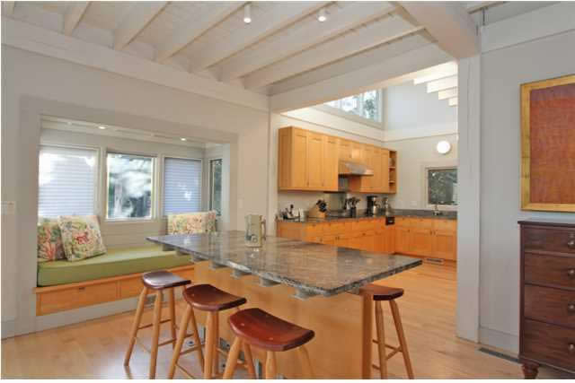
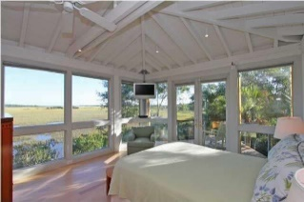
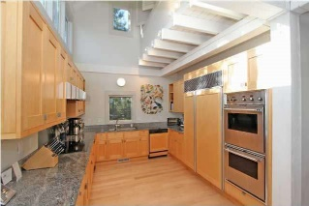
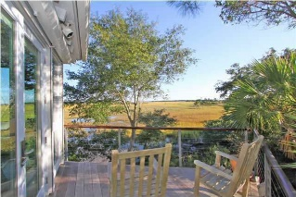
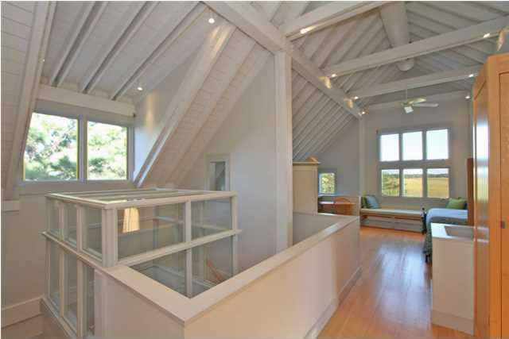
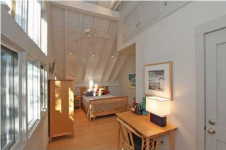
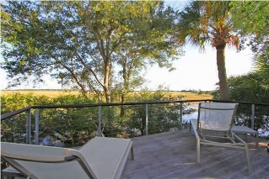
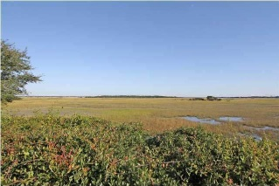
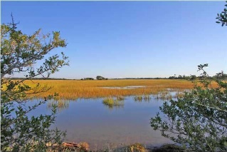


23 Seagrass Lane Wild Dunes - Isle of Palms MLS# 1425726 - $1,599,000
Breathtaking Panoramic Views
PRIVACY WITH BREATHTAKING PANORAMIC MARSH/WATER VIEWS and Dewees Island! This post and beam construction is a custom design by the famous Architect, Peter Bohlin, recipient of the 2010 American Institute of Architects Gold Medal and designer of a portion of Bill and Melinda Gates' home and the Apple Store on Fifth Avenue in NYC. This very private home is surrounded by marsh and is situated on Seagrass Lane culd-es-ac. When you step out of the car you will hear 'silence'. Upon entering 23 Seagrass you will see walls of glass doors with expansive marsh views, high ceilings and maple floors. The gourmet kitchen features Sub Zero refrigerator with custom panels, stainless steel appliances, granite counters and double wall ovens. This home was built for relaxing and entertaining. The kitchen island/table that seats 6, the window seat, and the dining room all are open to the living space with doors opening to bring the outside in from the covered porch or the screen porch. Give your entertaining that extra punch with the 90'', front projection HDTV screen and surround Bose speakers. Wake up to equally beautiful views in your main floor master bedroom. The abundant closet space and exceptional storage in this home is fabulous and definitely custom. Additional custom features include a 3 stop elevator, Ipe decking, outdoor hot water shower and hurricane shutters. This home is perfect for a primary residence or 2nd home. Gross vacation rental income for 2014 was $76,938. Come and relax at 23 Seagrass Lane, Wild Dunes.
Darlene Smith Office - (843) 886-8110
Mobile - (843) 696-7824
darlenesmith@carolinaone.com
DarleneSmithTeam.com
Carolina One Real Estate
1503 Palm Blvd Ste
Isle of Palms, SC 29451

