Slide 1
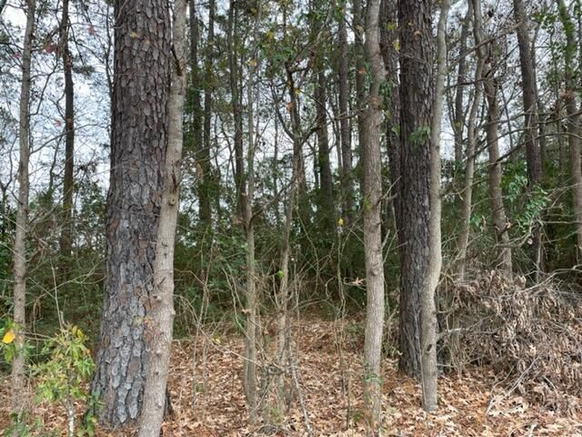
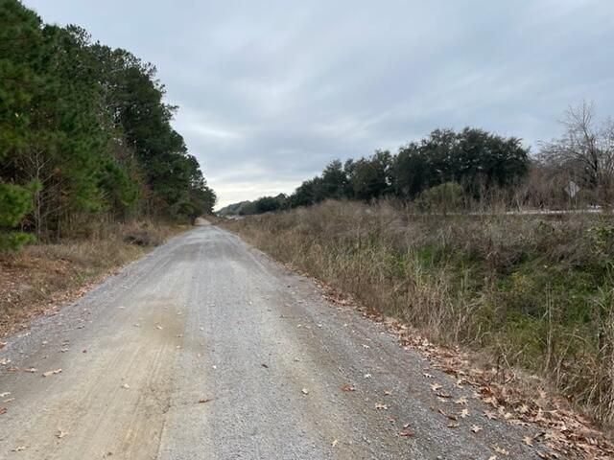
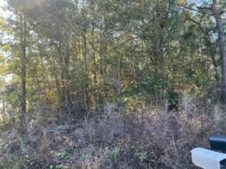

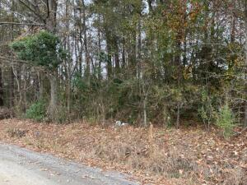
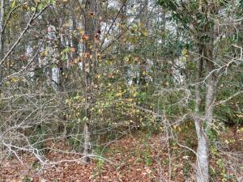
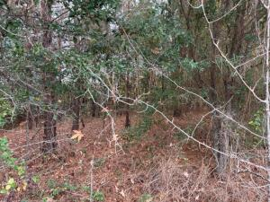
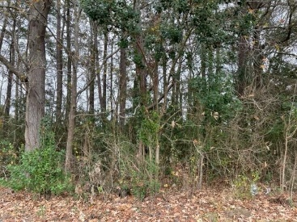

Vacant Lot In Goose Creek
Reduced!
Lot 23 Dennis Drive
Boulder Bluff · Goose Creek, SC 29445
MLS# 21032432 · $25,000
Michael Dew
O 843-769-5100
M 843-870-7000
michaeledew@gmail.com
www.michaeldewrealestate.com
Vacant lot in heart of Goose Creek.
.14 acres raw land.
AgentOwned Charleston Group
902 Savannah Hwy
Charleston, SC 29407
Real Estate ● Mortgage
Insurance ● Business Brokerage

