Slide 1
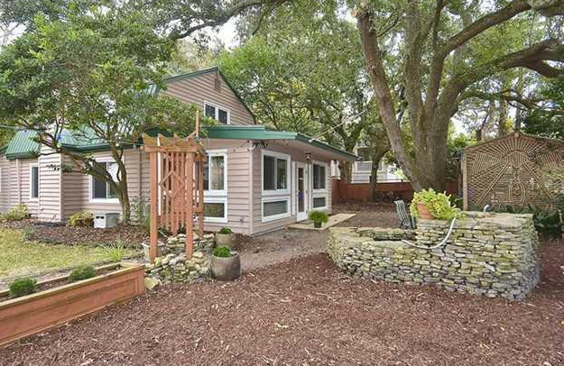
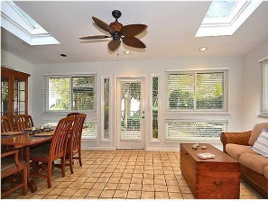
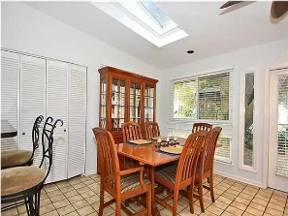
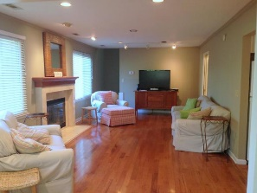
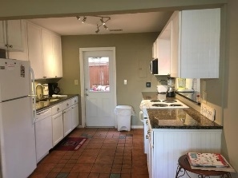
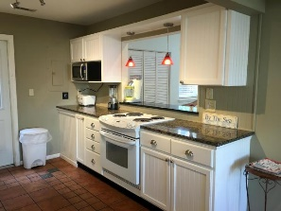
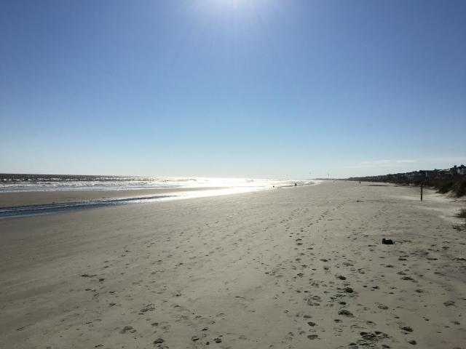
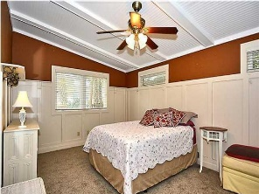
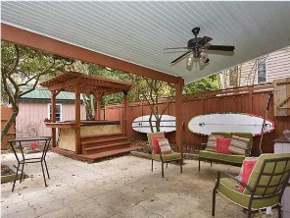
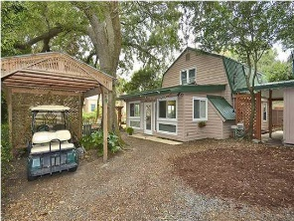
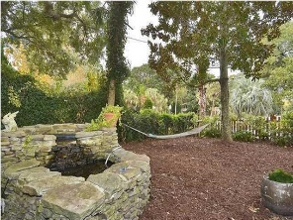
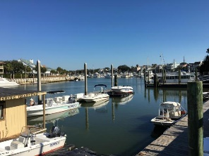



2400 Hartnett Boulevard
Isle of Palms, SC 29451
MLS# 16003024
$665,000
4 Bedrooms ▪ 2 Baths ▪ 1,919 sq. ft.
Just Listed on Isle of Palms
Great family home, second home or Vacation Rental!
Just Reduced!
Charming Beach House Only Two Blocks from the Beach! A great family home, second home, or a vacation rental (VRBO). Four bedrooms with master suite on the main level, 2 full baths, dining/sunroom with skylights, family room with hardwood flooring, and renovated kitchen with granite counter tops. Featuring a private covered courtyard for outdoor seating, grilling and dining. A pergola, outdoor shower, a stacked stone fountain, two storage sheds for bikes, surf boards, beach chairs and tools. A custom golf cart storage area, fenced corner lot yard, oak trees, palm trees, and lots of other vegetation. Located a short walk or bike ride to the beach, to the new Harris Teeter, Isle of Palms Marina, shopping and dining.
Jennifer Nipper, Realtor®
(843) 478-1800 | jen@AgentOwned.com
www.AgentOwned.com
The AgentOwned Realty Co | 824 Johnnie Dodds Blvd | Mt. Pleasant, SC 29464
Real Estate • Mortgage • Insurance

