Slide 1
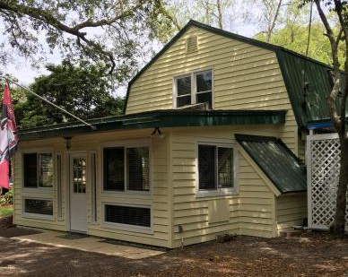
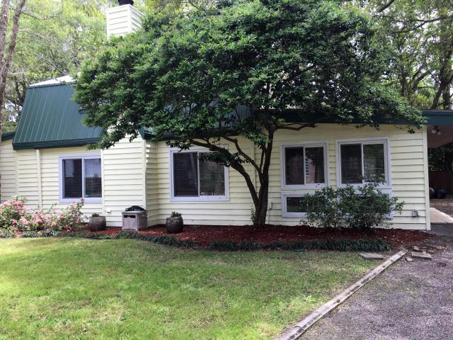
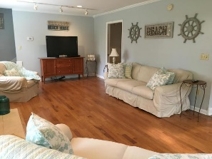
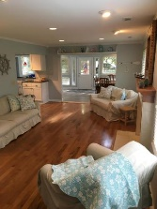
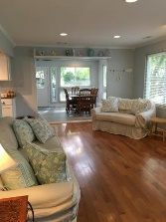
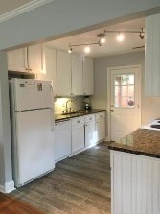
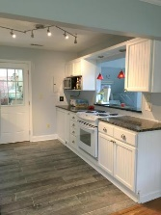
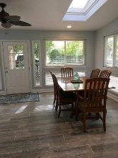
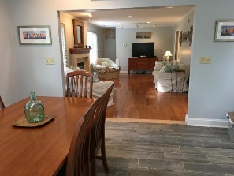
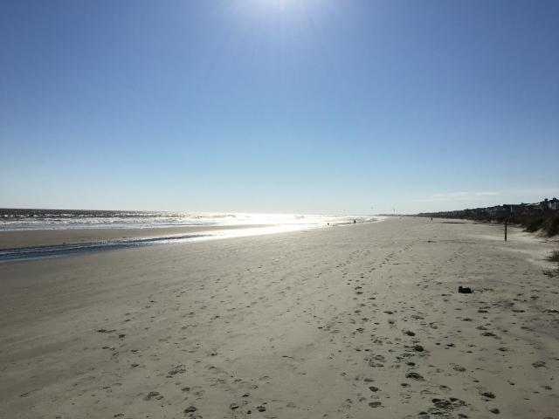
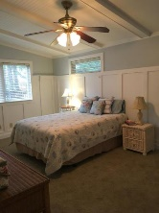
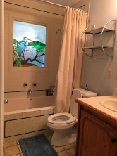
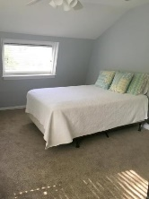
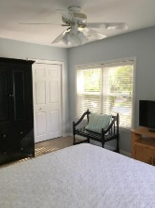
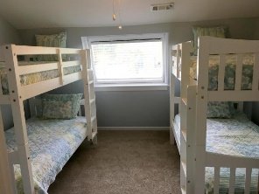
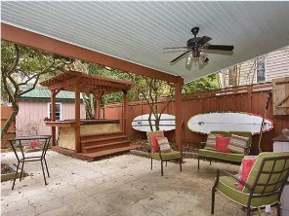
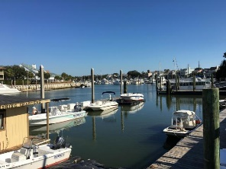



2400 Hartnett Boulevard Isle of Palms, SC 29451 MLS# 16003024 $629,900 4 Bedrooms ▪ 2 Baths ▪ 1,919 sq. ft.
Seller Said Get It Sold!
Great family home, second home, or vacation rental!
Just Reduced!
This charming beach house is only 2 blocks from the beach and centrally located to restaurants, shopping, recreation center and the marina. A great family home, a second home for beach getaways, or a vacation rental (VRBO). This is a 4 bedroom home with the master suite on the main level, 2 full baths, dining/sunroom with skylights, large family room, kitchen with granite counter tops, and an office. Recent renovations to include new flooring in dining/sunroom and kitchen, entire interior has been freshly painted including ceilings, walls, trim, and all doors, and new front and back doors. The exterior of the house has just been painted with additional renovations still underway. Fencing will be painted white. Beautiful large lot with 9-10 palm trees, Crepe Myrtles. Outdoor dining area would be a great outdoor kitchen/bar renovation! A custom golf cart storage area, fenced corner lot yard, oak trees, palm trees, and lots of other vegetation. Located a short walk or bike ride to the beach, to the new Harris Teeter, Isle of Palms Marina, shopping and dining. This is island living at its best! Furnishings are negotiable.
Jennifer Nipper, Realtor®
(843) 478-1800 | jen@AgentOwned.com
www.AgentOwned.com
The AgentOwned Realty Co | 824 Johnnie Dodds Blvd | Mt. Pleasant, SC 29464
Real Estate • Mortgage • Insurance

