Slide 1
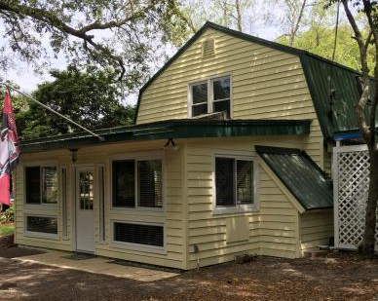
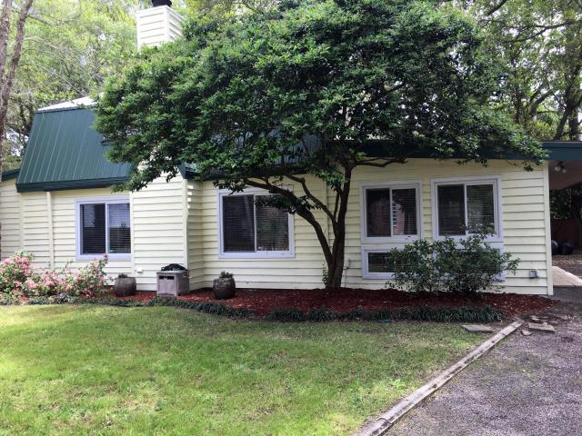
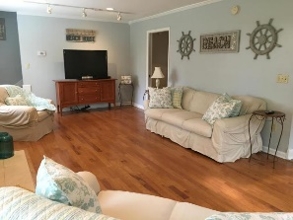
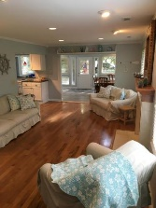
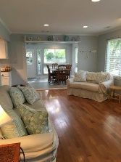
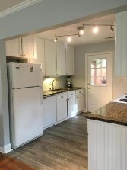
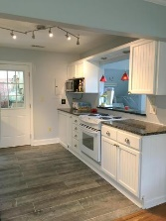
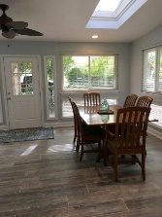
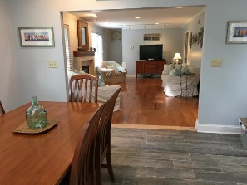
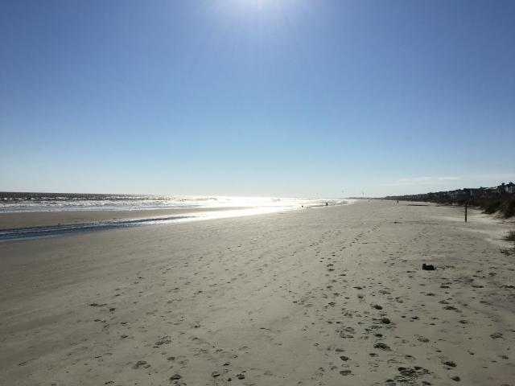
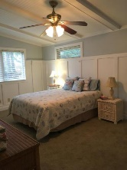
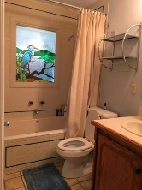
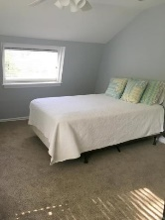
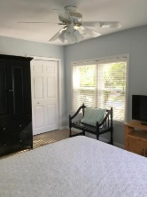
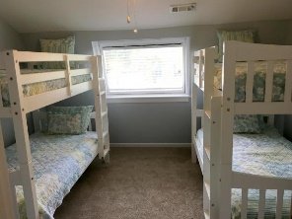
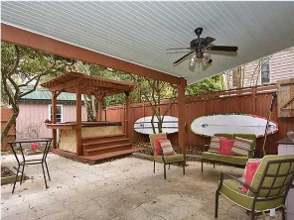
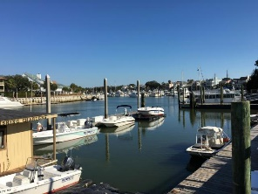



2400 Hartnett Boulevard
Isle of Palms, SC 29451
MLS# 16003024
$629,000
4 Bedrooms ▪ 2 Baths ▪ 1,919 sq. ft.
Isle of Palms
Island Living at it’s Best!
This charming home is 2 blocks from the beach. A great family home, a second home for island getaways, or a vacation rental (VRBO). This is a 4 bedroom, 2 bath home with dining/sunroom, large family room, kitchen with granite and an office. Recent renovations to include new HVAC, new flooring in dining/sunroom and kitchen, entire interior has been freshly painted including ceilings, walls, trim, and doors, and new front and back doors. The exterior of the house has just been painted and fencing will be painted soon. A beautiful, large lot with 2 storage buildings, a custom golf cart storage area, a Pergola and a covered patio for outdoor entertaining. There are 9-10 palm trees on this large corner lot, Crepe Myrtles, Jasmine, and more. Located a short walk, bike, or golf cart ride to beach, county park with lifeguards on duty during summer season, restaurants, shopping, the new Harris Teeter, Isle of Palms Marina and more.
Jennifer Nipper, Realtor®
(843) 478-1800 | jen@AgentOwned.com
www.AgentOwned.com
The AgentOwned Realty Co | 824 Johnnie Dodds Blvd | Mt. Pleasant, SC 29464
Real Estate • Mortgage • Insurance

