Slide 1
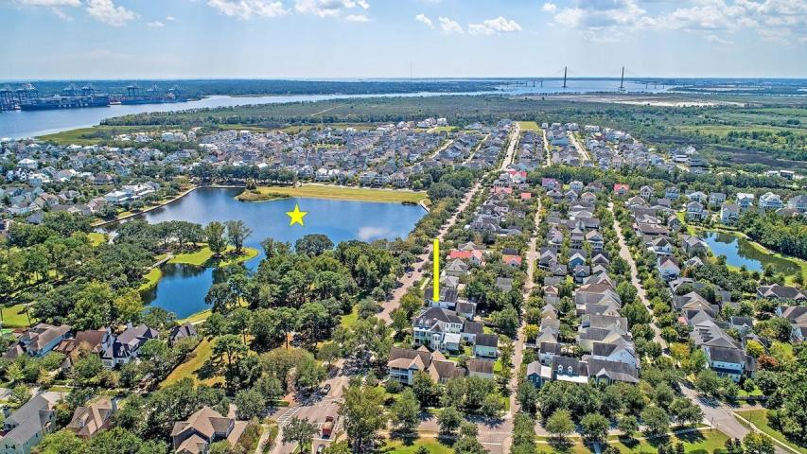
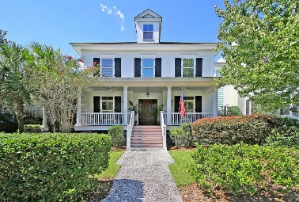
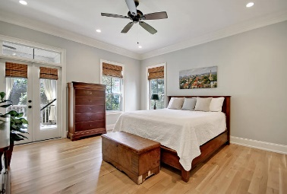
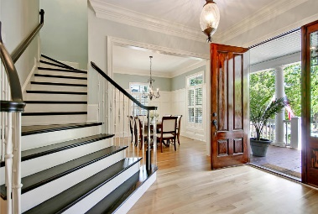
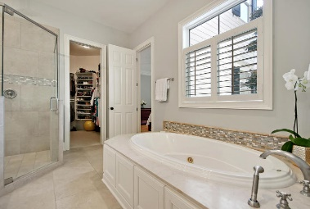
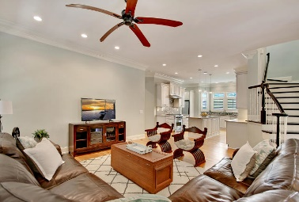
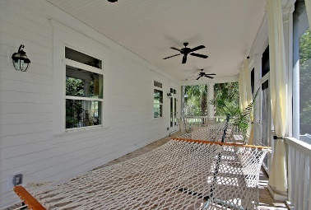
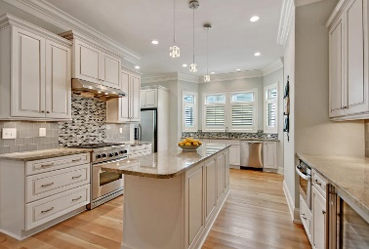
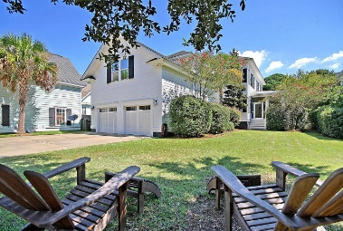
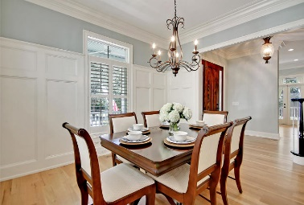
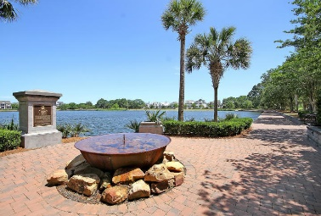
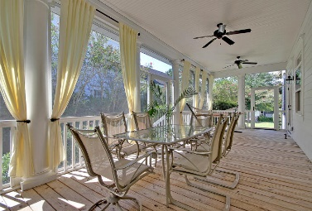
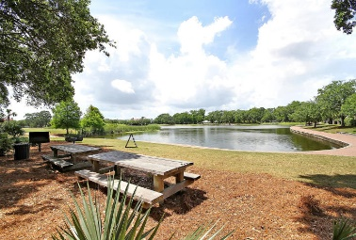
Great Downtown Investment Opportunity
Price Reduced!
2401 Daniel Island Drive
Daniel Island, SC 29492 ~ MLS# 18026062 ~ $1,050,000
In a single word, magnificent can be used to describe this home's location, layout and attention to detail. You can't get much closer than just across the street from the absolutely breathtaking Smythe Lake, the Pirate Park and walking distance to schools, 2 neighborhood pools and Daniel Island shops and dining. This two story home boasts a sun-drenched, open layout that features a first floor master suite, an inviting front porch, spacious, screened-in side porch and an amazing FROG that could serve as a mother-in-law suite with its own en-suite full bath. Gleaming hardwood floors, plantation shutters, crown molding, wainscoting, SS appliances, granite counters and beautiful tile work are among some of the high end finishes you'll find at your new home!
There is nothing left to do here except move in!
Additional features include:
Kitchen has a center island, gas range, tile backsplash, built-in wine fridge and built-in desk/study nook in the hallway leading to the garage
Master bath has a dual vanity, gorgeous walk-in shower, jacuzzi tub and walk-in closet
2nd level has a beautiful office area with built-ins
2 of the bedrooms (3 including the FROG) feature en-suite full baths
Cozy loft area between the bedrooms and FROG makes a great additional living space or kids playroom
Laundry room has a sink and built-ins
Tons of storage
Storm shutters on EVERY window (upstairs & downstairs)
Plenty of space for home office
Well manicured side yard
Book your showing today!
Book your viewing today!
Paige Rhodes 843-830-3281
paige@mattoneillteam.com
Ben Laaper 843-642-3546
ben@mattoneillteam.com

