Slide 1
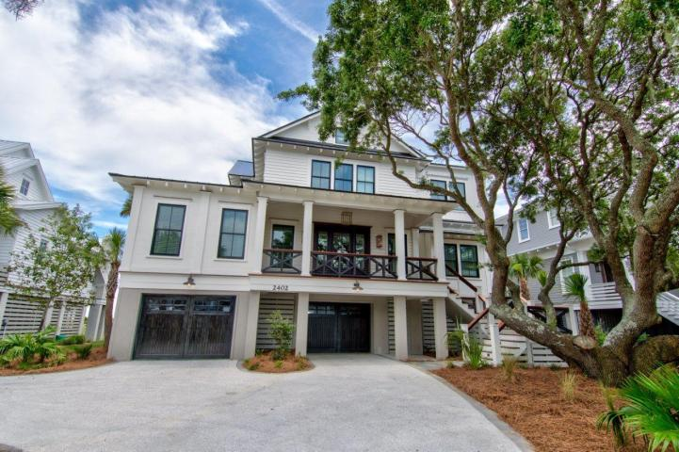
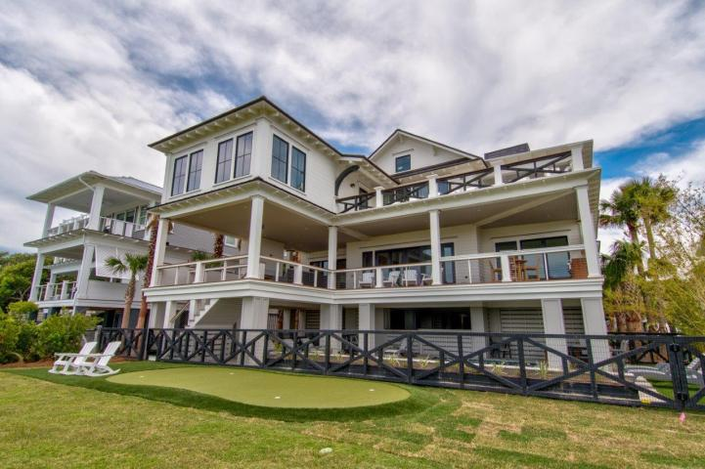
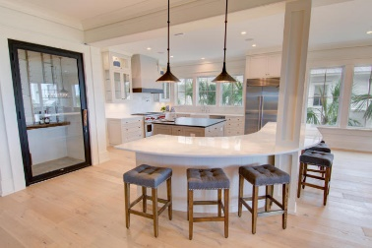
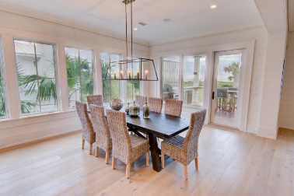
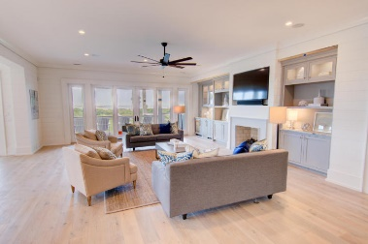
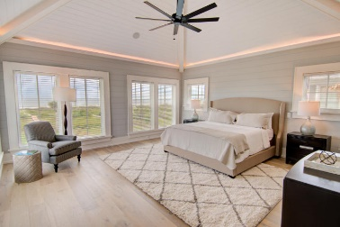
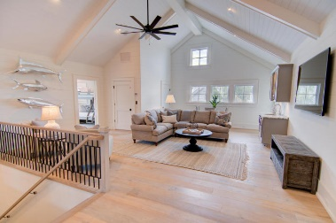
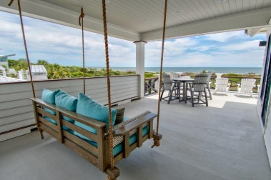
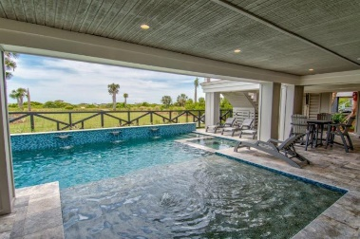
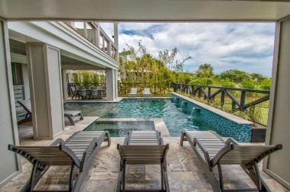


Potential Short Sale!
REALTOR HAPPY HOUR
Wednesday, June 21 from 11-6
2402 Palm Boulevard
Isle of Palms, SC 29451 ~ MLS# 16014857 ~ $5,989,000
Framed between a 100 year old live oak and stunning native palms, this Sullivan's Island style design by renowned architect, Carl McCants, boasts unobstructed panoramic views of the Atlantic Ocean. Situated on the most stable stretch of beach with no erosion issues, this IOP home has 6BRs, library/study/7thBR, wine room, and 600 sq. foot veranda w/fireplace. Custom interior trim carpentry, and shiplap walls prevail throughout this masterpiece. All luxury finishes including 48'' Wolf gas range, Sub-Zero Stainless Steel Refrigerator & Freezer, Wine Room, and elevator. Metal roof, outdoor living area w/fireplace, oceanfront master suite on main living level and a spectacular 2nd floor master suite w/vaulted ceilings and breathtaking panoramic views of the Atlantic Ocean.
Chuck & Edy Mimms
Cell 843-224-9507
Office 843-530-8100 www.sanddollarsc.com
www.facebook.com/Sanddollarsc
Sand Dollar Real Estate Group | 2205 Middle Street | Suite 203, Mailbox 2 | Sullivans Island, SC 29482

