Slide 1
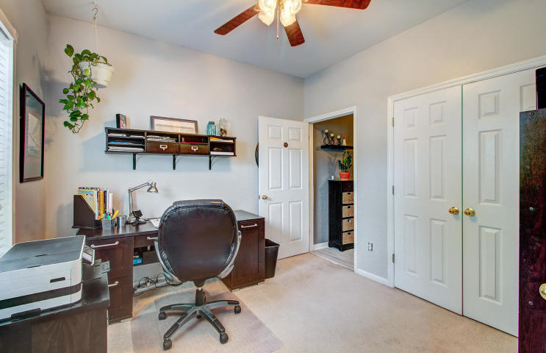
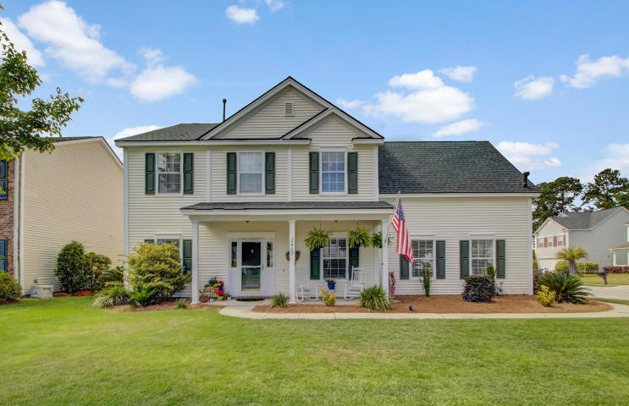
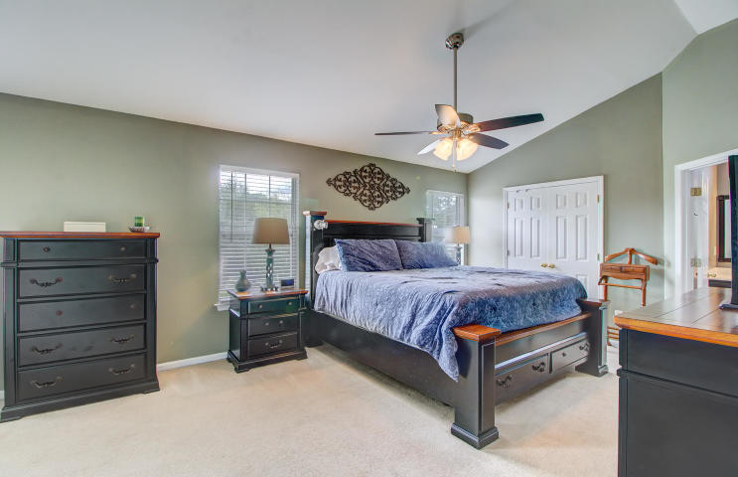
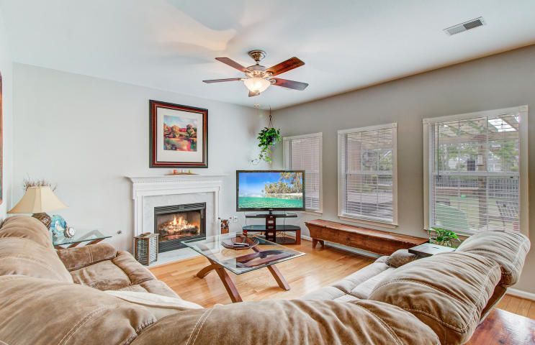
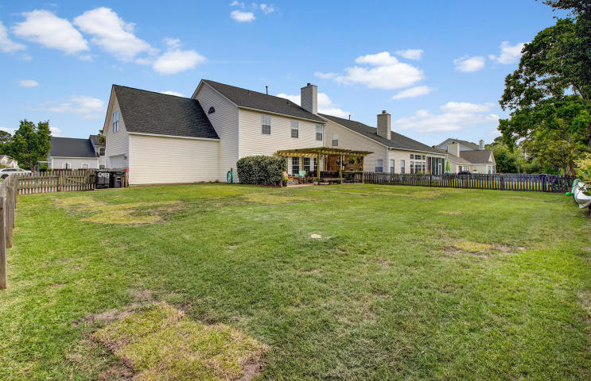
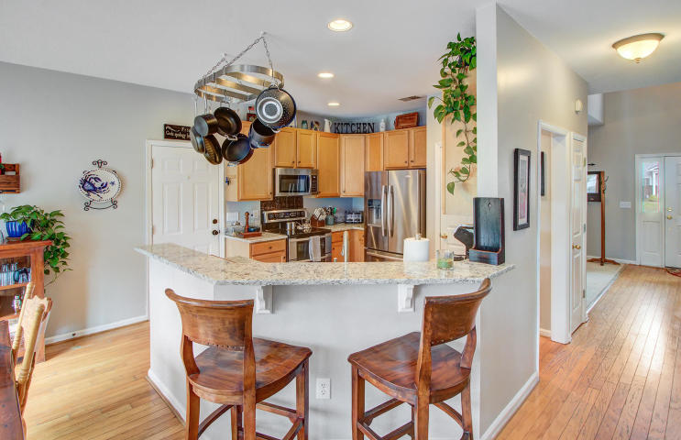
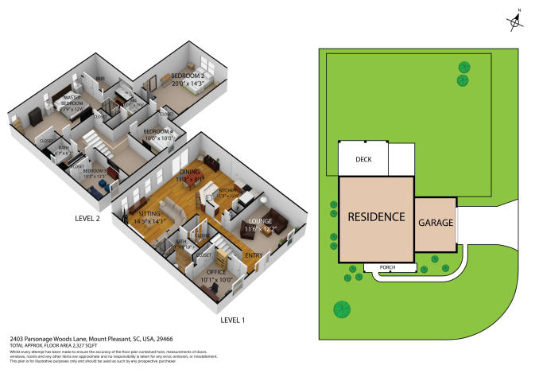


JUST LISTED!
Located in the beloved Arlington neighborhood in the heart of Park West
2403 Parsonage Woods Ln
Park West
Mount Pleasant, SC 29466
MLS# 20013289 | $430,000
5 bedroom home including a mother in law suite on first level. Kitchen has new granite and stainless steel appliances. Updated baths and new roof. HVAC is a mere 4 years old. Open concept kitchen and family room.
Awesome fenced in back yard with amazing patio- fire pit, sitting area and room for a hot tub.
Corner lot in Arlington at Park West, an easy bike ride to the neighborhood amenities and students attend award winning schools. 15 minutes to the beach and a short ride to Historic Downtown Charleston!
Check out the virtual tour here
https://my.matterport.com/show/?m=sYz9BSbKrFM
Ellen O'Neil
Broker/Owner, ABR, e-PRO, CNE
Charleston Realtor of Distinction
(843) 300-8530
www.EllenONeilProperties.com

