Slide 1
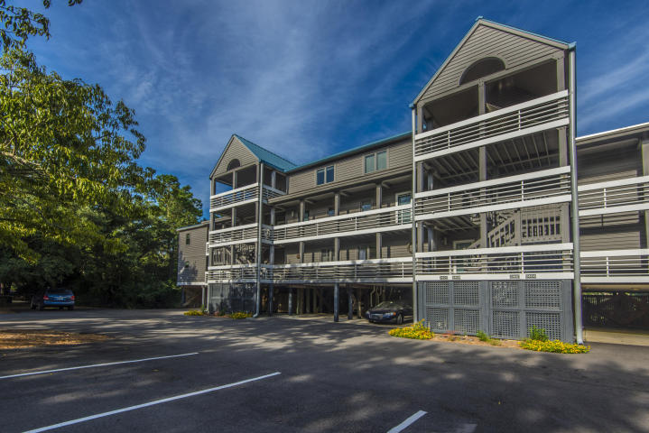
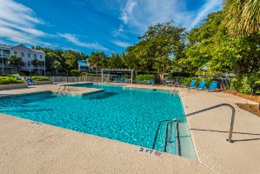
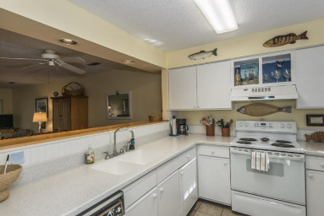
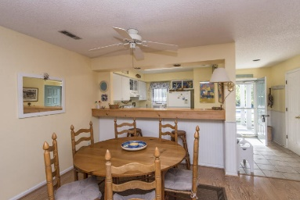
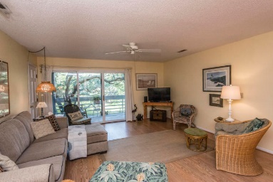
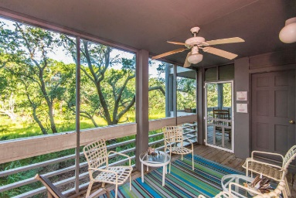
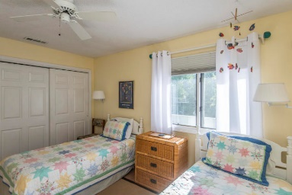
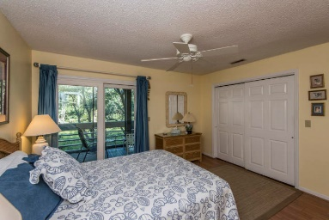
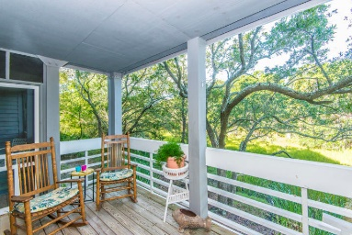



Price Improved Plus $2,000 Agent Bonus
2405 Racquet Club Drive
Seabrook Island ~ Johns Island, SC 29455
MLS# 18024869 ~ $189,900
Enjoy all the natural beauty of Seabrook from this RARE ONE STORY condo. You will appreciate the marsh views the moment you step in the front door. Open floor plan with 2 bedrooms and 2 full baths. Kitchen offers white cabinets with new countertops including custom bar top. Both bathrooms have been updated with new vanities. Bead board in foyer and kitchen. Plenty of outdoor space to appreciate your private views of marsh and wildlife with a balcony off living area AND screen porch off master suite. Move right in and enjoy all that Seabrook has to offer...Racquet Club Villas have their own beautiful pool w/ deck and Gazebo- 8 x 8 storage area plus carport area located under the building! Sold fully furnished! Walk to Lake House, Equestrian Center and Tennis!
Jennifer Frampton Pait
843-568-9509
jenniferfp@carolinaone.com

