Slide 1
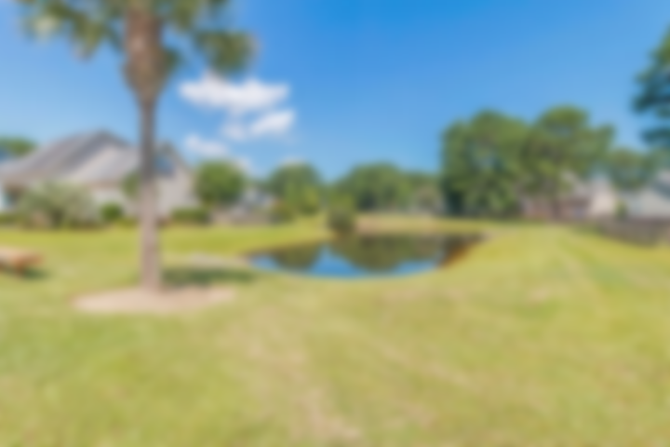
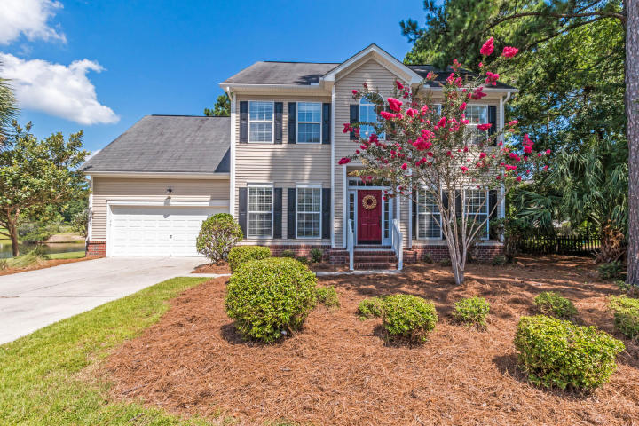
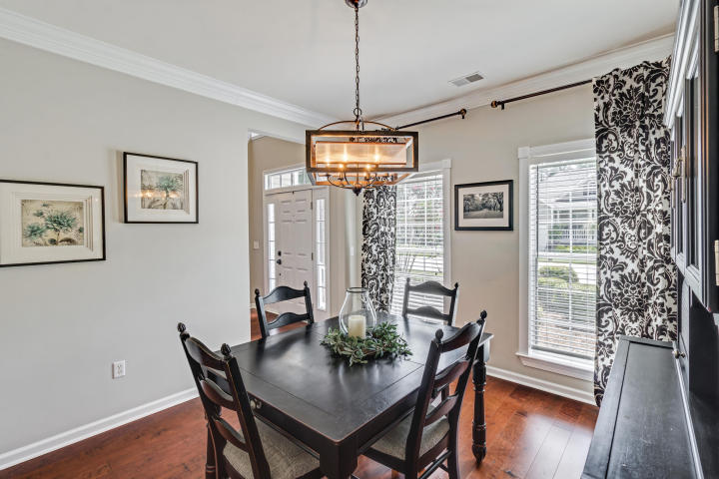
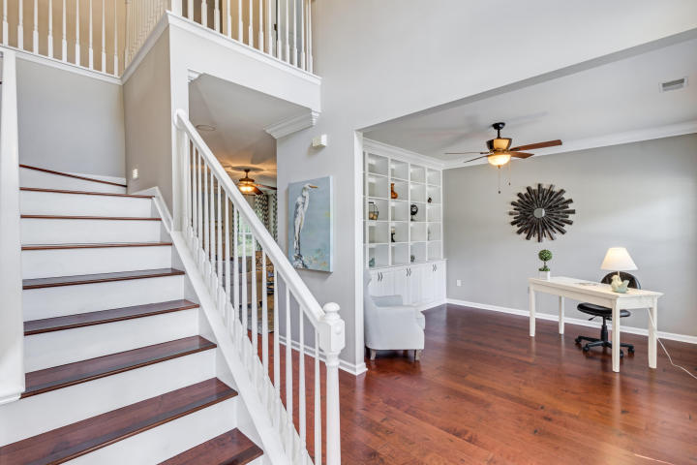
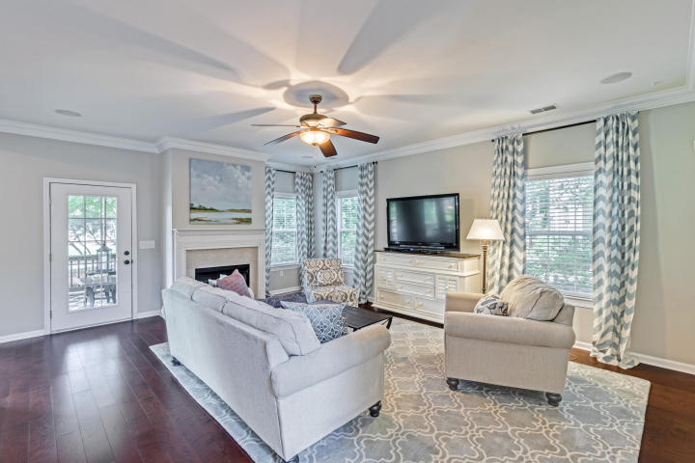
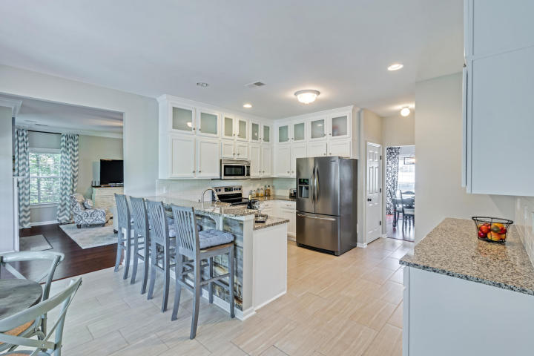
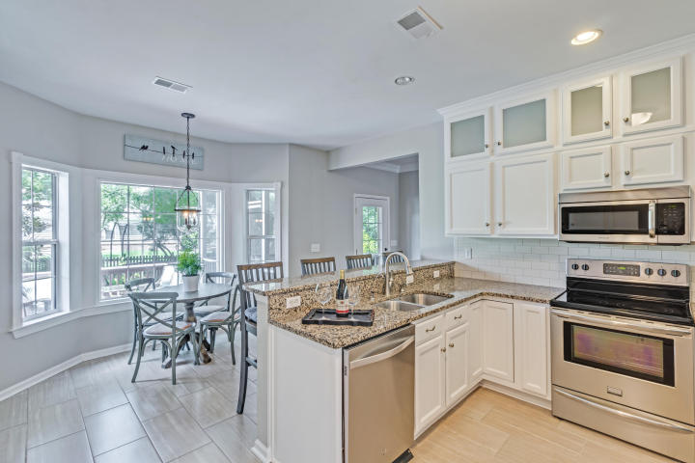
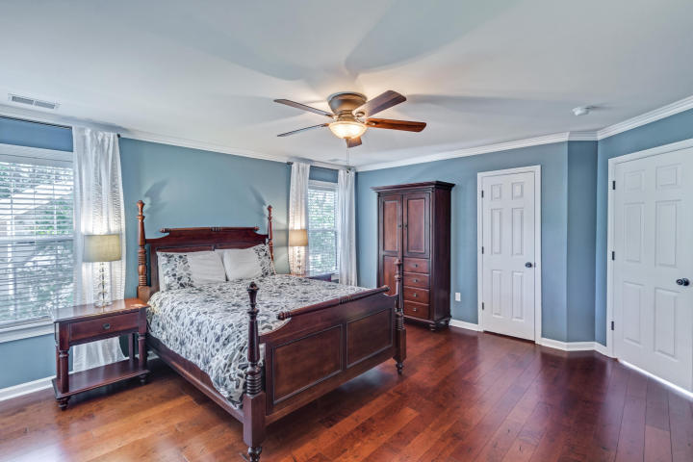
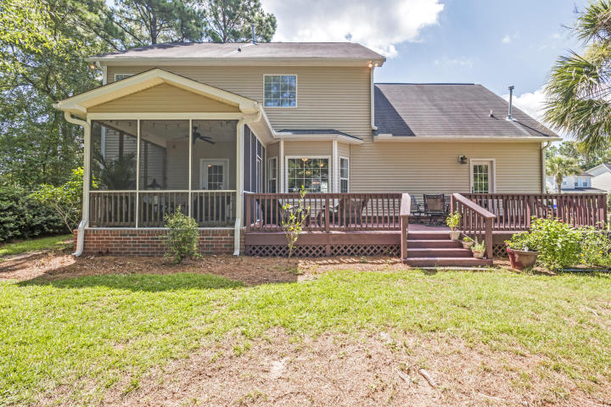
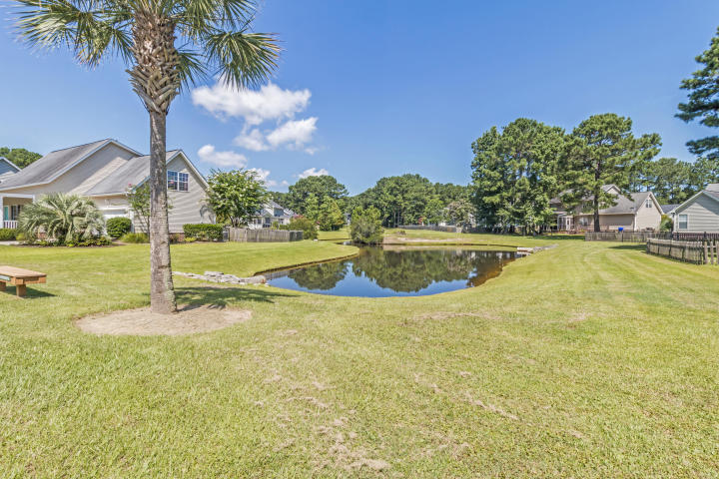
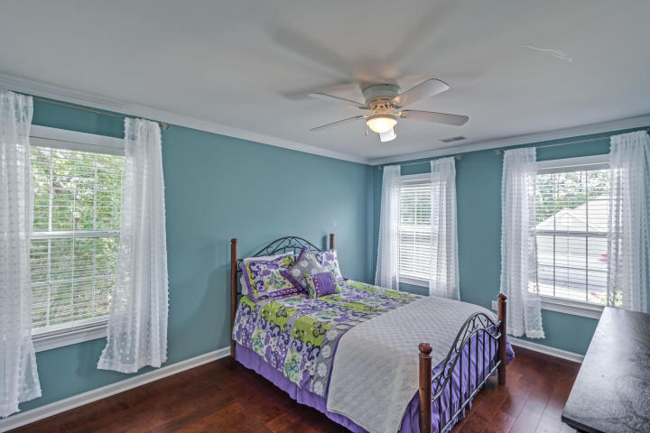
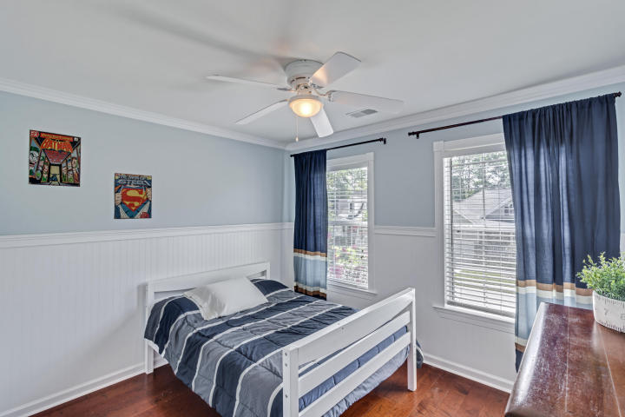
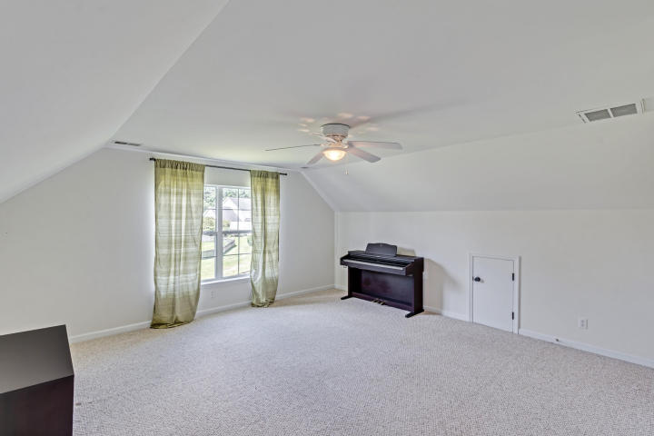
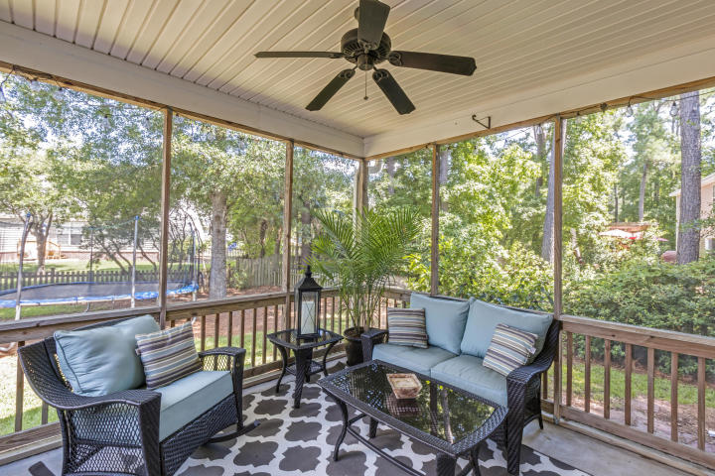
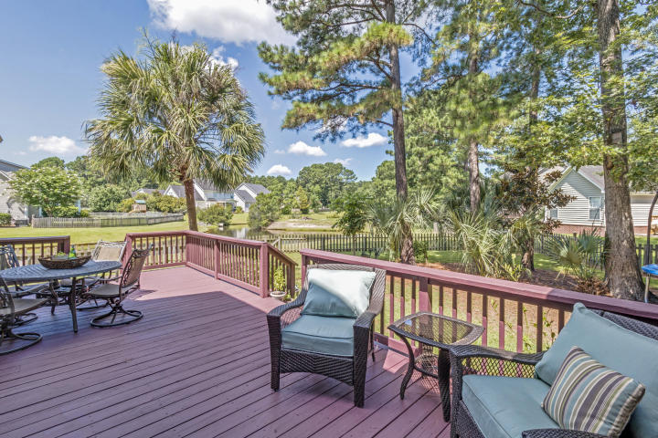
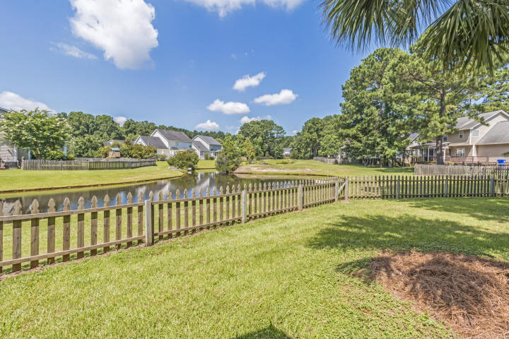
Price Reduced!
2407 Bergeron Way
Planters Pointe | Mount Pleasant, SC 29466
MLS# 17019267 | $449,000
Gorgeous move in ready home. Bergeron is located in the front of Rivertowne with easy in and out access, membership to the highly sought after Planters Pointe neighborhood pool, and you are still in the Pinckney/Cario/Wando school district. This home has a coastal flair, with a white kitchen with new custom cabinets to the ceiling, subway backsplash, granite counter tops and custom driftwood accents on the bar. As you enter the home, you are welcomed by 5'' hand scraped plank hardwood floors that you will see throughout. The office/living room space to the right has custom built in bookshelves and cabinetry. Plenty of windows throughout the downstairs that adds lots of natural light and views of your private fenced in yard with views of the pond. The upstairs offers plenty of space with 3 large bedrooms and a 4th with a built in murphy bed, that can be used as a bedroom or just an additional flex space. HVAC was replaced within the last 4 years and is solar ready. The deck was also just freshly painted. Come take a look at this beautiful home!
Catherine Parker
(843) 814-0551 | catherine@cpreco.com | www.cpreco.com
CP Real Estate Co. | 260 Hobcaw Dr | Mt. Pleasant, SC 29464

