Slide 1

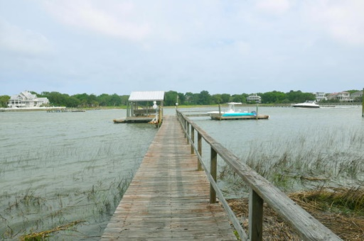
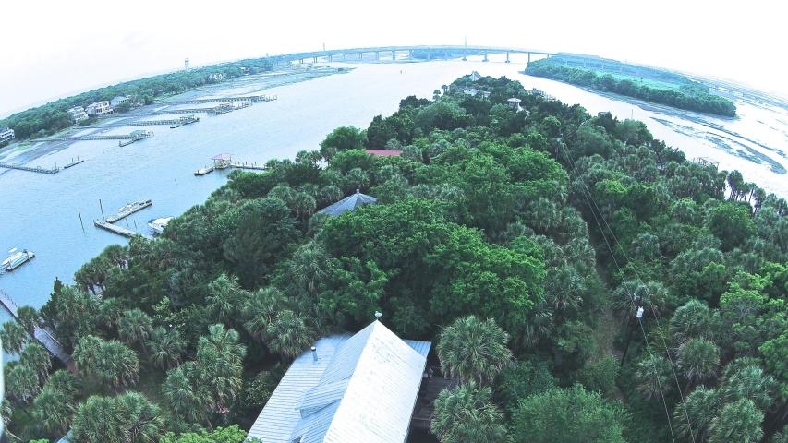
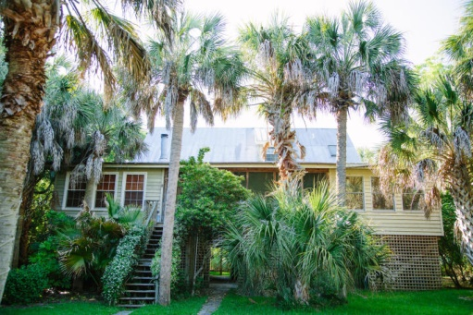
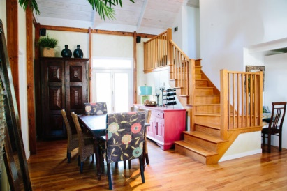
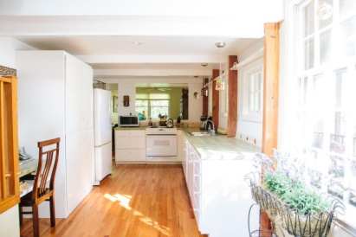
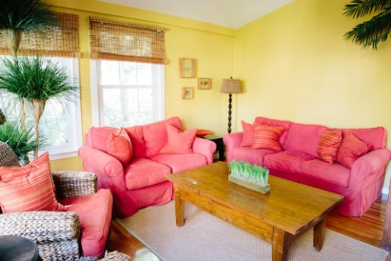
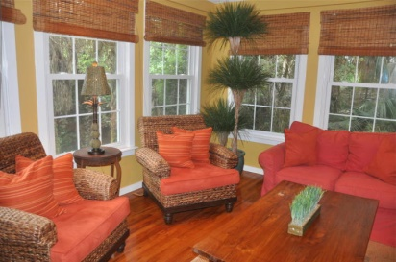
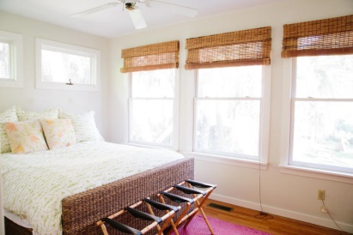
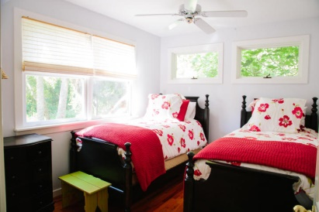
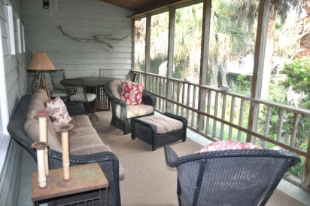
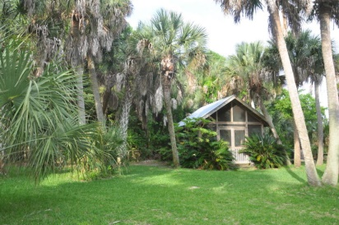

2407 Captain John Hutt Road
Goat Island
Isle of Palms
MLS# 15013766
$549,000
Unique opportunity to own a slice of paradise on Goat Island overlooking the Intracoastal Waterway just 2 minutes f/Isle of Palms Marina-10 minutes f/Wild Dunes-25 minutes from Historic Charleston priced $71K BELOW 2013 appraisal. Bring your friends & family & enjoy this beautifully furnished cottage w/4 BR's/2 BA's. It's a very special place! Enjoy outdoor living on the cozy screened porch or alfresco dining on the deck under the stars! The detached screened room next to fire pit offers another area to relax or entertain friends. Enjoy a nap in the hammock under the lush, tropical foilage or fish & crab right f/your own dock or walk to one of South Carolina's premier fishing creeks w/tons of Red Fish & Trout! Birdwatch, dolphin watch...occasionally spot a manatee while watching a sunset!
The home has beautiful hardwood floors throughout living areas & bedrooms with tiled baths & a thoughtful floor plan with 3 bedrooms on the main & the master suite upstairs. Vaulted ceilings in central dining area & master bedroom make the home feel spacious & open. There are wonderful areas to entertain depending on the mood. Build a fire in the fire pit and roast smores after a day of exploring. Get a game of Bocce going amidst friends in the regulation size Bocce court in the back yard. Enjoy dinner alfresco under the stars on the back deck or grill out & set up a feast in the screened gazebo that is near the water and dock. Catch dinner after a day of fishing to grill & bring some oysters to roast! This is a very special place only a few lucky persons get to call, "home." There is NO WHERE in the area where you can own a 4 bedroom home on the water for this price and be this close to Isle of Palms, Sullivan's Island, Mt. Pleasant and Historic Charleston! This home comes beautifully furnished and turn key with acceptable offer! You can boat over and enjoy staying here immediately and only have to bring some food, drinks and clothes! It has everything you need to live very comfortably including a washer and dryer, dishes, linens, indoor and outdoor furniture!
*This home also has a reverse osmosis purification system with two 1500 gallon storage tanks of purified water.
GQRE, LLC of Mt. Pleasant
677 Long Point Rd
Mt. Pleasant, SC 29464
www.GQRE.com
Donna Webb
Mobile - (843) 469-1110
donna@gqre.com

