Slide 1
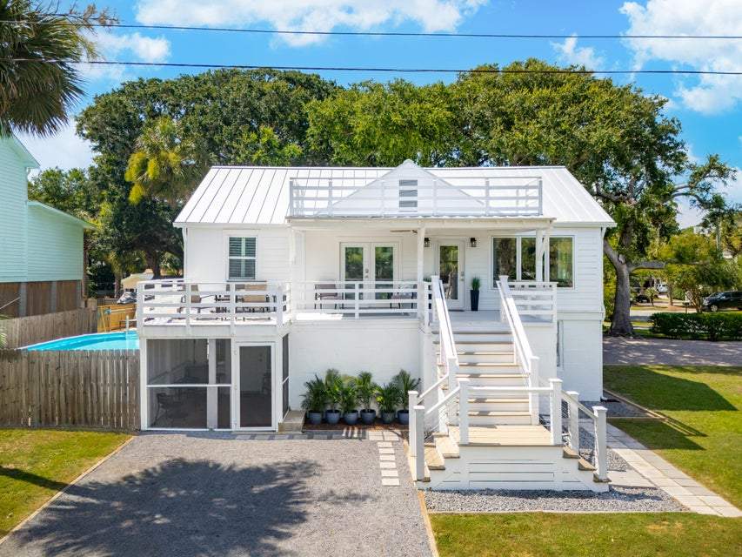
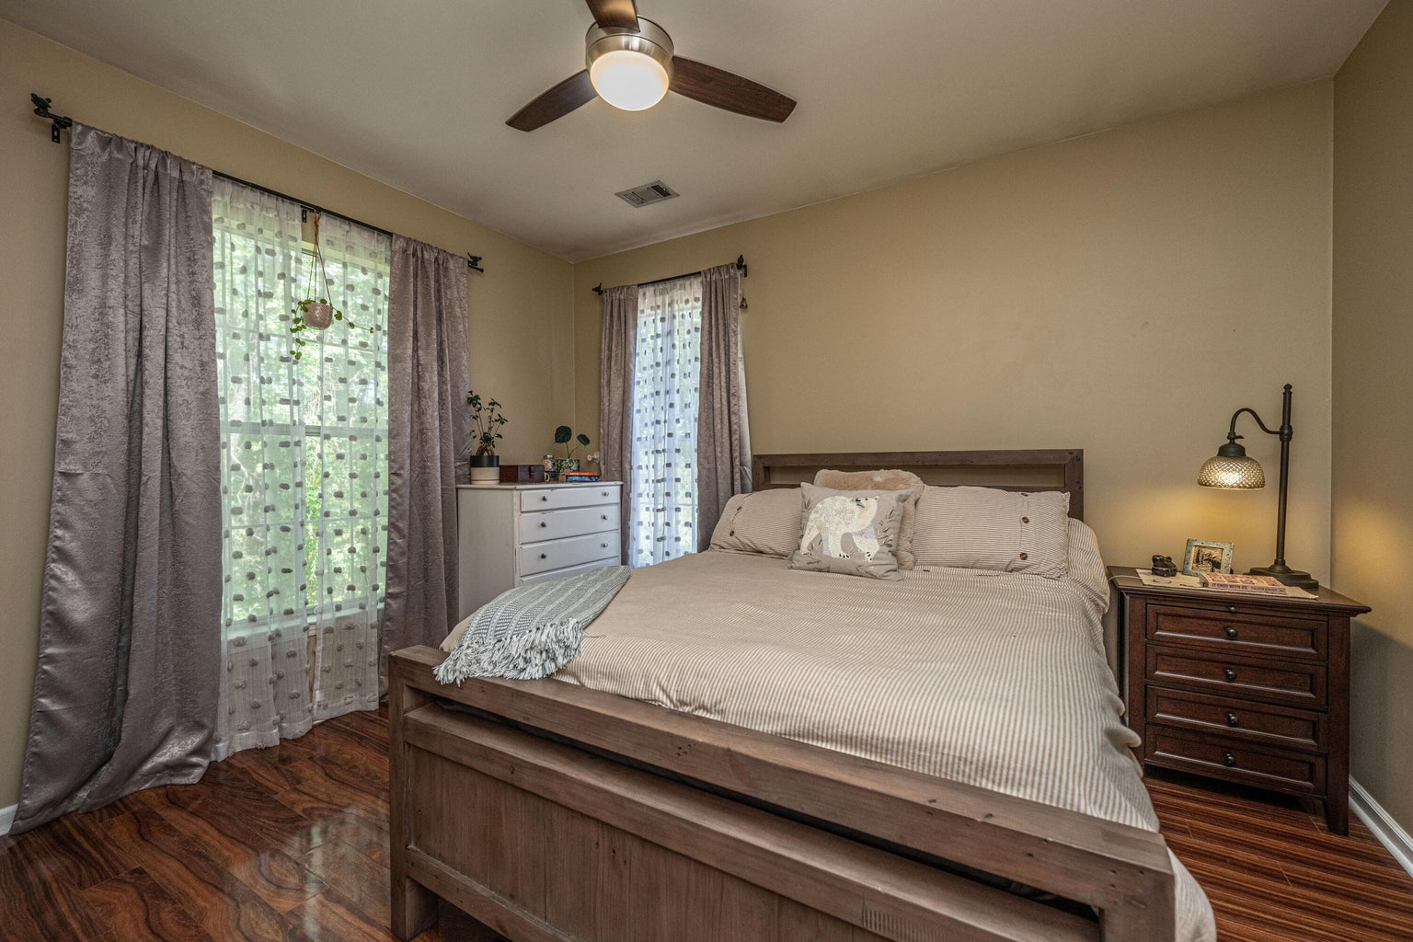
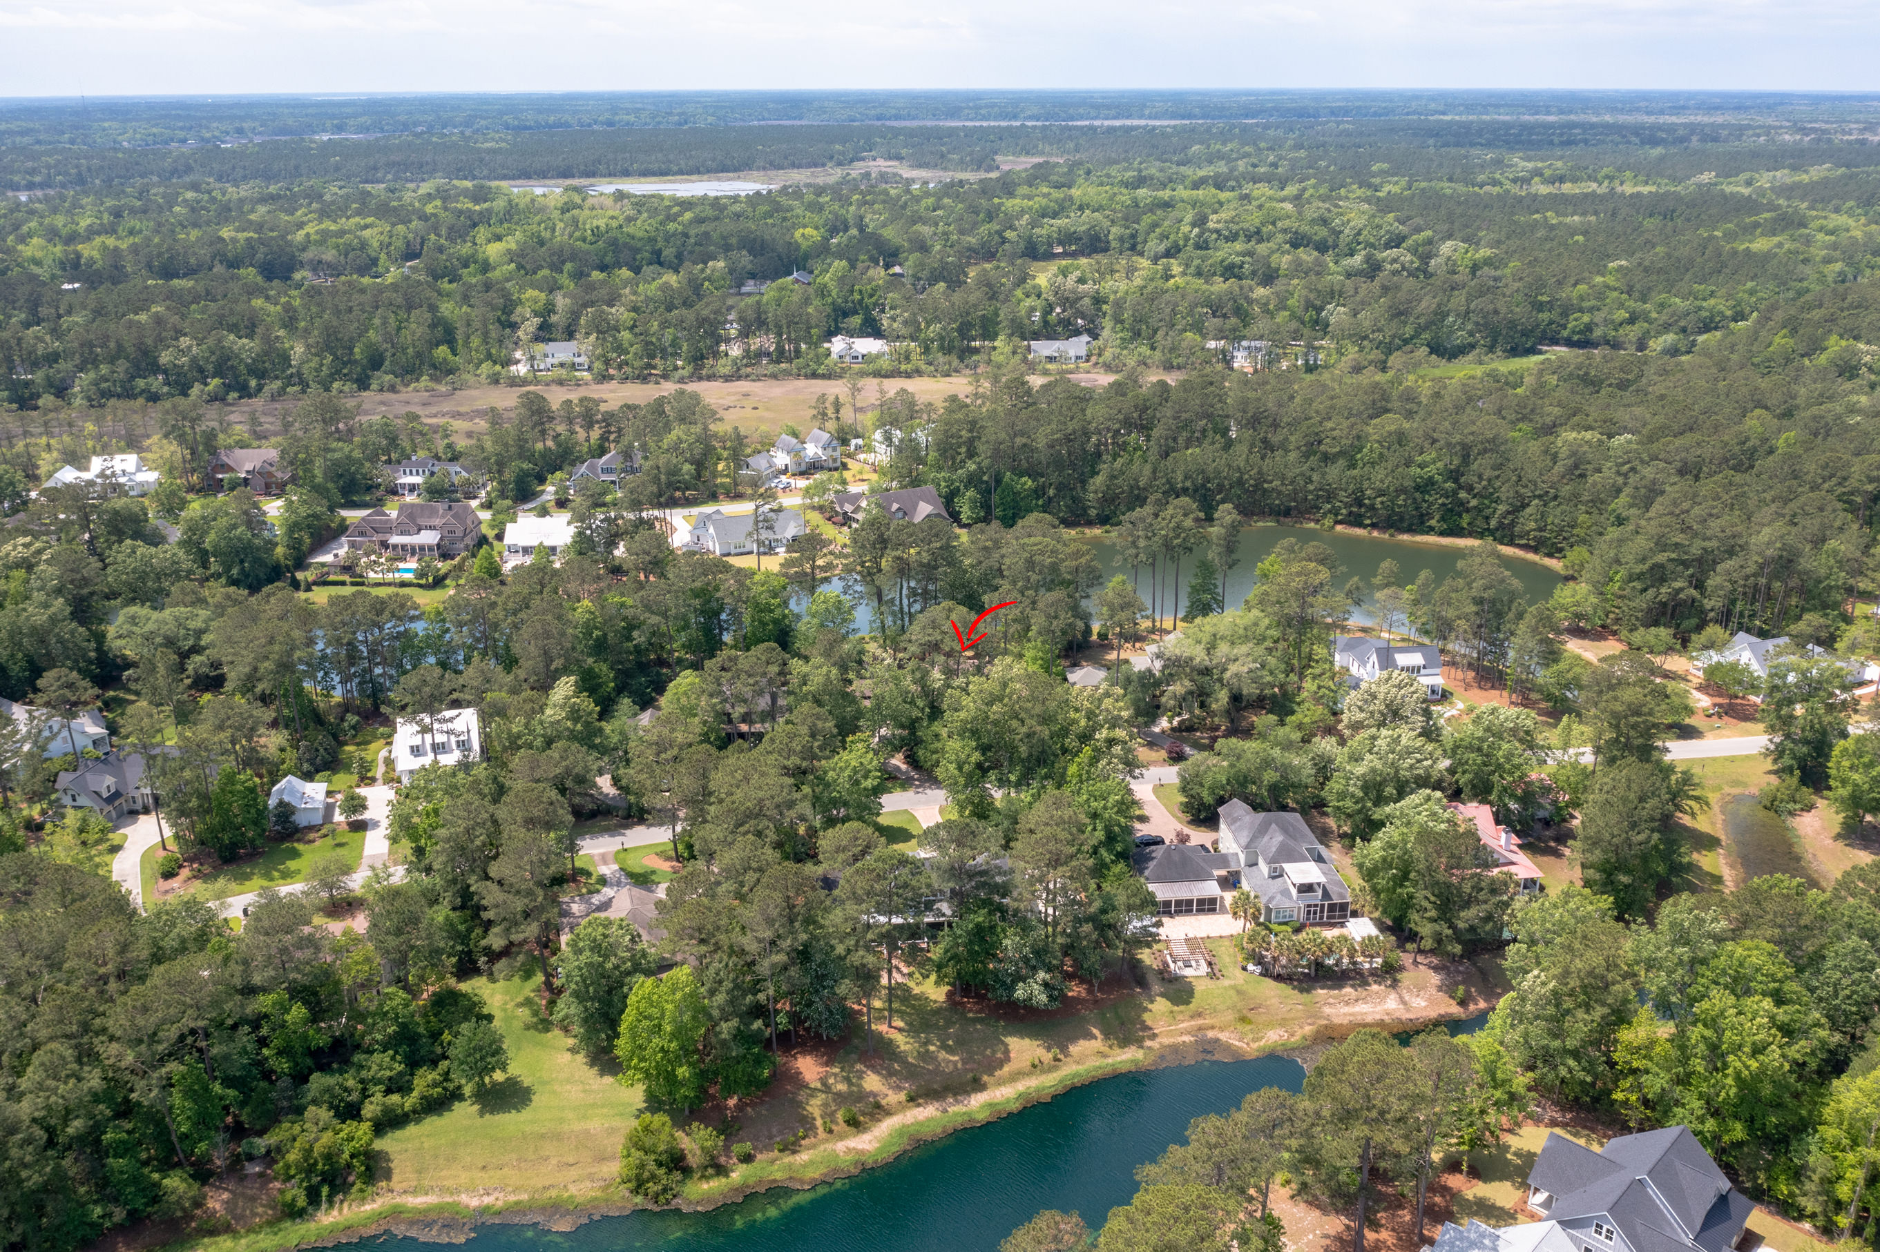
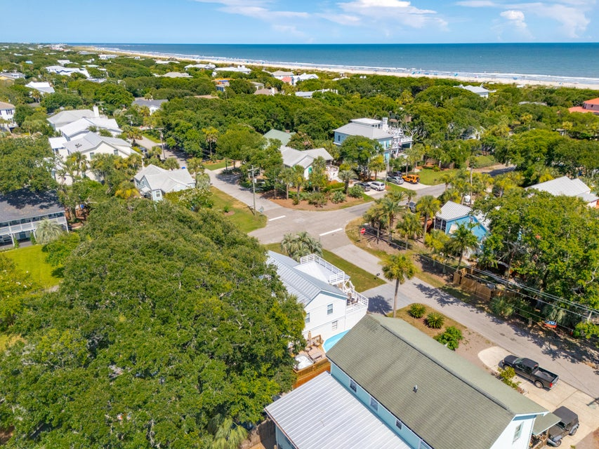
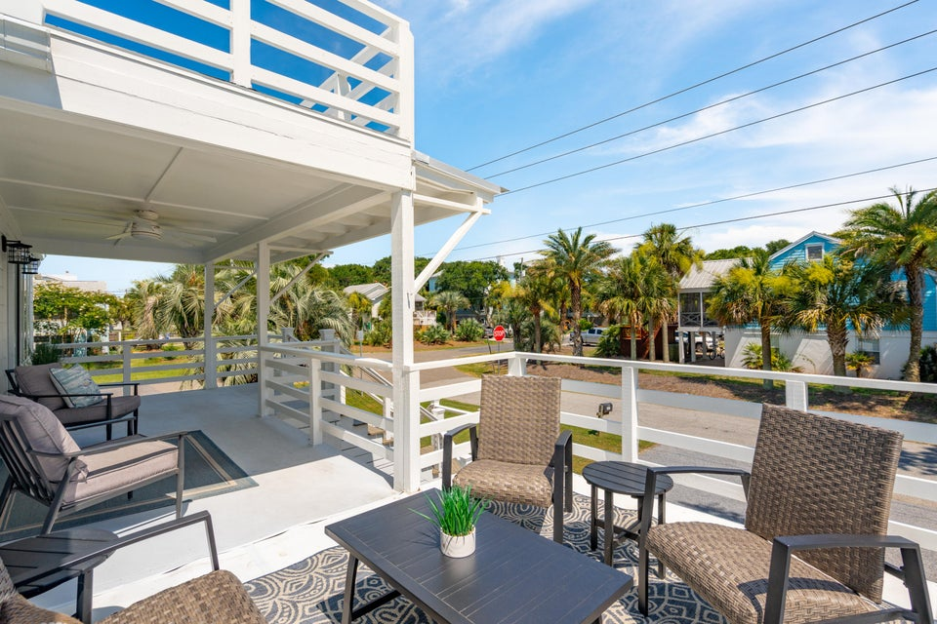
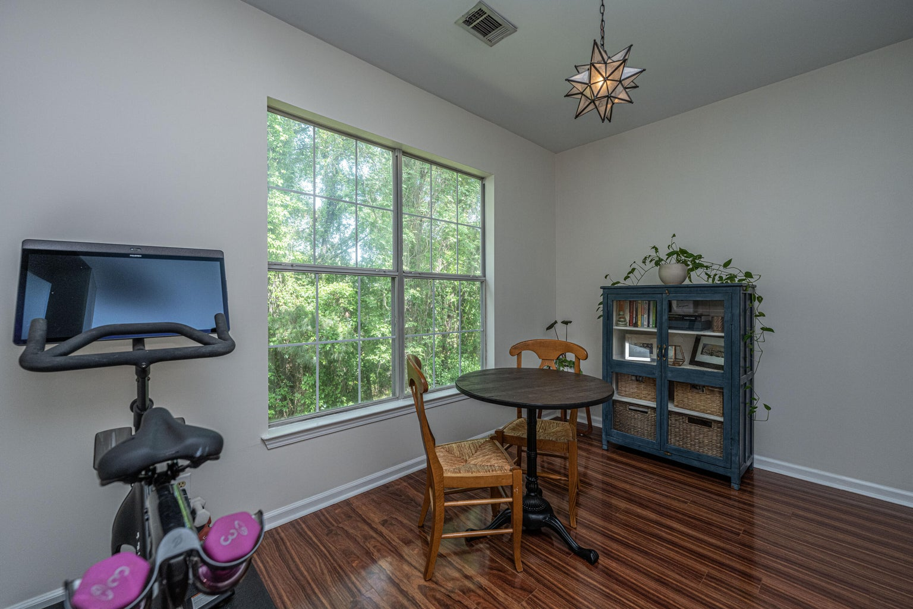
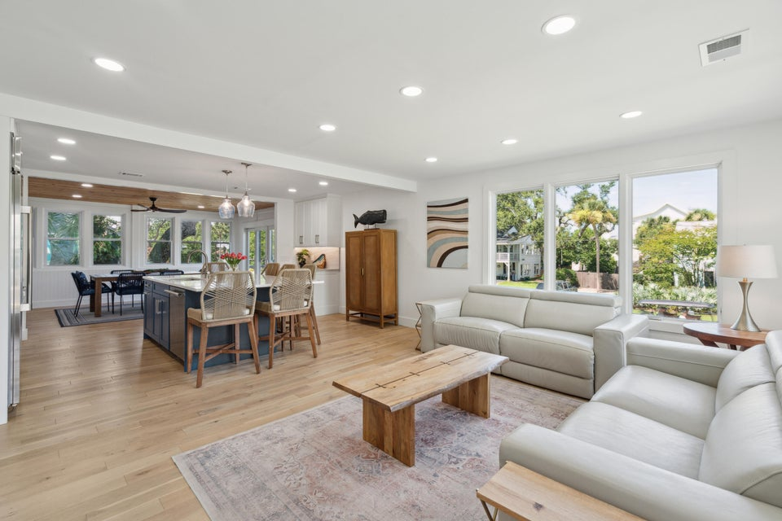
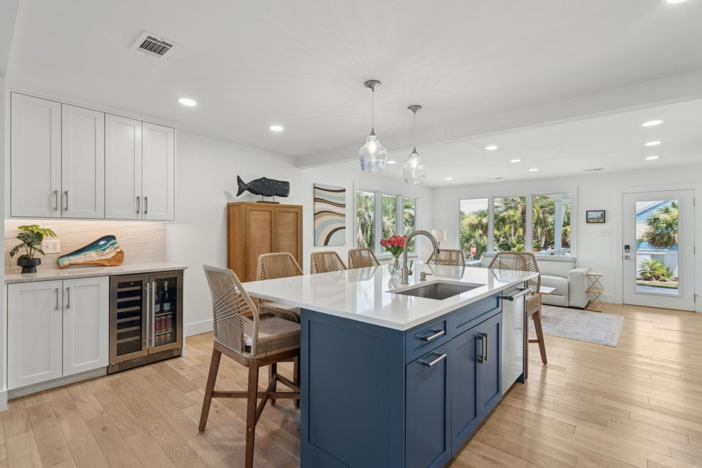



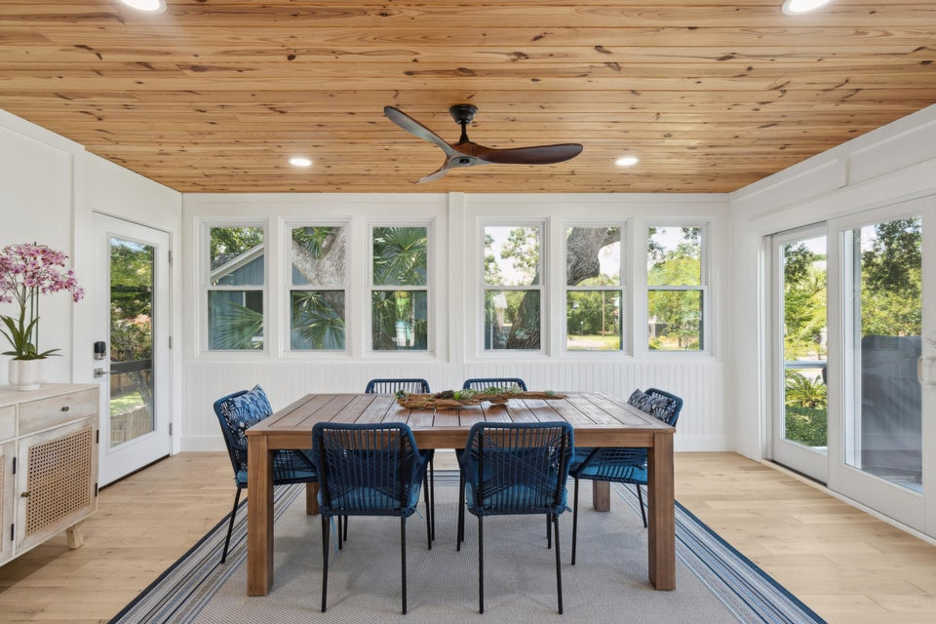
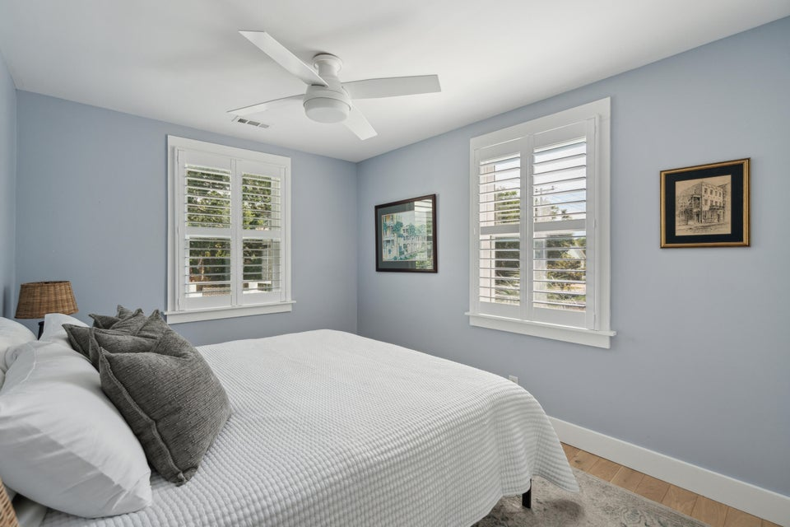
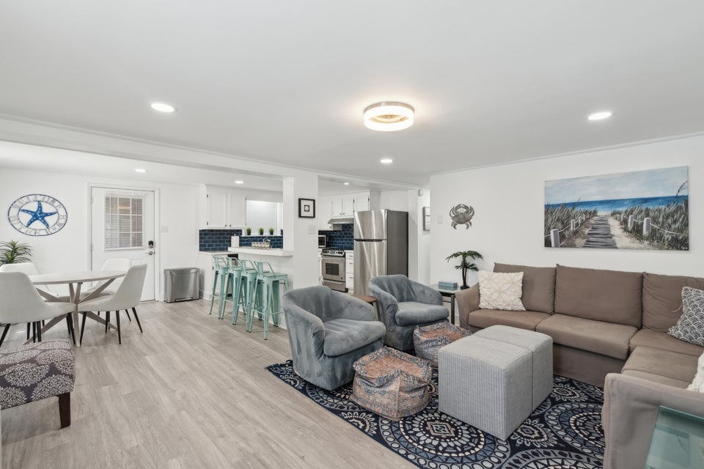
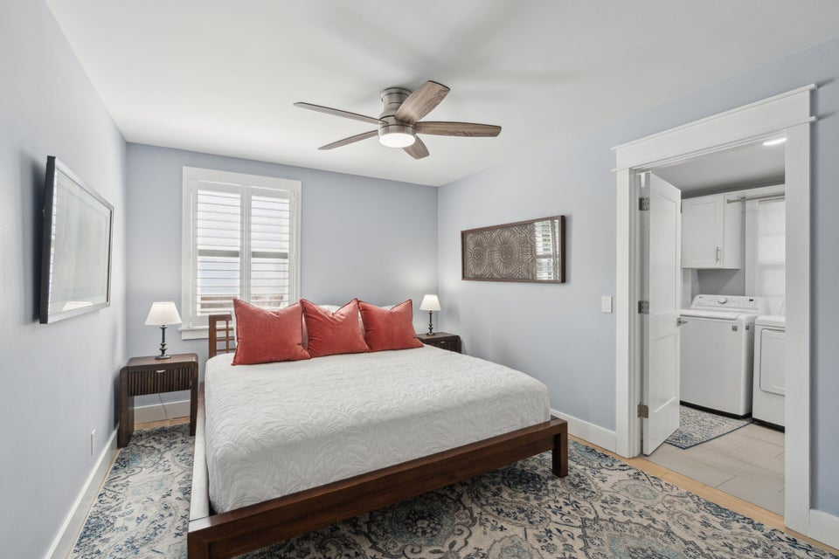
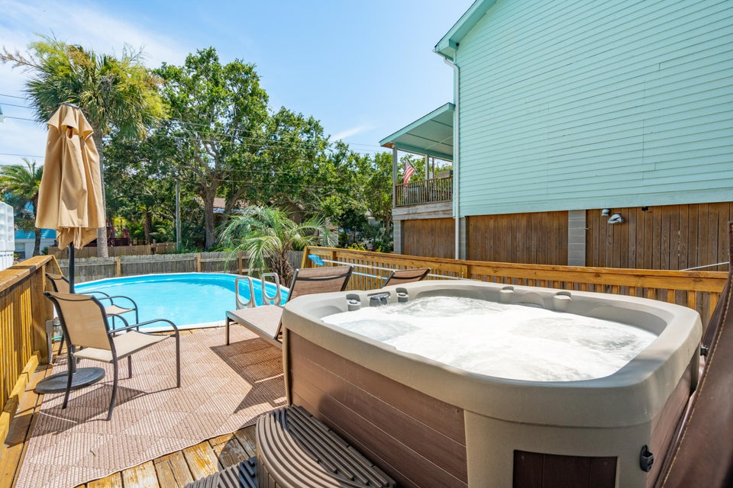



Steps from the Beach!
2407 Cameron Boulevard
Isle of Palms, SC 29451
MLS# 25018140 | $2,390,000
Beautifully Renovated Duplex on Isle of Palms
This stunning coastal duplex sits on a large corner lot just one block from beach access. A rare find, this original JC Long property has been fully renovated with modern finishes while retaining its island charm. With new roofing, flooring, kitchens, bathrooms, electrical, plumbing, a garage, and custom porches, this home is move-in ready with endless potential. Live in one unit and rent the other, create a dedicated guest or in-law suite, or convert to a spacious single-family home — the choice is yours!
Listing agent is the homeowner.
Reach out if you have any questions!
VIDEO TOUR | MLS LISTING
4
3
1,844
Waterfront Views
Dock Access Out the Back Door
Elevator Accessing All Levels
Massive Screened Porch
Spa-Like Primary Suite
Potential Second Suite or MILS
Jeanette Cornier
303.204.9694
jc@stishgroup.com
StishGroup.com

