Slide 1
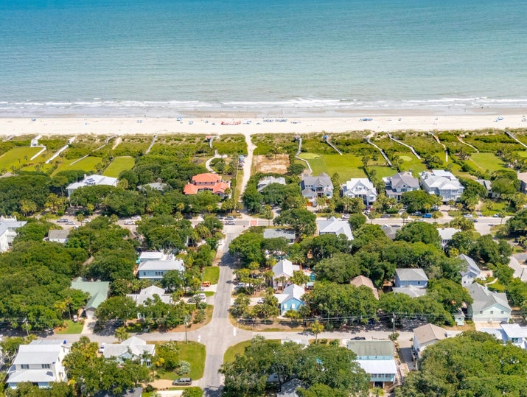
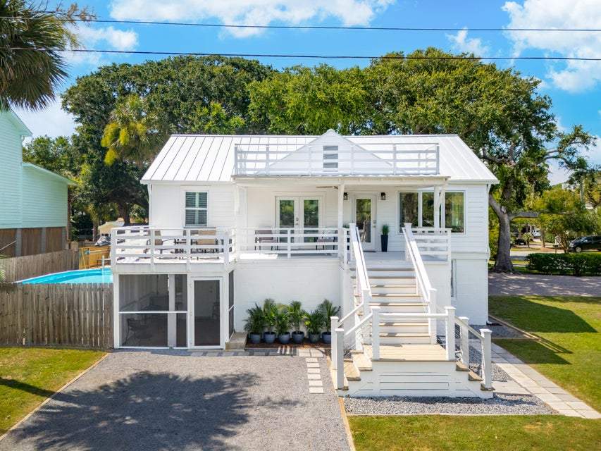
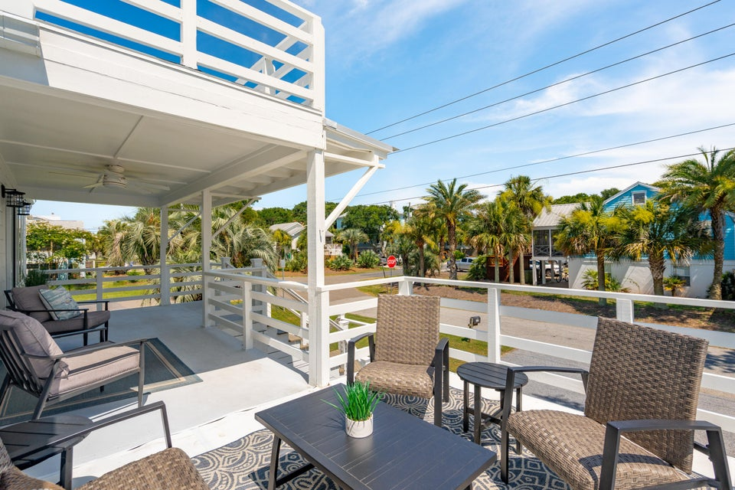
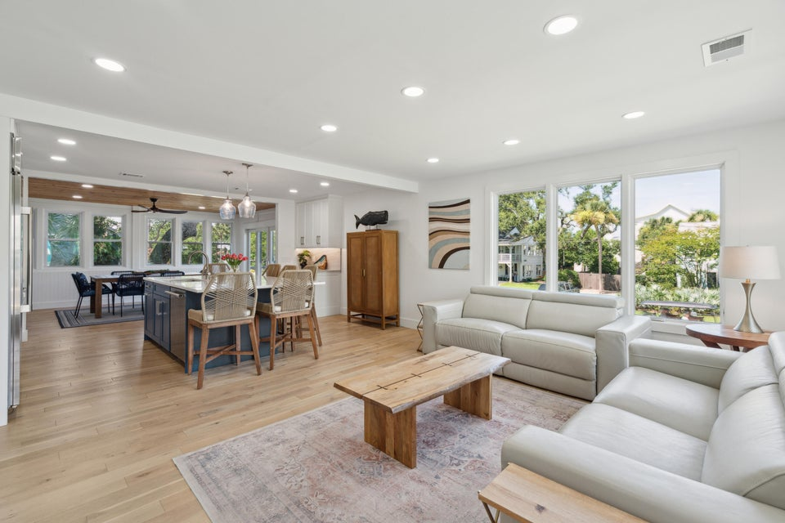
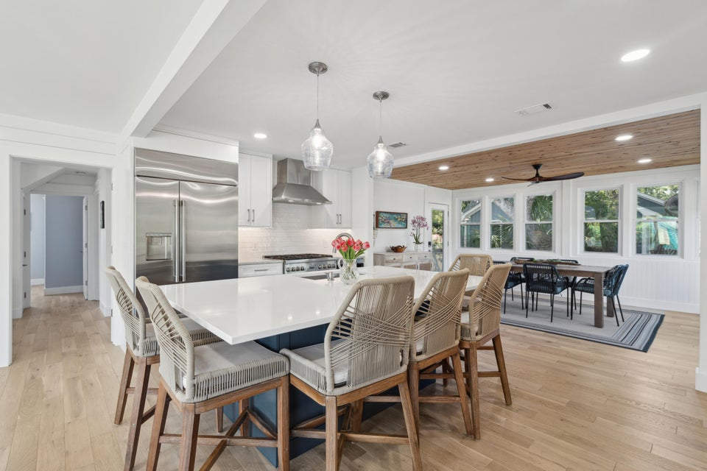
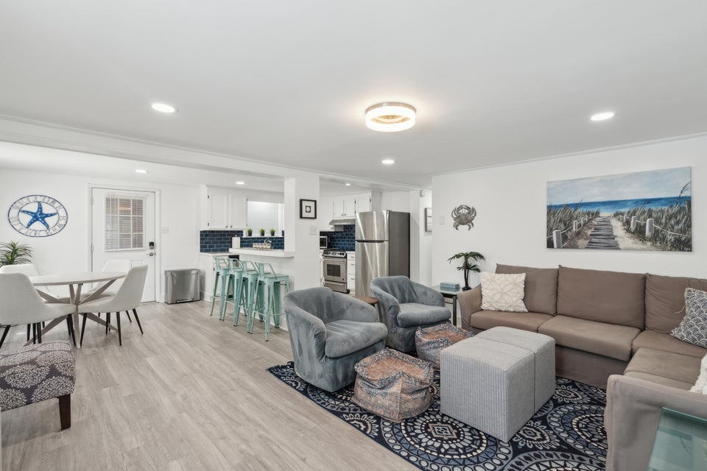
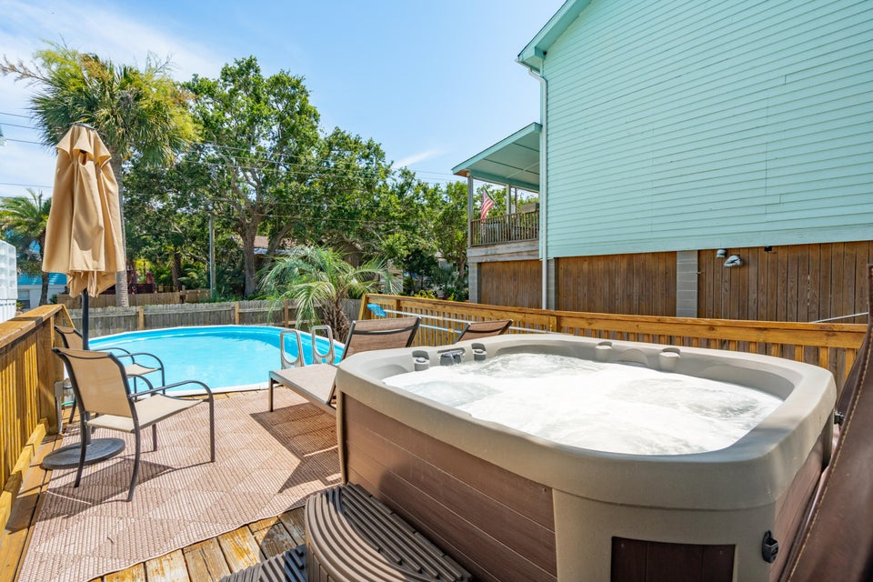



The Beach Life Is Calling! Priced To Sell
2407 Cameron Boulevard
4+ Bedrooms - 3 Bathrooms
DUPLEX 2BD/1BTH Down - 2+BD/2BTH Up
NEW PRICE: $2,290,000
MLS: 25018140
Invest in Your Lifestyle
•1 Block to 25th Ave Beach Access on Isle of Palms
•Beautifully Renovated Open Floor Plan w/ Natural Light
•Gourmet Kitchen with High End Stainless Steel Appliances
•Rental Income, Guest Apartment, or Spacious Single Family
•Large Corner Lot, Pool & Hot Tub, Porches and Palm Trees
•25 Minutes to Downtown Charleston
Listing agent is the homeowner. Reach out if you have any questions!
CLICK FOR MLS LISTING
Jeanette Cornier 303.204.9694
jc@stishgroup.com
StishGroup.com

