Slide 1
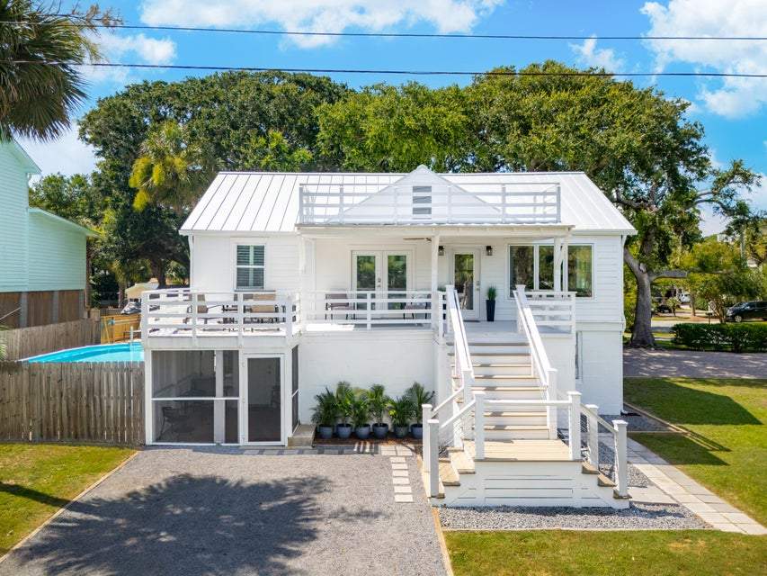
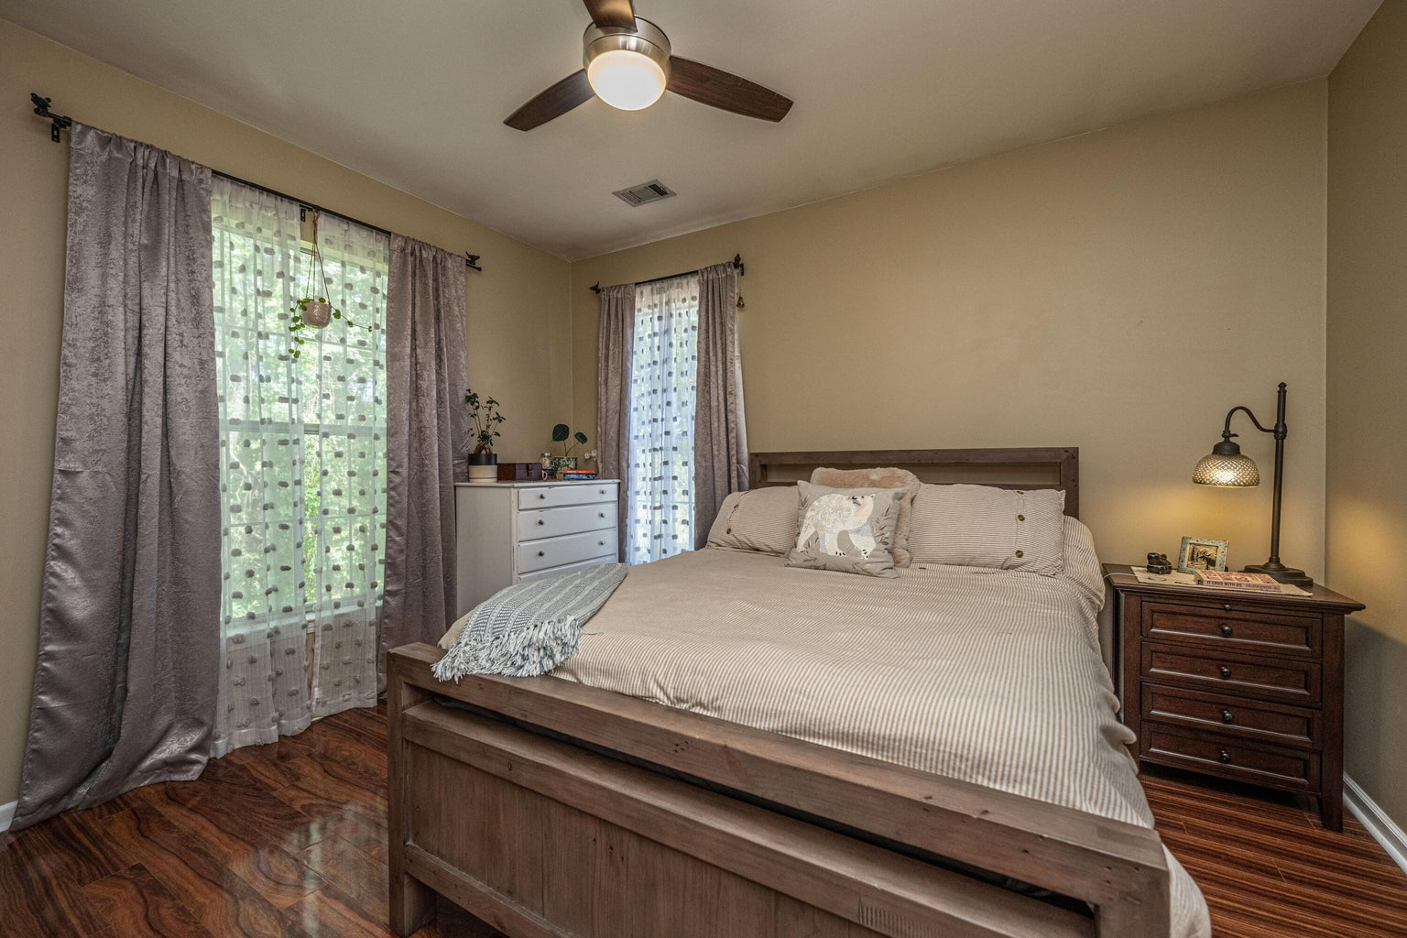
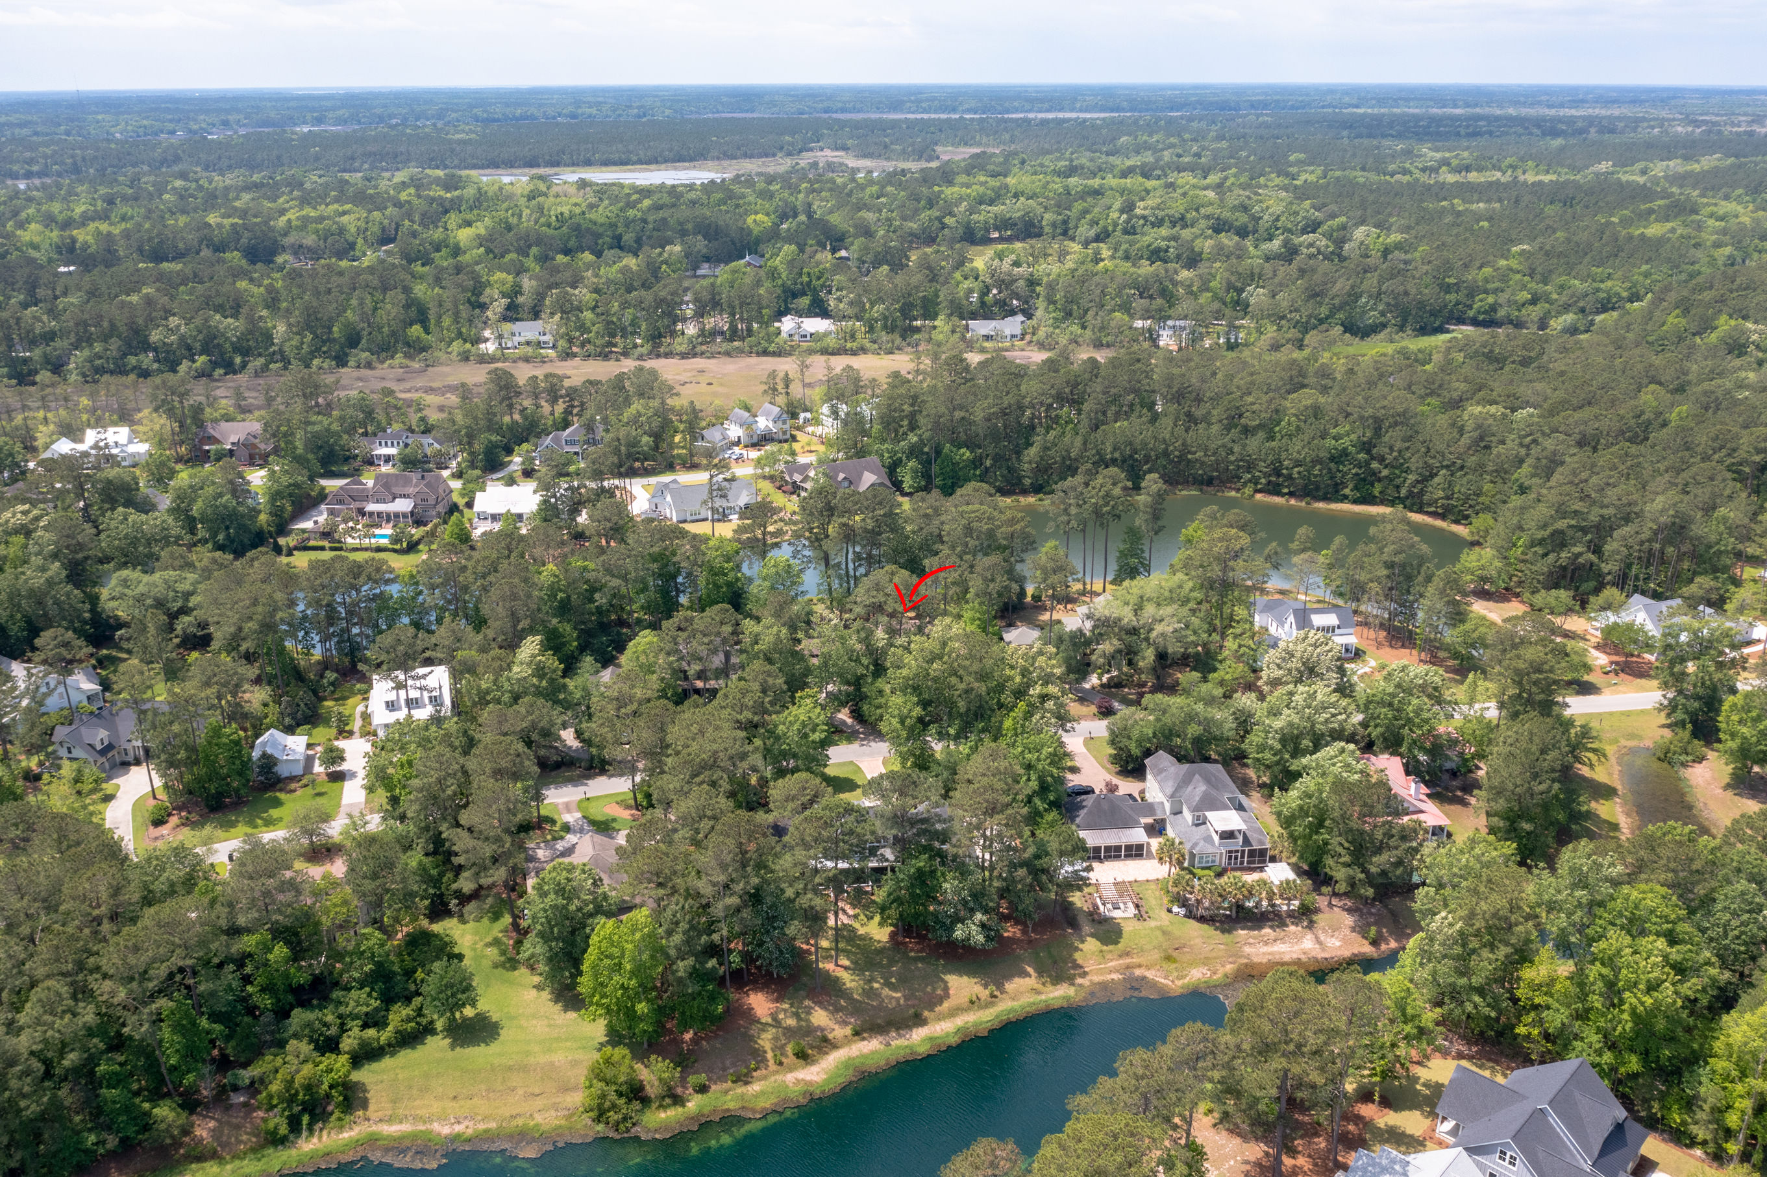
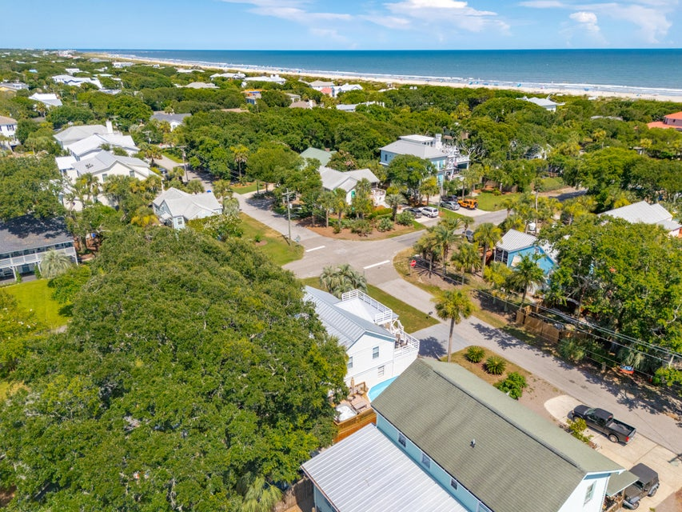
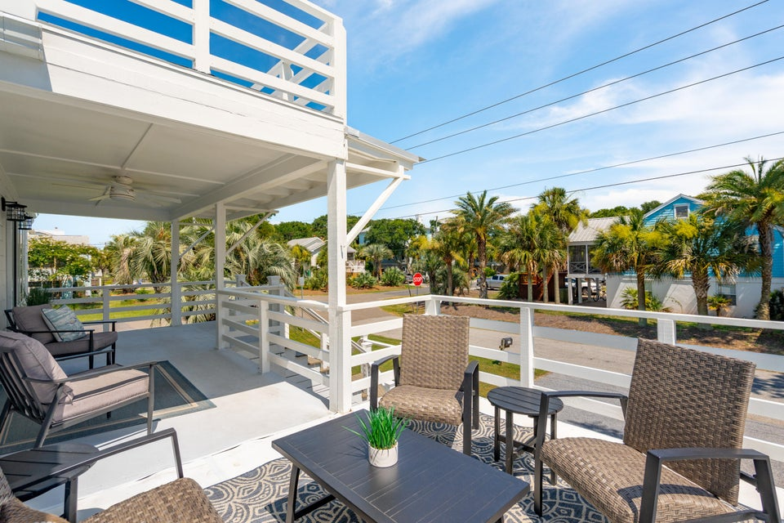
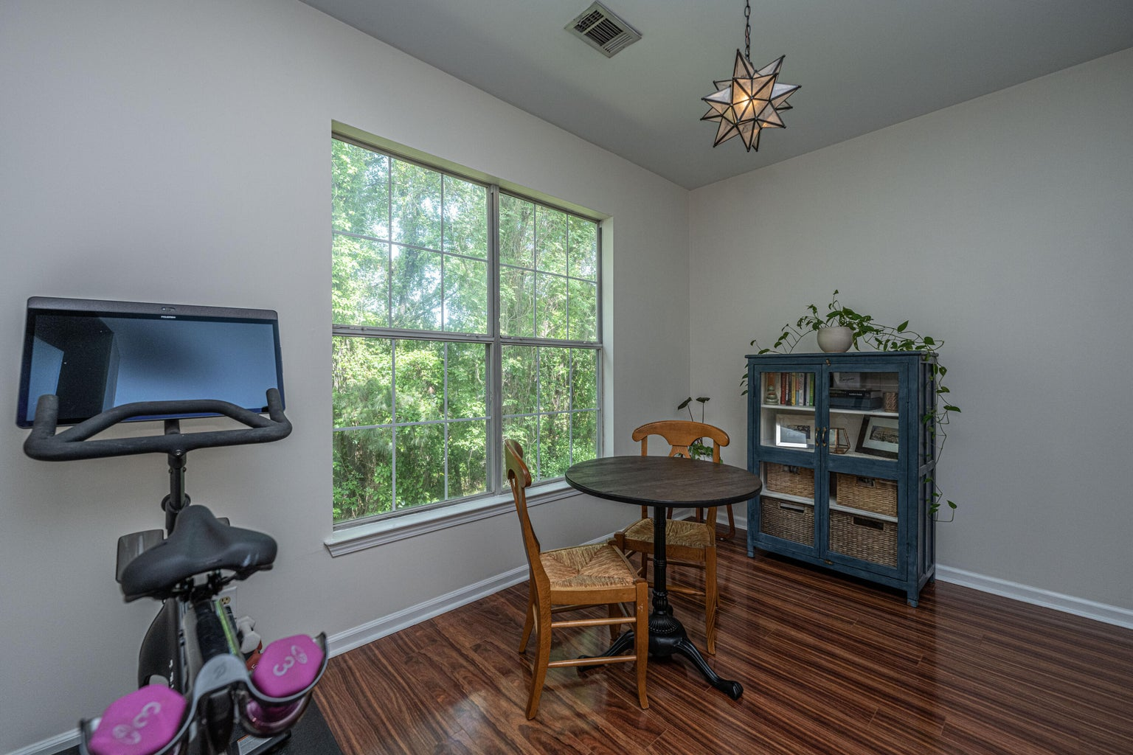
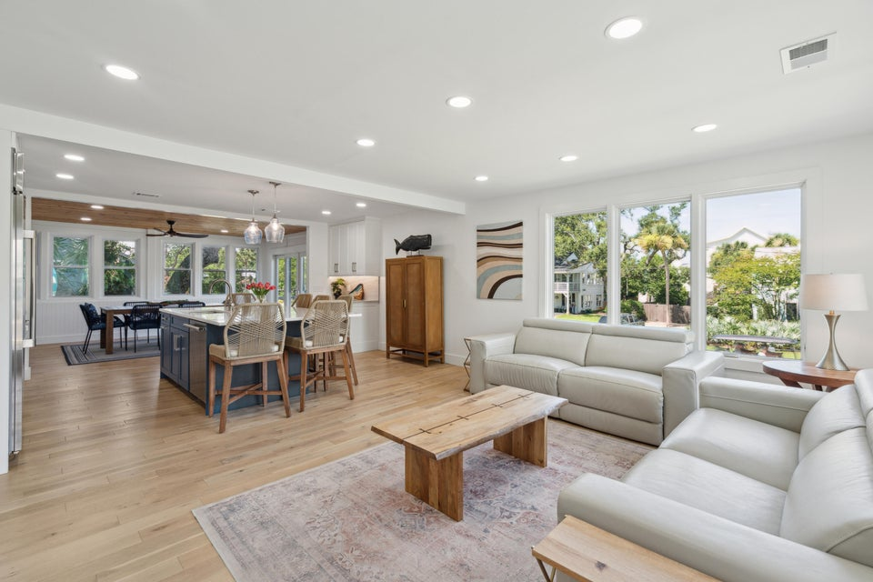
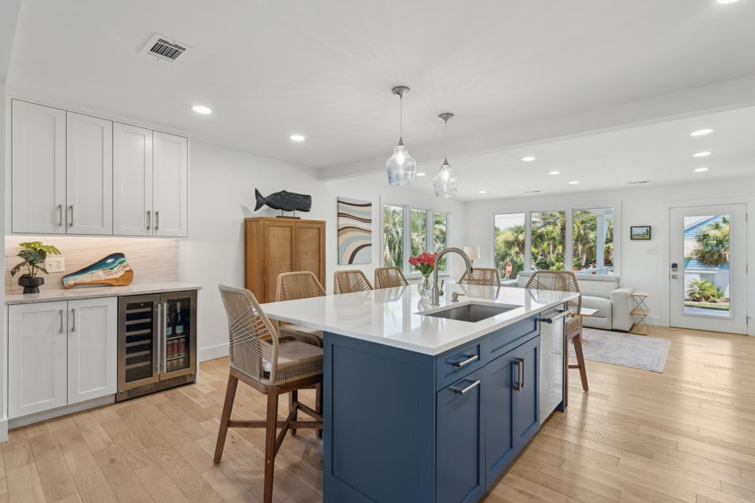



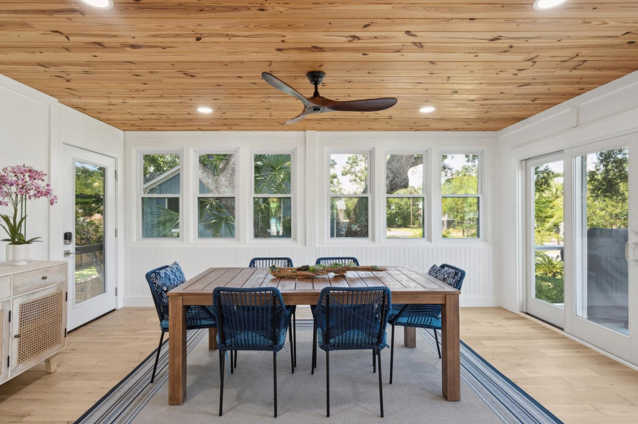
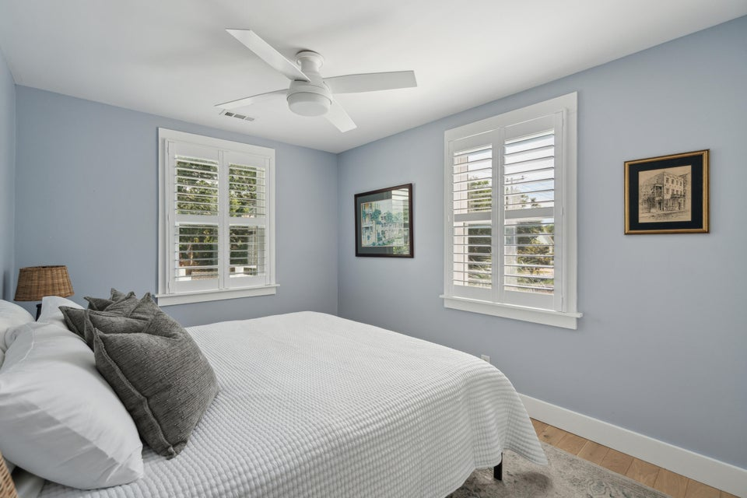
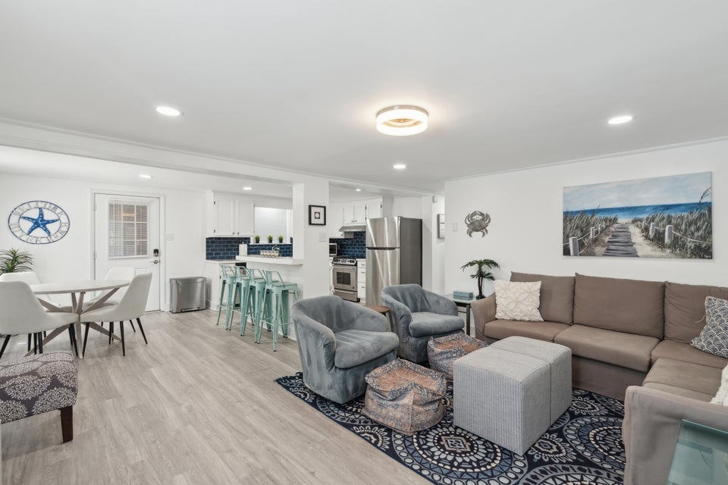
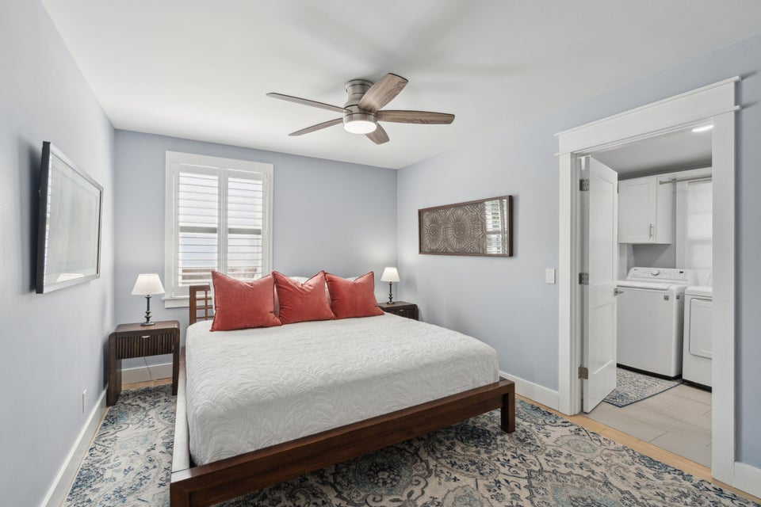
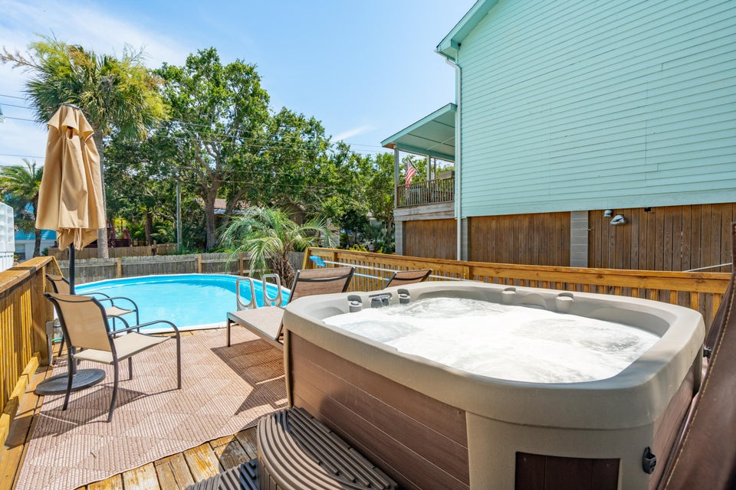



Price Improved on Isle of Palms!
2407 Cameron Boulevard
Isle of Palms, SC 29451
MLS# 25018140
NEW PRICE: $2,220,000
Duplex with Rental Income or Guest Apartment, or Spacious Single Family… the opportunities are endless!
1 Block to 25th Ave Beach Access
Renovated Open Floor Plan w/ Natural Light
Gourmet Kitchen with High End Appliances
Insulated and Conditioned Attic Storage
Large Corner Lot with 2 Driveways plus 1-Car Garage
Listing Agent is the homeowner.
Reach out for more information!
VIDEO TOUR | MLS LISTING
4
3
1,844
Waterfront Views
Dock Access Out the Back Door
Elevator Accessing All Levels
Massive Screened Porch
Spa-Like Primary Suite
Potential Second Suite or MILS
Jeanette Cornier 303.204.9694
jc@stishgroup.com
StishGroup.com

