Slide 1
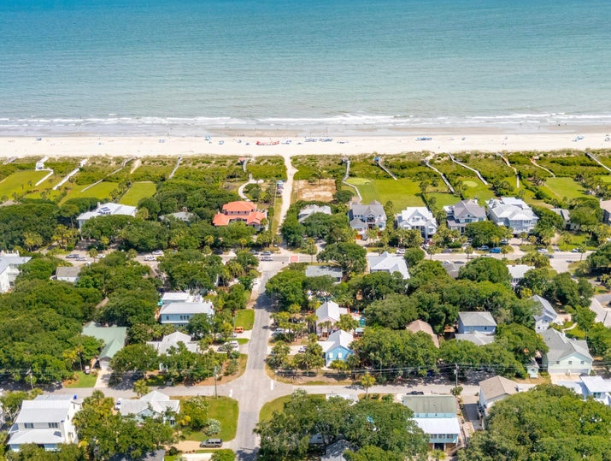
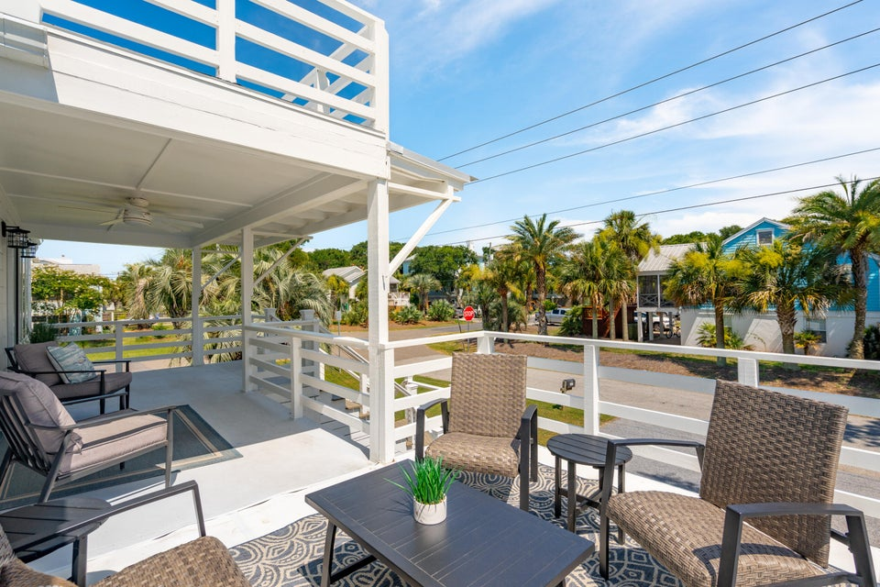
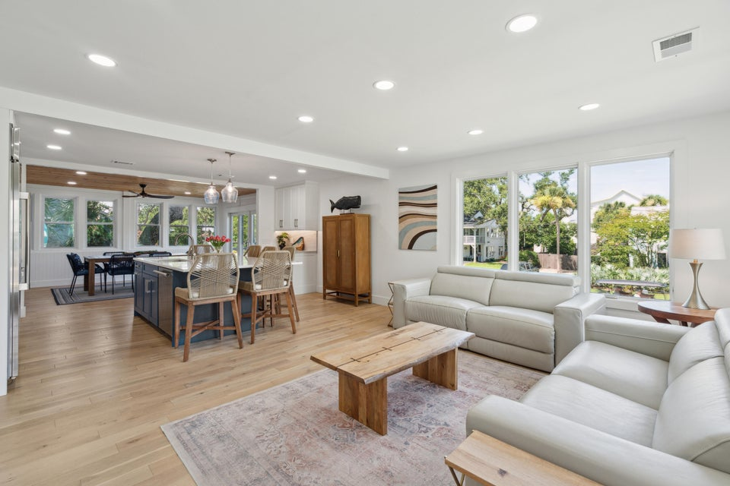
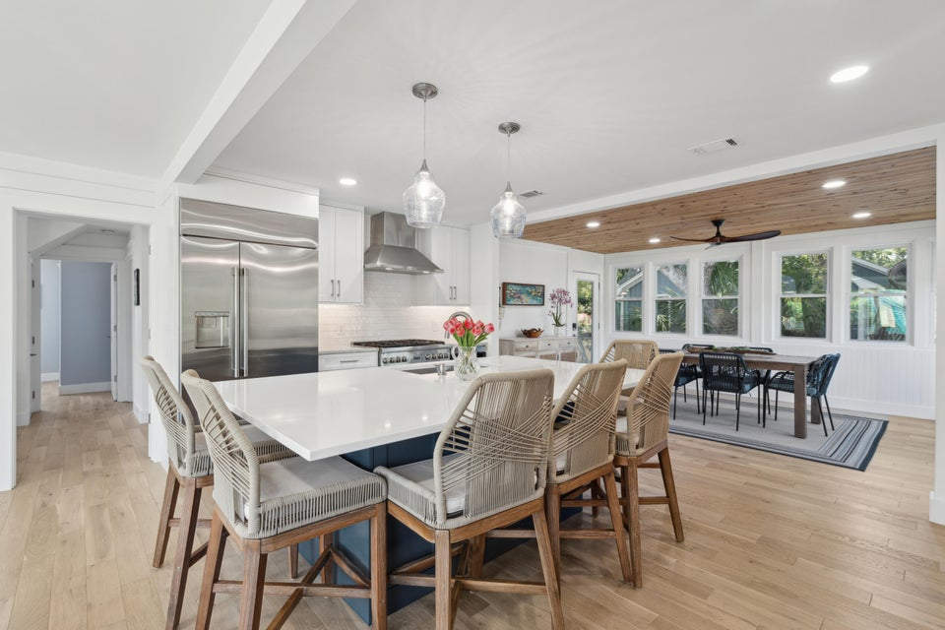
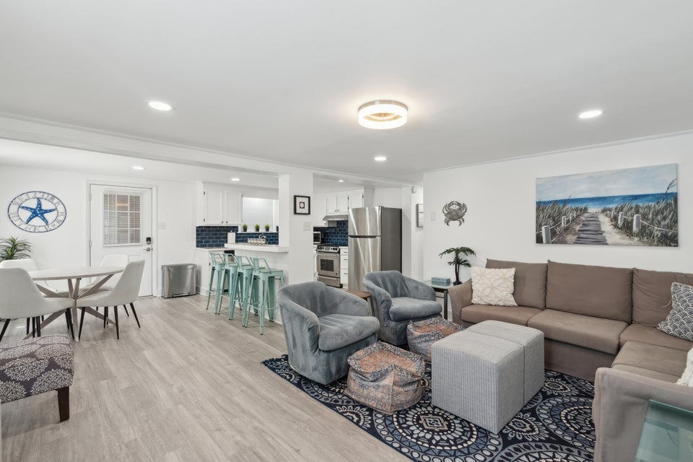
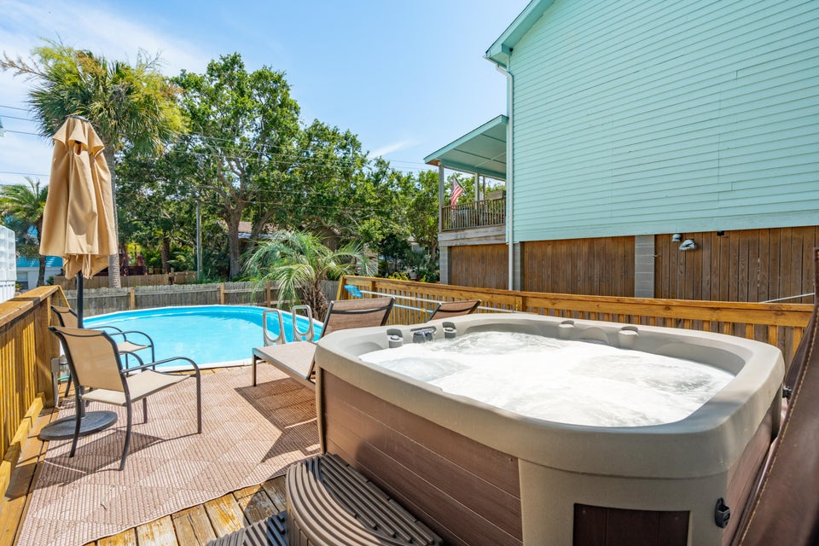



The Beach Life Is Calling! Price Improved!!
2407 Cameron Boulevard
Duplex with Rental Income or Guest Apartment, or Spacious Single Family
The opportunities are endless!
NEW PRICE: $2,220,000
MLS: 25018140
1 Block to 25th Ave Beach Access
Renovated Open Floor Plan w/ Natural Light
Gourmet Kitchen with High End Appliances
Insulated and Conditioned Attic Storage
Large Corner Lot with 2 Driveways plus 1-Car Garage
Listing Agent is the homeowner.
Reach out for more information!
CLICK FOR MLS LISTING
Jeanette Cornier 303.204.9694
jc@stishgroup.com
StishGroup.com

