Slide 1
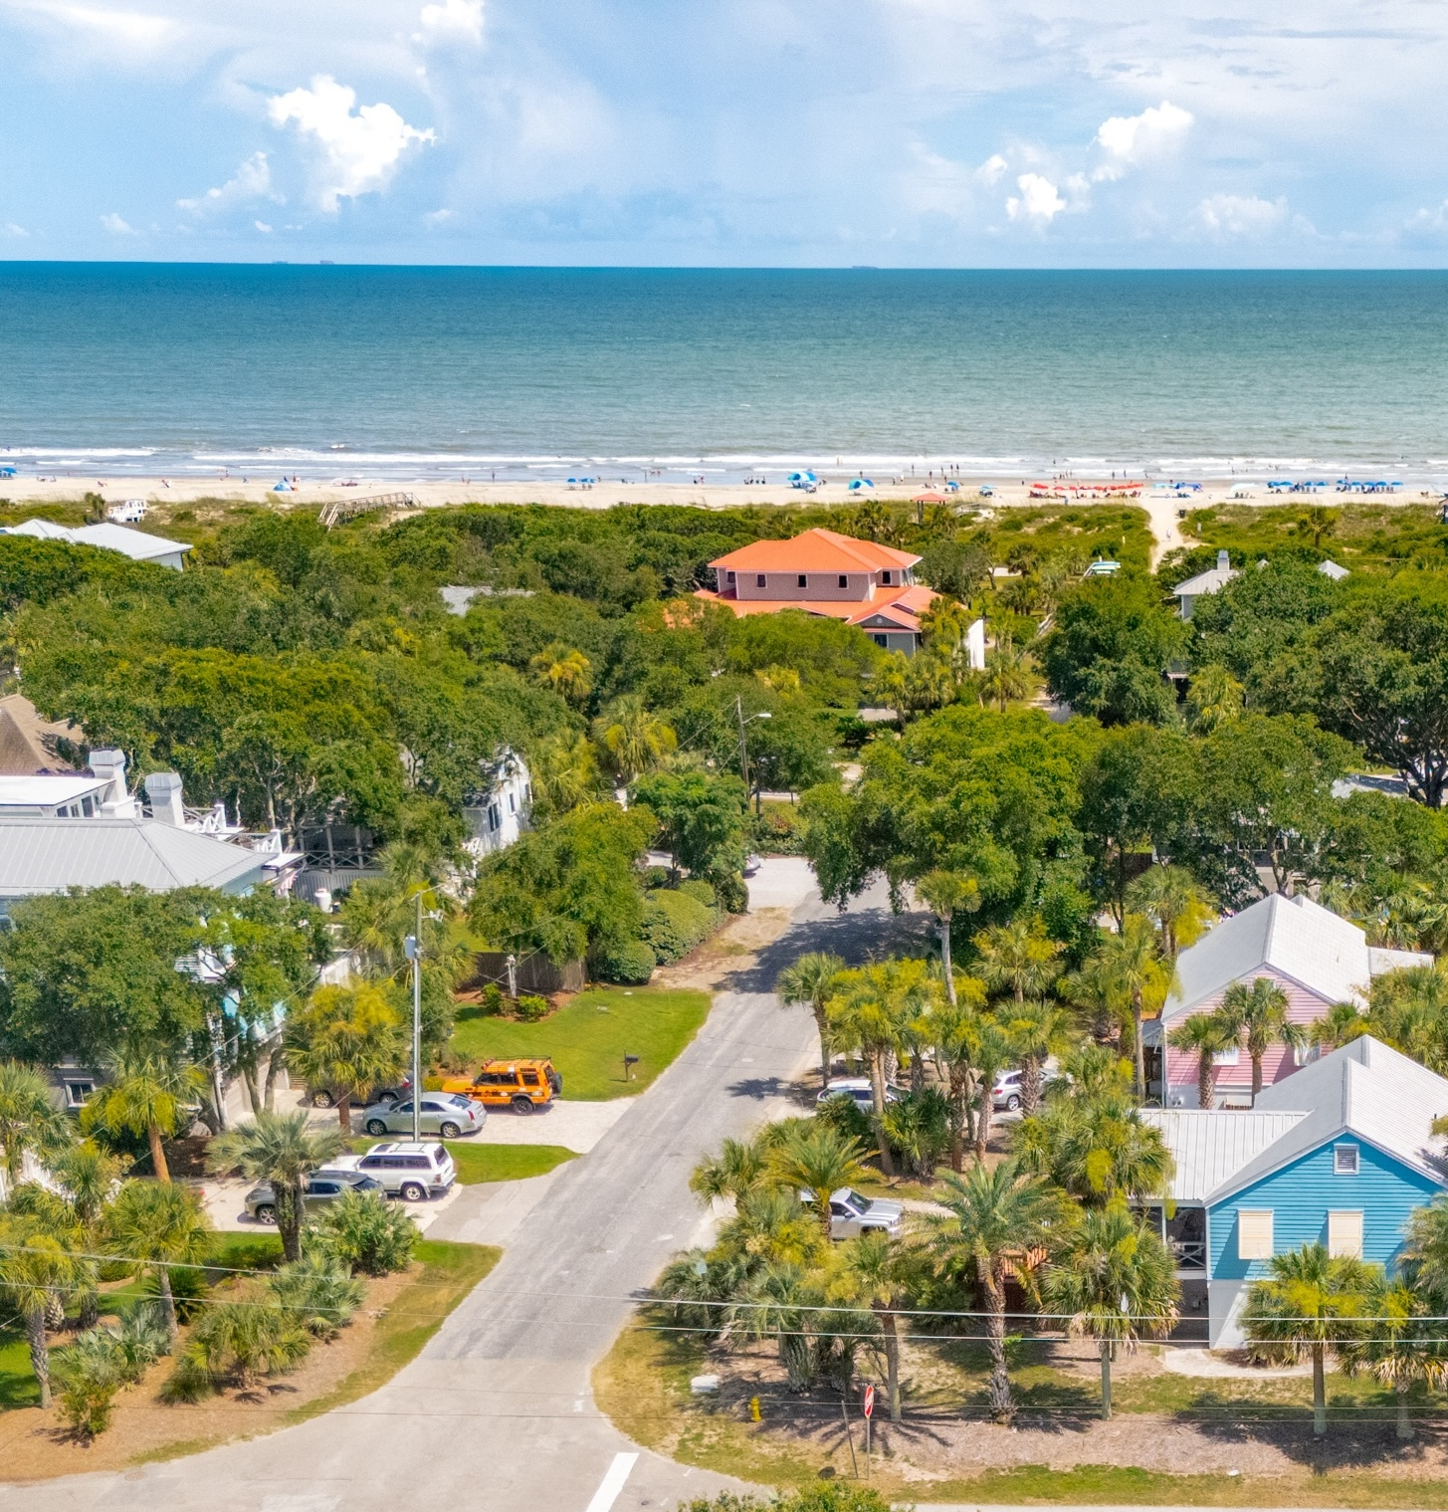
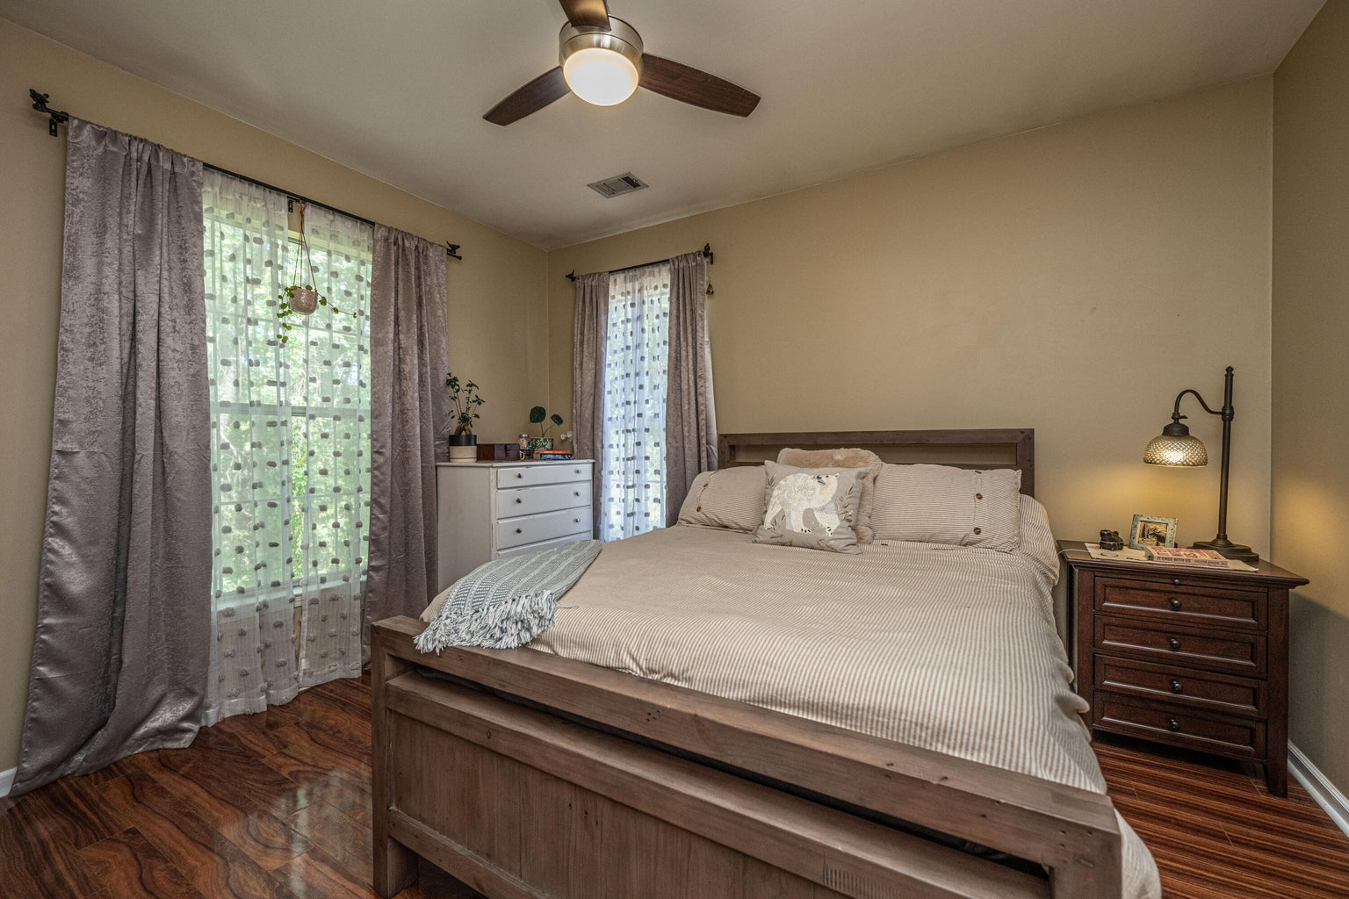
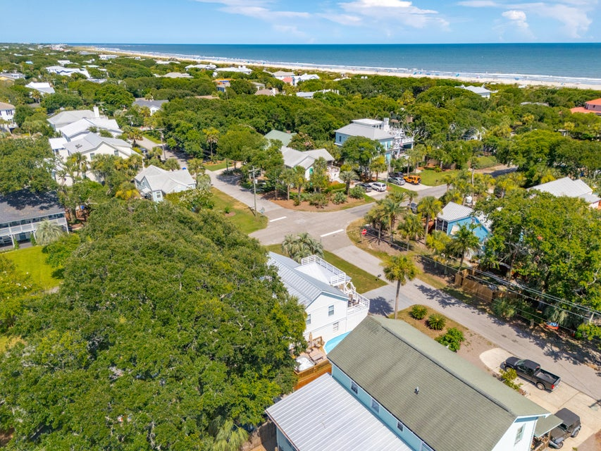
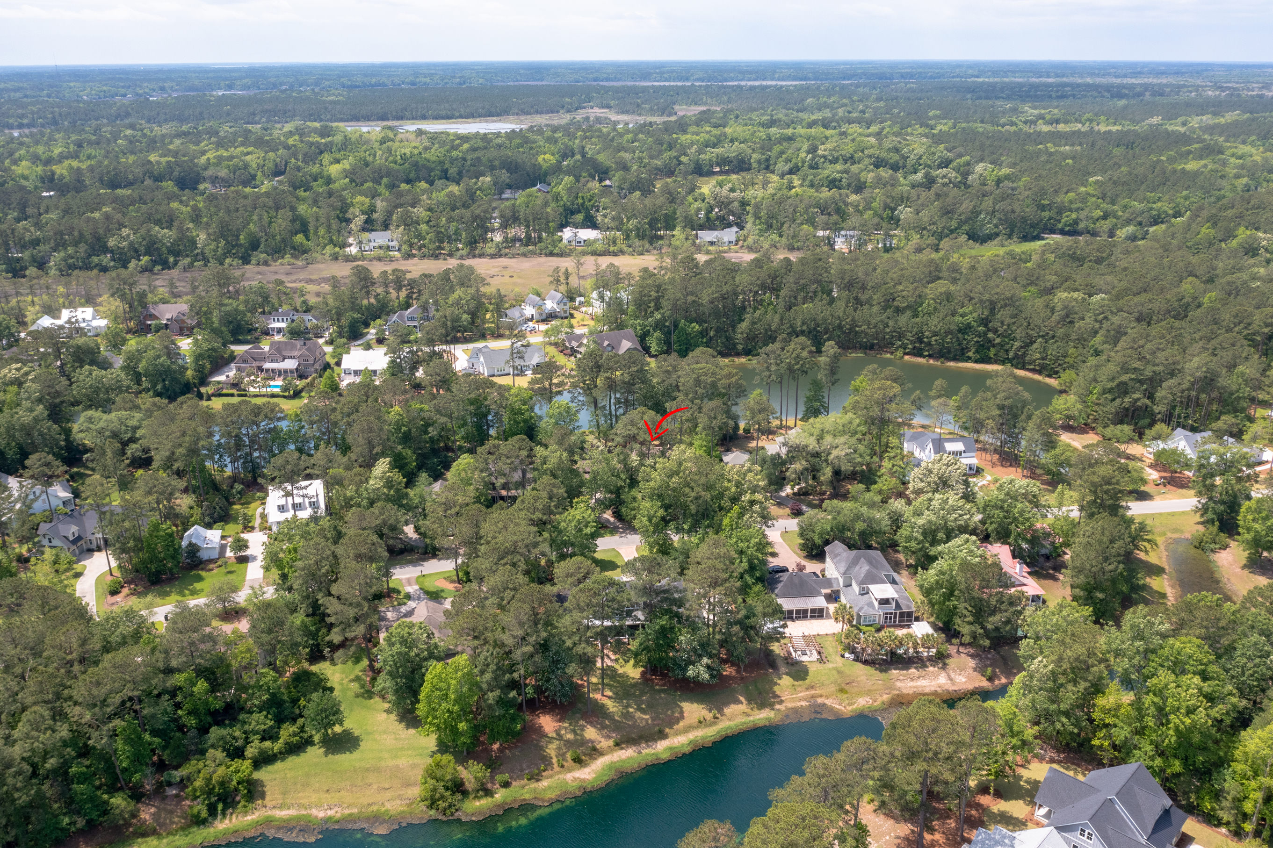


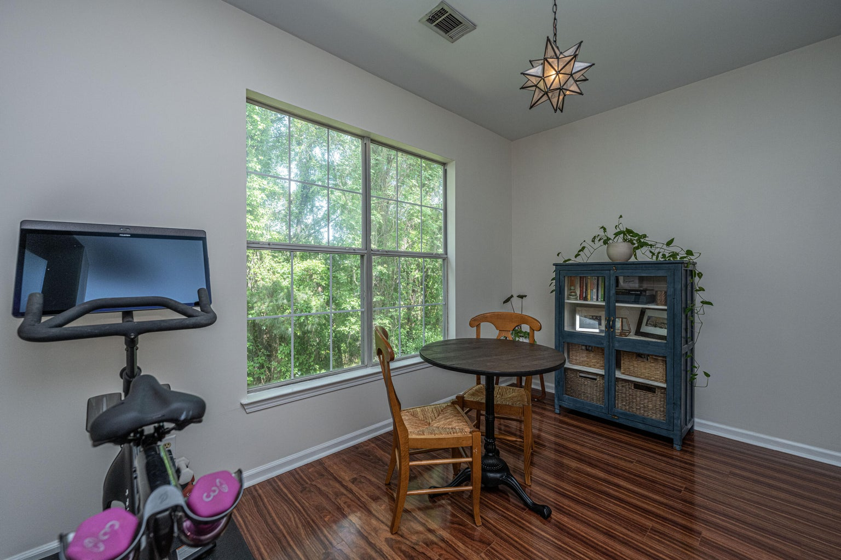
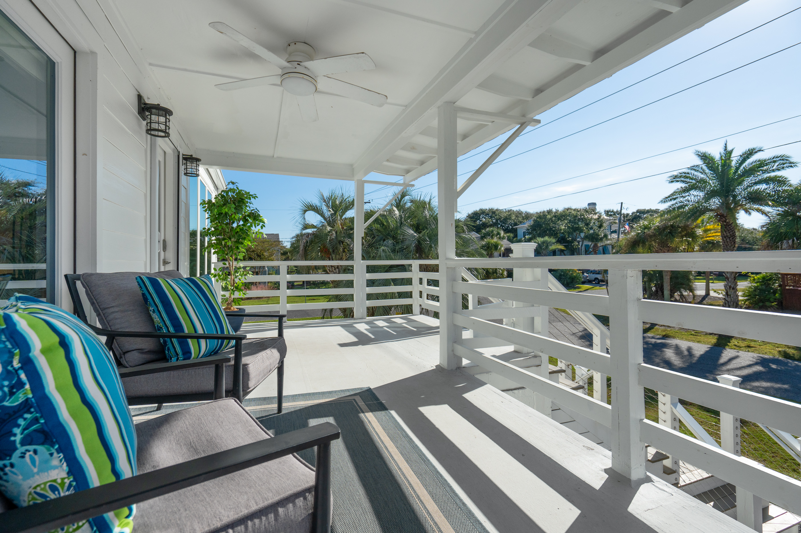
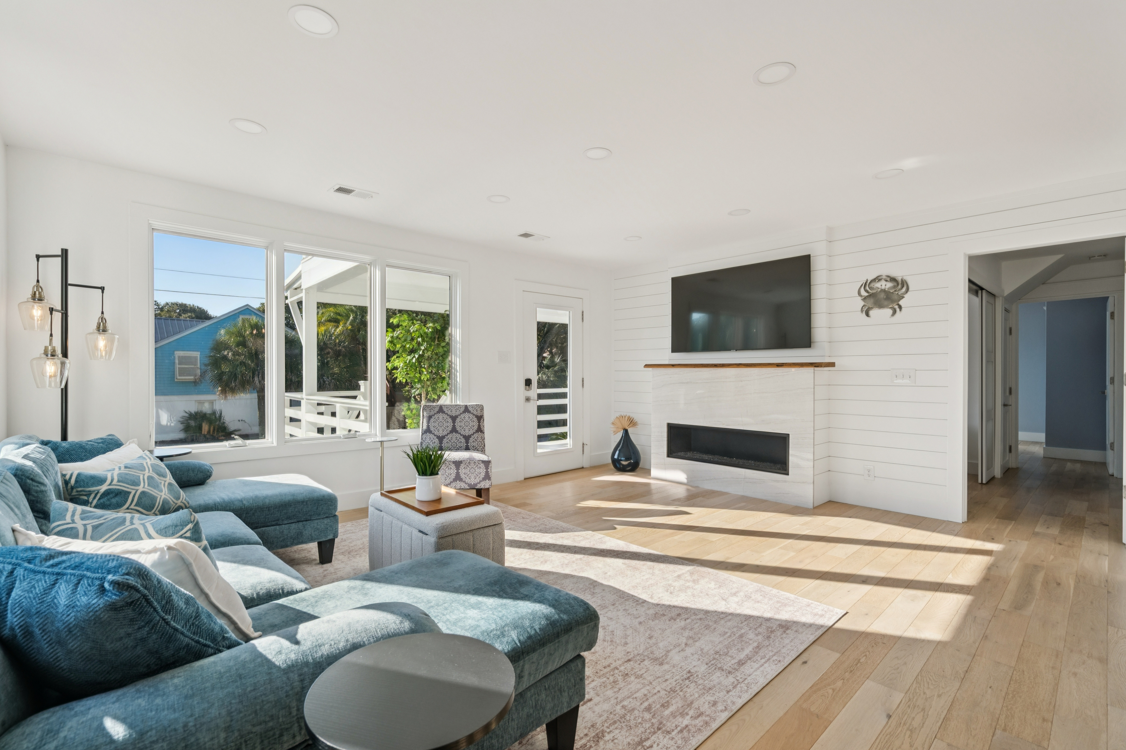

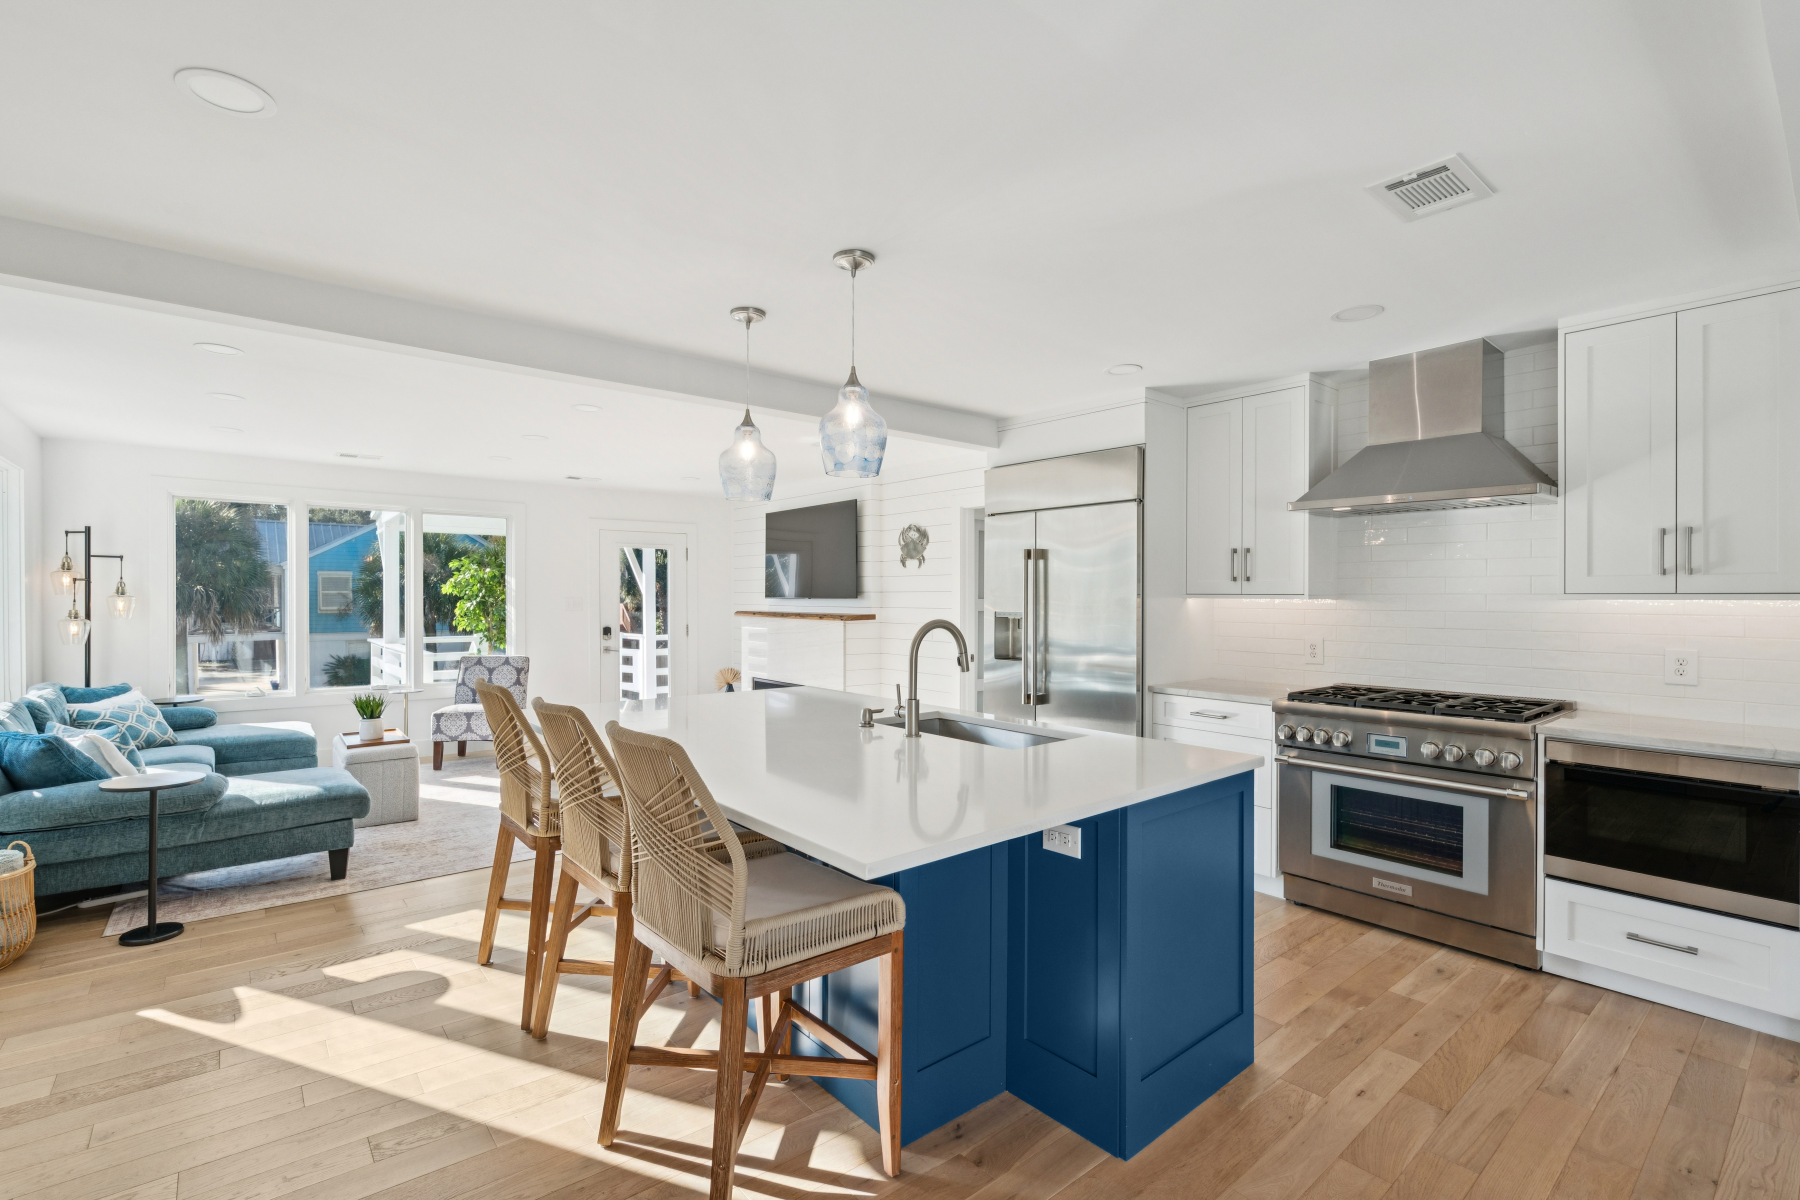


Opportunity on IOP
2407 Cameron Boulevard
$2,220,000 | MLS# 25018140
5 Bedrooms
4 Bathrooms
2025 Countdown - Invest Now!
Luxury Duplex with Short‑Term Rental Potential
Perfect for STR income, a spacious guest apartment, or multi‑generational living. Only one block from beach access with convenient golf cart parking.
Property Highlights
Beautifully renovated open floor plan with abundant natural light
Gourmet kitchen featuring high-end stainless steel appliances
Duplex layout offering flexibility for rentals or guest accommodations
Large corner lot with fenced yard & covered porches with palm views
Gravel driveways and 1-car garage with excellent parking options
Coastal oasis ideal for relaxation and entertaining
VIDEO TOUR | LISTING INFO
Listing Agent is Seller
3
1,844
Jeanette Cornier 303.204.9694
jeanette.cornier@carolinaone.com

