Slide 1
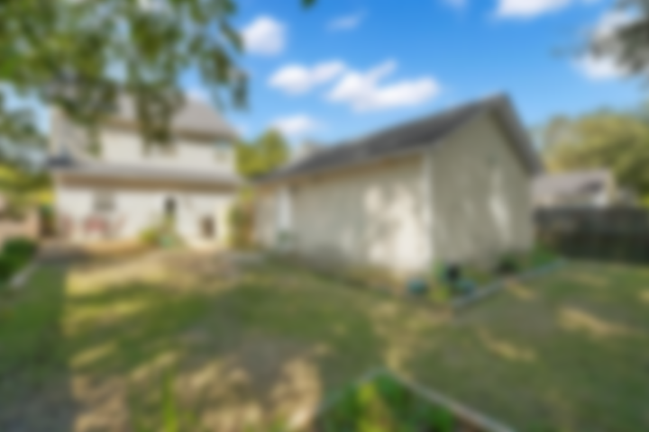
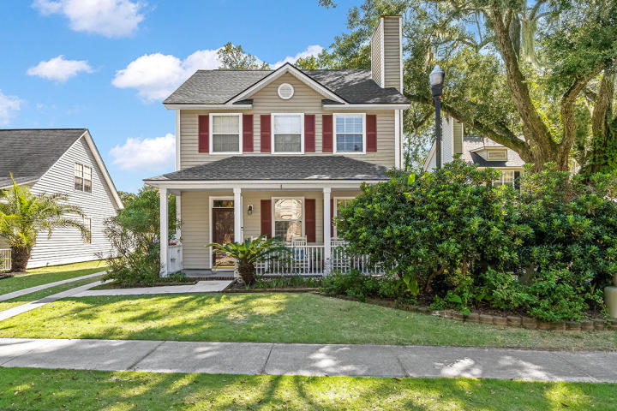
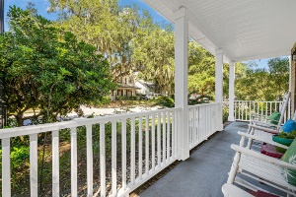
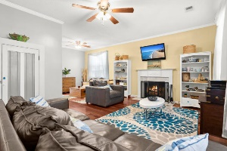
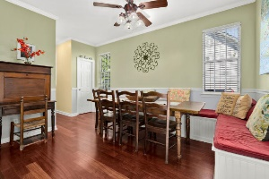
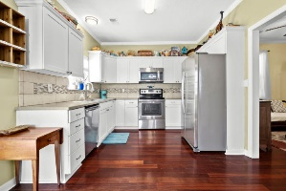
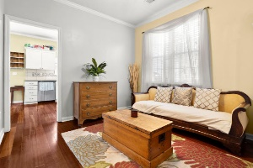
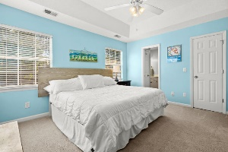
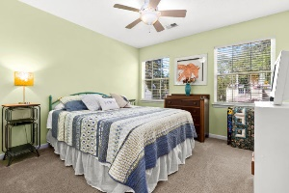
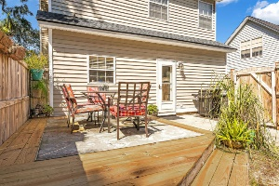

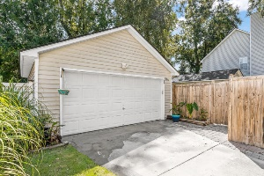

Just Listed! Fully Fenced In Yard New Roof
2409 Fulford Court
Chadbury Village
Mount Pleasant, SC 29466
MLS# 20028012 | $435,000
Welcome home to 2409 Fulford Court in Chadbury Village which is conveniently located close to the beach and shopping district. This two-story home is overflowing with charm with a quaint front porch and a lovely outdoor living space! The roof was replaced in 2020! This home has hardwood floors throughout the downstairs and a woodburning fireplace that leads into a light and bright kitchen. Kitchen has white shaker cabinets, stainless steel appliances, and a large breakfast area with a wonderful built-in bench. Upstairs you will find a large master retreat with dual vanities and a walk-in closet. In addition, upstairs are two large secondary bedrooms and a full bathroom. The Backyard is perfect for entertaining! It is fully fenced in with an elevated deck and room for a garden! An added bonus is the full size 2 car detached garage
Marthe Teixeira (917) 325-8033
marthet@carolinaone.com
Scott Fulton 843-324-8845
ScottandMarthe@gmail.com
fultonteixeirahomes.com
Carolina One Real Estate | 2713 Highway 17 North | Mt. Pleasant, SC 29466

